Slide 1

Programs and Resources for Teachers
Corpus Christi ISD
October 9, 2017
Notes:
LOAD PAGES BEFORE PRESENTATION
Introduce self and Marissa; Marissa is passing out sign in sheets for each of you to fill out
Talk about my work with Humanities Texas
Coordinator of educational programs
have been working here for 9 years, started as a Program Officer in 2008; currently Coordinator of Education Programs, in which I’m so pleased to have the opportunity to work with classroom teachers
Excited about being here today to tell you about Humanities Texas and our programs that recognize, encourage, and improve classroom teaching in Texas schools, including professional development programs, outstanding teaching awards, and a broad range of print, audio, and digital educational resources
Handouts:
sign in sheet, please fill out information
One-page info sheet
Of course, I’m happy to take questions throughout presentation, or individual questions at the end; please don’t hesitate to ask anything!

Slide 2

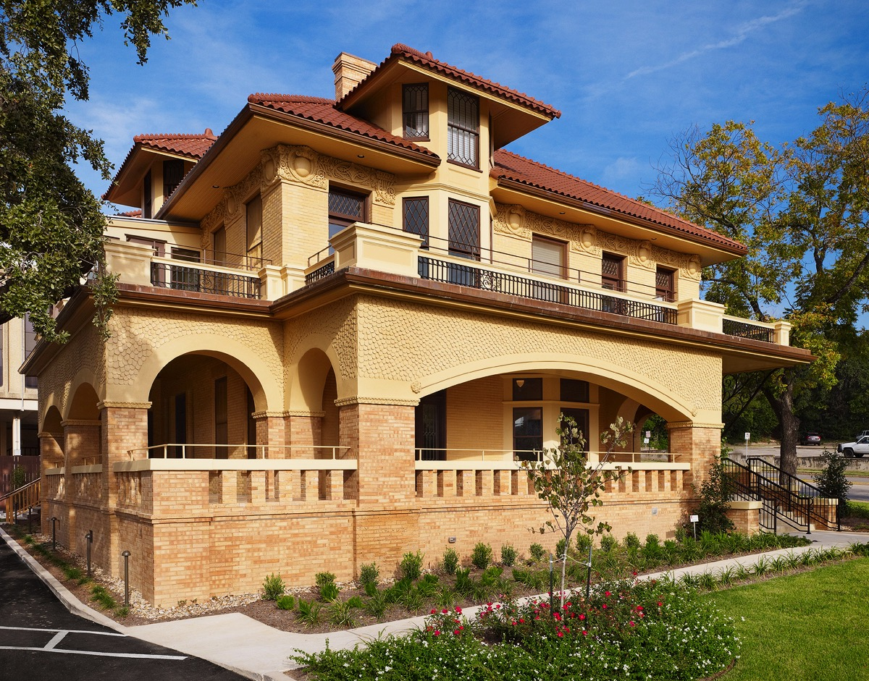
About Humanities Texas
State affiliate of the NEH
Private nonprofit, with headquarters in Austin and a statewide board of directors
Mission: to promote the humanities throughout Texas
Notes:
Poll the room to see who has participated in or is familiar with Humanities Texas programs?
Humanities Texas is a nonprofit, educational organization founded in 1973
state affiliate of NEH (there is state humanities council in every state and U.S. territory but they all do different kind of work in the humanities).
supported by appropriations from the U.S. Congress and the state of Texas and by gifts and grants from foundations, corporations, and individuals.
A statewide volunteer board governs the organization (~6 gubernatorial appointees)
PHOTO: our offices in Austin (historic restoration done in 2010)
Our mission:
The mission of Humanities Texas is educational excellence. Through programs that improve the quality of classroom teaching, support libraries and museums, and create opportunities for lifelong learning, we advance education throughout the state.

Slide 3


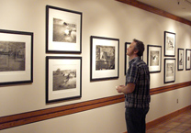
Humanities Texas Core Programs
Teacher programs and curriculum resources
Traveling exhibitions
Grants
Outstanding Teaching Awards
Texas Originals radio program
History Harvests
Public Programs
E-newsletter and website
Notes:
We support our mission through a number of core or “signature” programs including:
Teacher programs and curriculum resources
Traveling exhibitions
Grants
Outstanding Teaching Awards
Texas Originals
History Harvests
Public Program: including Holiday Book Fair, public lectures
E-newsletter and website

Slide 4
2015–16
Notes:
Map shows distribution over 2 year period (2015–16) of our major programs
including teacher workshop participants (1,616)
exhibition circulation (243 exhibits rented out over period)
grantees (295 grants given; both mini and major grants)
and outstanding teaching award recipients (30, 15/year)
REALLY SHOWS STATEWIDE IMPACT OF OUR PROGRAMS

Slide 5
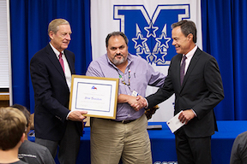
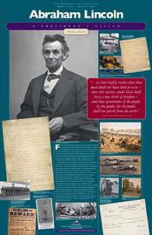
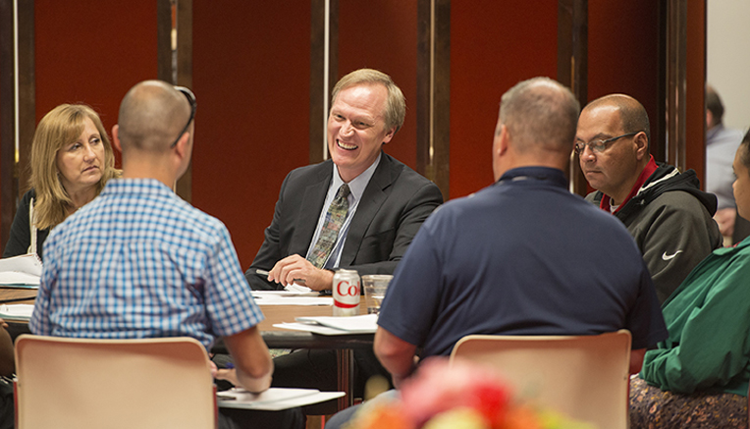
Programs and Resources for Teachers
Teacher institutes and workshops
Outstanding Teaching Awards
Texas Originals radio program
A President’s Vision
Exhibitions
Grants
Content-rich website
Educational resources
Notes:
While our core programs reach number of diverse audiences, I want to specifically address the programs available for classroom teachers. I’ll tell you a little bit about each program and also walk you through our website along the way.
If you have questions, feel free to speak up!
Humanities Texas offers a number of exciting programs for educators who teach courses in language arts, social studies, and other humanities subjects at both the primary and secondary levels:
Teacher institutes and workshops
Outstanding Teaching Awards
Texas Originals
A President’s Vision
Exhibitions
Grants
Website

Slide 6
Teacher Institutes and Workshops
One-day workshops, three-day summer institutes for social studies and ELA teachers
Study with leading scholars
Get books and resources
Curriculum is TEKS-aligned, timed to anticipate when subjects are covered
Free
  Academic year: travel and sub reimbursements
  Summer: travel reimbursements and stipends
Online application, reviewed on rolling basis
Notes:
TEACHER INSTITUTES AND WORKSHOPS
Since 2004, Humanities Texas has partnered with the state’s leading universities and cultural organizations to hold enrichment institutes supporting classroom teachers’ intellectual and professional development.
With the support of its first-ever state legislative appropriation, Humanities Texas significantly expanded this program in 2010, targeting early-career teachers in areas with low student achievement on state assessments.
One-day programs during the school year, three-day residential summer institutes on university campuses
Programs offer teachers the opportunity to work closely with leading humanities scholars and explore topics at the heart of social studies and language arts curricula.
Curriculum is aligned with state standards and topics are timed to coincide with when teachers teach particular subjects
Programs ARE FREE to attend for teachers and their districts; we pay a stipend during the summer institutes, and reimburse for substitutes during the school year; we also cover travel reimbursement and provide numerous resources and books to take back with you to the classroom: all at no cost
Application is available online, reviewed on a rolling basis
Describe a typical day:
Morning consists of teacher-centered presentations with experts in the field
afternoon primary source workshops where smaller groups work more closely with the presenters to discuss how to use materials in the classroom effectively, what documents to use, and how to reach students on difficult topics like the Constitution
Often will also include a Resource presentations:
Educational specialist from the National Archives: Charlie Flanagan is one of more popular presenters, very pitch perfect for classroom teachers (he was a high school teacher for 30 years); great at showing teachers how to instruct with documents; hopefully I’ll have time at the end to play a clip from one of his presentations

Slide 7
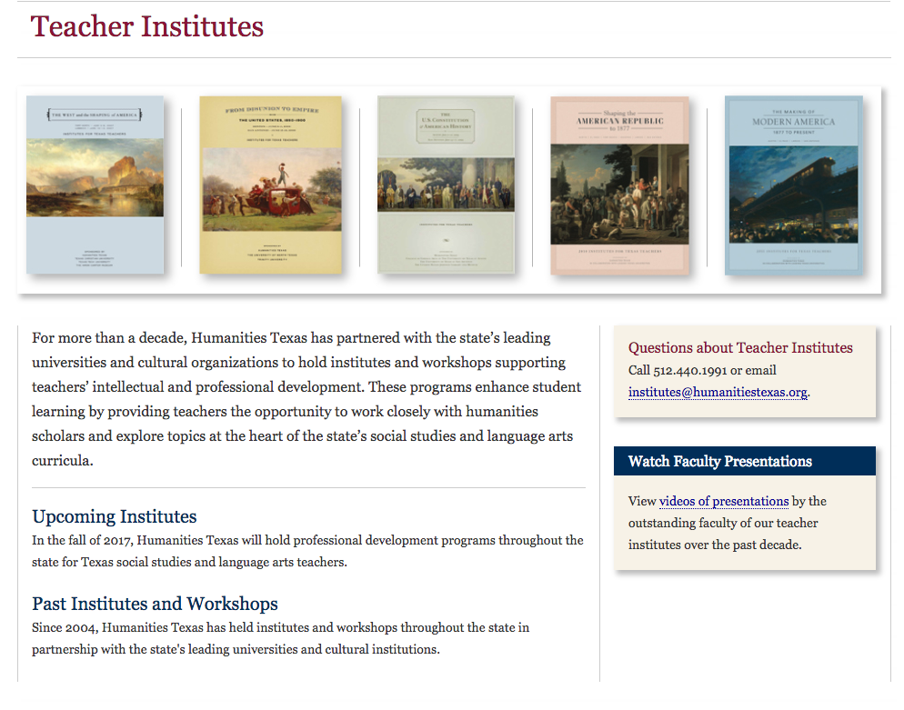
Notes:
On our website we have links to upcoming teacher institutes and workshops, as well as lists of Past institutes and workshops.
TAKE THEM TO WEBSITE IF POSSIBLE

Slide 8
Fall 2017 Teacher Workshops
THE AMERICAN REVOLUTION
9/27: Fort Worth
9/28: Dallas
9/29: San Antonio
UNDERSTANDING CONGRESS
10/12: Austin
TEACHING THE U.S. CONSTITUTION
10/18: Edinburg
10/19: Corpus
10/20: San Antonio
Notes:
In the fall, we have a number of teacher workshops in the works, including:
APPLICATION IS CURRENTLY OPEN ONLINE:
Teaching the American Revolution: September
Understanding Congress: October
Teaching the U.S. Constitution: October
PULL UP PAGES FOR EACH ONLINE IF POSSISBLE
Be on the lookout for announcements about workshops for ELA teachers (share info with your English colleagues) and a one-day workshop for Texas History teachers.
QUESTIONS ABOUT OUR PROFESSIONAL DEVELOPMENT PROGRAMS BEFORE WE MOVE ON?

Slide 9
Teaching the U.S. Constitution
10/18: Edinburg
10/19: Corpus
10/20: San Antonio
The program includes presentations on:
The Articles of Confederation
Compromises in Adopting the Constitution
The Bill of Rights
Teaching the Constitution and the Bill of Rights
Also: primary source seminars with faculty!
Notes:
In the fall, we have a number of teacher workshops in the works, including:
APPLICATION IS CURRENTLY OPEN ONLINE:
Teaching the American Revolution: September
Understanding Congress: October
Teaching the U.S. Constitution: October
PULL UP PAGES FOR EACH ONLINE IF POSSISBLE
Be on the lookout for announcements about workshops for ELA teachers (share info with your English colleagues) and a one-day workshop for Texas History teachers.
QUESTIONS ABOUT OUR PROFESSIONAL DEVELOPMENT PROGRAMS BEFORE WE MOVE ON?

Slide 10
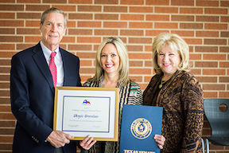
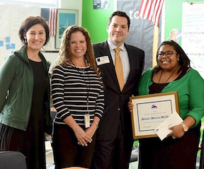
Outstanding Teaching Awards
Fifteen Awards Annually
  Outstanding Teaching of the Humanities Award (12)
  Outstanding Teaching of Texas History Award (1)
  Award for Outstanding Early-Career Teaching (2)
$5,000 prize, plus $500 to recipient’s school
Nomination available for 2018 in early Sept.!
Notes:
AWARDS: Outstanding Teaching Awards: Each year, Humanities Texas presents awards recognizing and encouraging excellence in teaching the humanities in Texas schools. In 2018, HTx will give out 15 awards in 3 different categories:
OTHA: The Outstanding Teaching of the Humanities Awards recognizes exemplary K–12 humanities teachers. Each year, twelve teachers are selected to receive a $5,000 cash award and an additional $500 for their respective schools to purchase humanities-based instructional materials. The highest-ranked applicant will receive the prestigious James F. Veninga Outstanding Teaching of the Humanities Award.
Howell: Texas history. One recipient; 5,000 cash award, $500 for school
Early-Career: recognizes exemplary contributions of humanities teachers who have been teaching for three years or fewer.
Describe nomination/application process (nominations called for in the fall; anyone from the general public can nominate a teacher by downloading the form and submitting to HTx) (nominated teachers are encouraged to apply, with application deadline in mid-February)
SHOW PAGE ONLINE
Award presentations take place in fall and spring with members of Congress (photos along side of webpage)
We will have the nomination form up in early September so we hope that you will nominate a deserving colleague for this award, and pass along the nomination form to your colleagues and administrators.

Slide 11

Texas Originals
http://www.texasoriginals.org
Radio series that profiles important Texans such as Sam Houston, Barbara Jordan, Héctor P. García, Juan Seguin
Episodes available online
Additional resources: educator guide
Juan Seguin
Barbara Jordan
Notes:
MARISSA WILL NOW TALK TO YOU A LITTLE BIT ABOUT TEXAS ORIGINALS
Radio series profiling individuals who have had a significant impact on Texas history and culture
Developed in partnership with Houston Public Media
Two-minute overview of important cultural and historical figures
Effective way to introduce your students to important figures in Texas history, as well as emphasizing those individuals’ most significant accomplishments
Ex: Stephen Austin, Sam Houston, Barbara Jordan, Hector P. Garcia, and More…
Broadcast at over fifteen stations across the state of Texas
Episodes are available on both our website and on iTunes
These radio programs align with the standards, and on our website you can find a list of the TEKS to which these programs correlate.
LISTEN TO EXAMPLES!

Slide 12
A President’s Vision
Poster series that examines the aspirations of 7 U.S. Presidents:
  Washington
  Jefferson
  Lincoln
  Teddy Roosevelt
  FDR
  LBJ
  Reagan
Online teacher guide
Curriculum materials
http://www.presidentsvision.org
Notes:
An innovative suite of posters and curriculum materials that examines the aspirations or “vision” of notable U.S. Presidents and the programs and initiatives that advanced each man’s vision:
Washington
Jefferson
Lincoln
Teddy Roosevelt
FDR
LBJ
Reagan
In 2012, set a set of posters to the librarian at every secondary accredited school in the state and to every Texas public library
Poster are really an “advertisement” for online resources that include curriculum materials and primary source documents from other repositories that help students see each presidency within the broader context of U.S. history
Each poster essentially makes an argument about that president’s vision—the “big idea” that guided his actions and decisions, with documents and other primary source materials that illustrate that vision
Downloadable worksheets and activities allow students to become “mini-historians” and examine choices made in the poster’s visual design and how the components of each poster work together to make a broader argument about that president.

Slide 13
Mentoring
The Humanities Texas mentoring program extends the training and support we provide to early-career teachers of social studies and language arts. Our mentor in CCISD is available to:
observe implementation of content and materials provided by Humanities Texas.
offer structured, constructive feedback on content and professional skills.
connect with content resources and assist in the development of lessons that promote student mastery of state standards and college readiness.
Notes:
An innovative suite of posters and curriculum materials that examines the aspirations or “vision” of notable U.S. Presidents and the programs and initiatives that advanced each man’s vision:
Washington
Jefferson
Lincoln
Teddy Roosevelt
FDR
LBJ
Reagan
In 2012, set a set of posters to the librarian at every secondary accredited school in the state and to every Texas public library
Poster are really an “advertisement” for online resources that include curriculum materials and primary source documents from other repositories that help students see each presidency within the broader context of U.S. history
Each poster essentially makes an argument about that president’s vision—the “big idea” that guided his actions and decisions, with documents and other primary source materials that illustrate that vision
Downloadable worksheets and activities allow students to become “mini-historians” and examine choices made in the poster’s visual design and how the components of each poster work together to make a broader argument about that president.

Slide 14
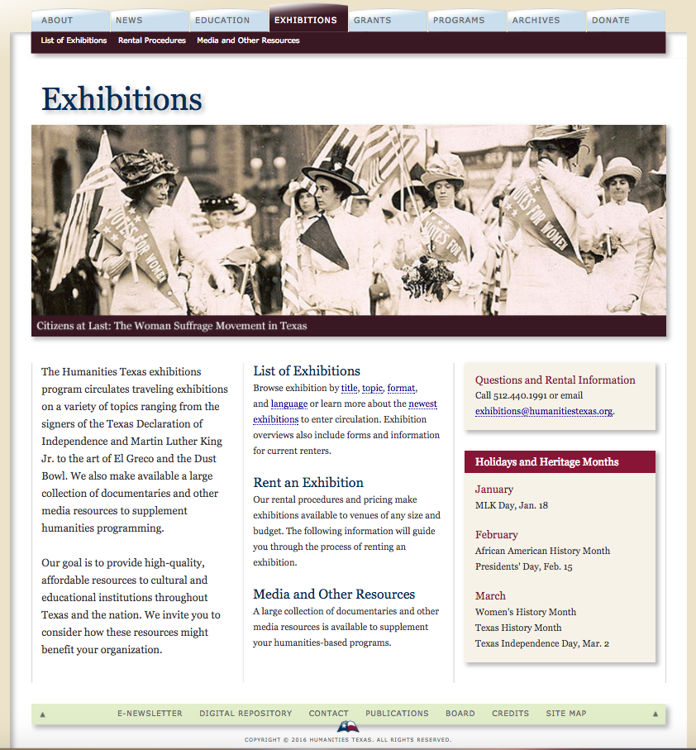
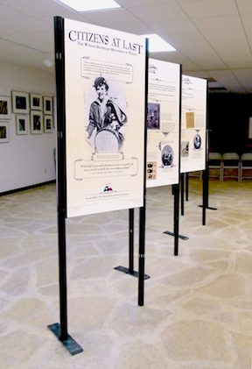
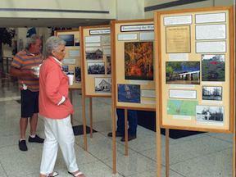
Traveling Exhibitions
http://www.humanitiestexas.org/exhibitions
Notes:
EXHIIBTIONS: ask if anyone has rented an exhibition from HTx before?
HTx circulates over 50 exhibitions to schools, libraries, museums and educational/cultural organizations across the state and nation
A variety of humanities topics: from the Signers of the Texas Declaration of Independence, to the Bill of Rights, to Rural Texas Woman, to political cartoons of Clifford Berryman
Very high-quality and affordable: we charge the cost of shipping the exhibition: we take care of coordinating shipping of exhibition; all you have to do is put it together
Teachers and others have used our exhibitions in their classrooms, school libraries, often to coincide with events on the academic calendar like Constitution Day and Women’s History Month.
Large collection of print materials, documentaries and other media resources to supplement curriculum development
Website shows the different exhibitions and you can search by topic, title, format, language: walk them through
See dimensions, what exhibit includes, format, cost for shipping
Questions: our exhibits coordinator Sara Nezamabadi will be happy to help!

Slide 15
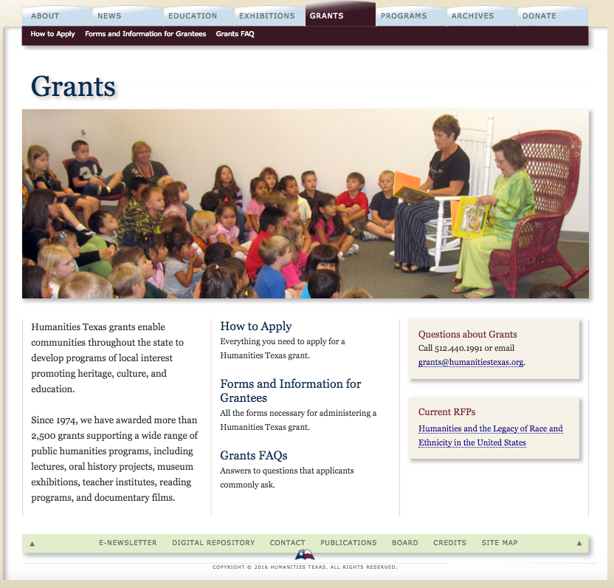
Mini-Grants
http://www.humanitiestexas.org/grants
Notes:
GRANTS:
Humanities Texas provides both mini and major grants. Our major grants, over $1,500 have a spring and a fall cycle. However, more relevant to you guys is our mini-grants program:
Smaller grants often used in conjunction with our exhibitions program, with a rolling deadline and quick turn around
up to $1,500 to support the rental of exhibitions in our collection or for a particular humanities-related program.
Application available online- 2 page application:
The application for the mini-grant is extremely easy and our grants program officer, Allison Dillon, is very helpful in walking you through the process
Only requirement is that since it is a mini-grant, the program or exhibition rented must include a public component, whether it is displayed during parent teacher night or basketball game, e.g.
Our grants staff is very good about helping you craft your application and making sure it fits our guidelines, so I hope you’ll make use of this program.

Slide 16
Humanities Texas Website
Digital Repository: http://www.humanitiestexas.org/archives/digital-repository
Videos of faculty lectures from past teacher programs
All episodes of Texas Originals
All President’s Vision posters and worksheets
All info about awards, grants, exhibitions
Resource guides:
http://www.humanitiestexas.org/education/online-resources
Notes:
In addition to providing information about our programs, applications, and the like, our website is very content-rich:
Wide-range of educational resources available to teachers on our website
ONLINE DIGITAL RESPONSITY: archive of historical documents, works of art, videos of public lectures and past presentations at our teacher institutes and workshops, Texas Originals
Searchable by topic (ie Civil War), format (video, image, document)
SHOW search for videos
TEXAS ORIGINALS
PRESIDENT’S VISION
RESOURCE GUIDES: recommended websites, topically organized resource guides for TEXAS HISTORY, U.S. HISTORY, ELA; guide on how to Texas Originals correlates with TEKS for 7 grade Texas history
Encourage teachers to explore our website and see how they can use our assembled resources in their classroom, with their students, to enhance their teaching and understanding.
Also, we hope they will provide feedback on anything use from our website or would be useful to them. We are here to support their work and we want to make sure we are doing so in the best way possible

Slide 17
Humanities Texas E-newsletter
Content-rich articles
  Articles on past lectures
  Oral histories: Prisoners of War
  Teacher Feature
First to know about upcoming teacher workshops
Sign up by filling out sign in sheet!
Notes:
Encourage teachers to sign up for e-newsletter!
It’s more than just a newsletter or collection of announcements. Emphasize content-rich!
Announcements about upcoming teacher workshops and institutes, when we accept award nomination, etc.

Slide 18
Coming attractions
Latino Americans: 500 Years of History Curriculum Materials
Pivotal U.S. Elections: Then and Now Curriculum Materials
Season three of Texas Originals
Spring workshops, summer institutes
Nominations and applications for 2018 awards
Notes:
Finally, I want to give you a preview of some programs that are in the works:
Latino Americans: 500 Years of History: HTx, in partnership with the National Endowment for the Humanities and the American Library Association is developing curriculum materials for the PBS Series Latino Americans. Broken down by Episode in the Series, the curriculum materials will be available on our website.
Pivotal U.S. Elections: Then and Now: forthcoming curriculum materials related to this public program on critical presidential elections in U.S. history
Season 3 of Texas Originals is hopefully in the works!
Spring workshops: APPLY!
Early Sept: nominations for the 2018 Outstanding Teaching Awards will be posted on our website!

Slide 19
How to stay in touch!
E-newsletter (turn in your sign-up sheets!)
Facebook
Twitter
Instagram
Eric Lupfer, elupfer@humanitiestexas.org
Notes:
CONCLUSIONS:
Does anyone have any questions?
GIVEAWAY: Show them what is on the Flash Drive!!!
Thank them for the work they do and wish the best of luck with the start of the new year. Stay in touch. Hope to see some of your faces at our upcoming workshops. And don’t hesitate to reach out any time. We are here to support you and your teaching!

