Slide 1
James Madison and the Constitution
Jack Rakove
Stanford University

Slide 2
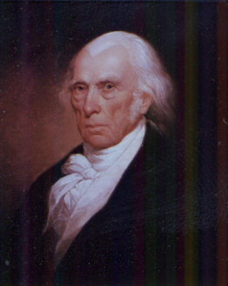

Slide 3
Madison, Federalist 49
Notwithstanding the success which has attended the revisions of our established forms of government, and which does so much honour to the virtue and intelligence of the people of America, it must be confessed, that the experiments are of too ticklish a nature to be unnecessarily multiplied. We are to recollect that all the existing constitutions were formed in the midst of a danger which repressed the passions most unfriendly to order and concord; of an enthusiastic confidence of the people in their patriotic leaders, which stifled the ordinary diversity of opinions on great national questions; of a universal ardor for new and opposite forms, produced by a universal resentment and indignation against the antient government; and whilst no spirit of party, connected with the changes to be made, or the abuses to be reformed, could mingle its leven in the operation.

Slide 4
Judith Shklar on Madison
He had a historian’s mind, which was a great intellectual advantage. It enabled him to penetrate to the logic of collective action, even when on the surface there seemed to be nothing but random irrationality and partisan wrangling. By reflecting upon previous occasions and experiences he was always able to see a pattern amid the confusion of men and events. (1997 APSA Presidential Address)

Slide 5
Bernard Bailyn on Madison
Paine was an ignoramus, both in ideas and in the practice of politics, next to Adams, Jefferson, Madison, or Wilson. . . . And he had none of the hard, quizzical, grainy quality of mind that led Madison to probe the deepest questions of republicanism not as an ideal contrast to monarchical corruption but as an operating, practical, everyday process of government capable of containing within it the explosive forces of society. (Faces of Revolution, 82)

Slide 6
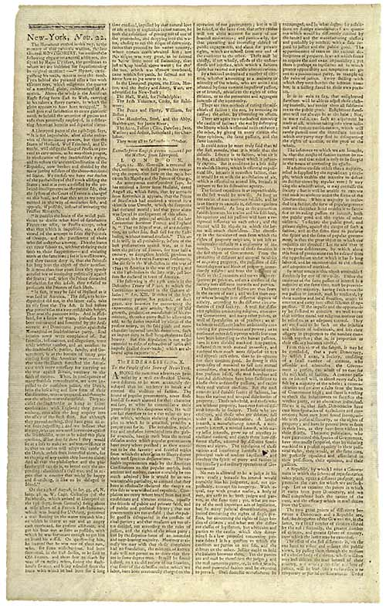

Slide 7
2 Paradigmatic Statements
In the extent and proper structure of the Union, therefore, we behold a republican remedy for the diseases most incident to republican government. (Federalist 10)
Ambition must be made to counteract ambition. The interest of the man must be connected with the constitutional rights of the place. (Federalist 51)

Slide 8
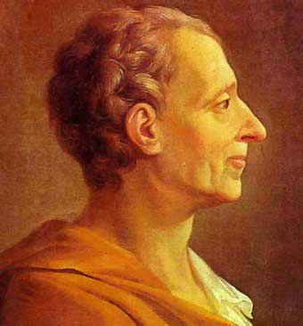

Slide 9
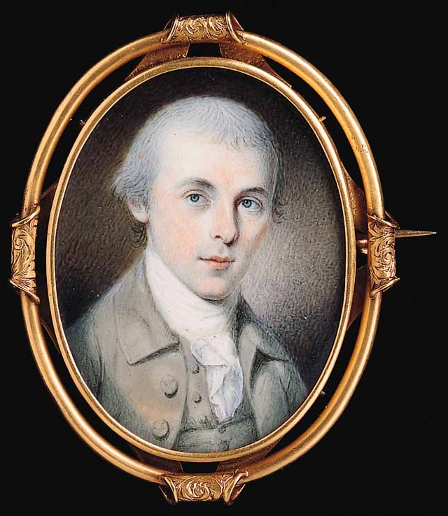
Notes:
1783 portrait by Charles Willson Peale

Slide 10
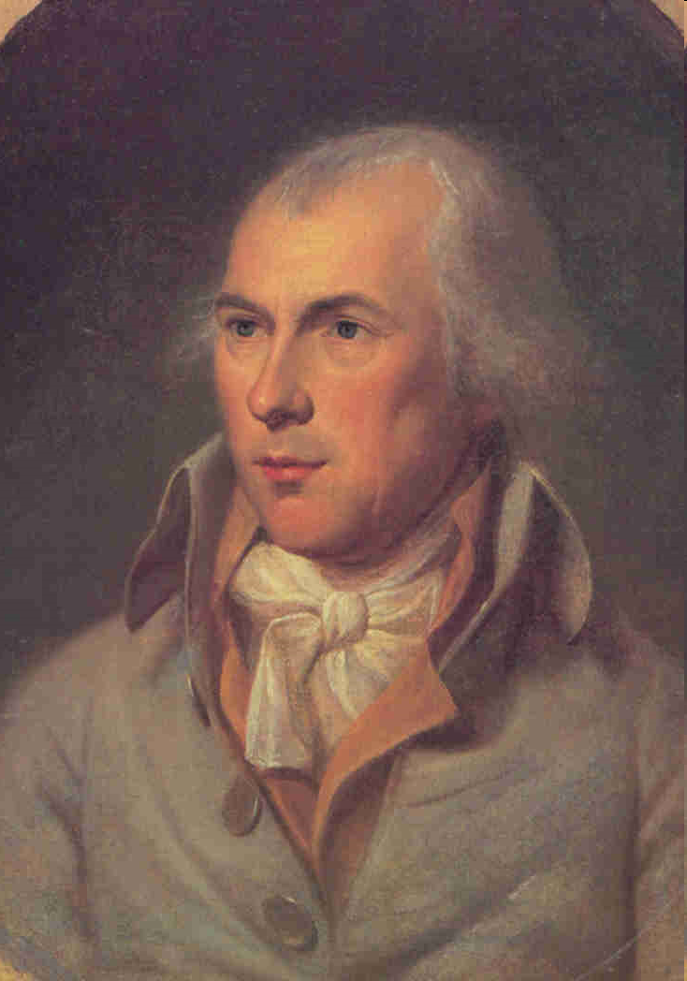

Slide 11
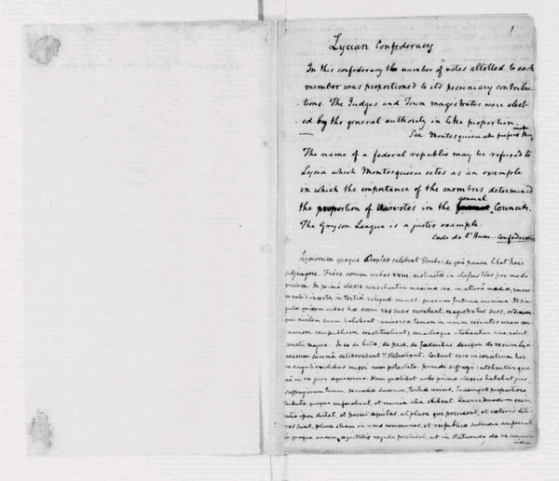

Slide 12
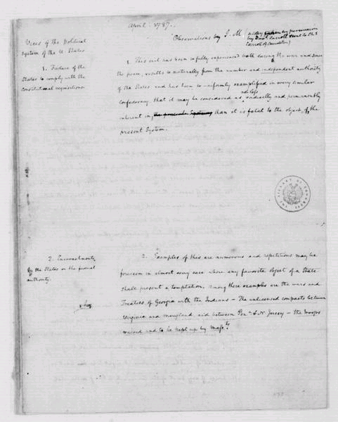

Slide 13
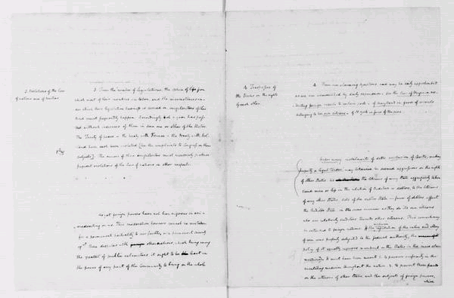

Slide 14
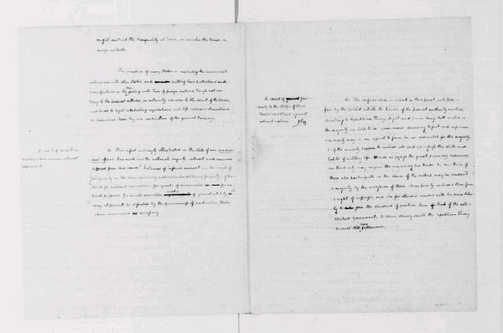

Slide 15
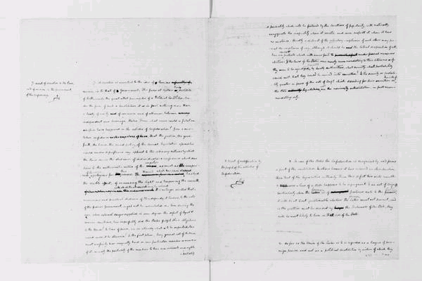

Slide 16
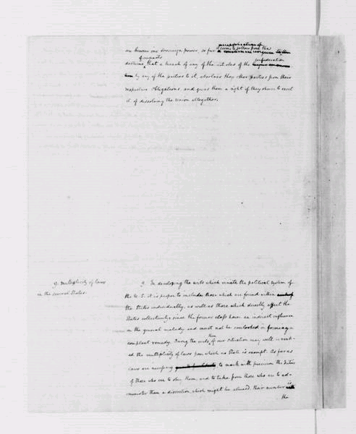

Slide 17
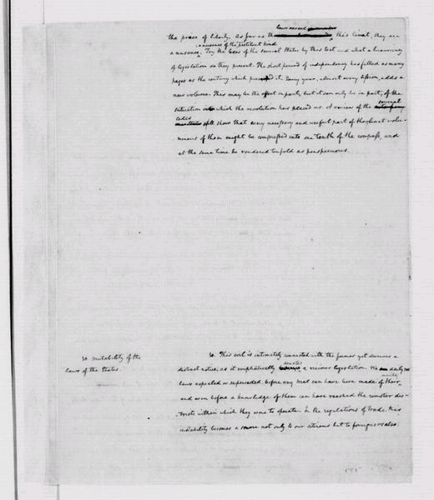

Slide 18
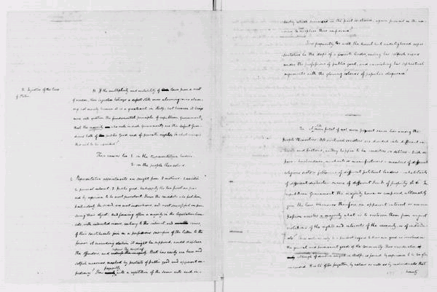

Slide 19
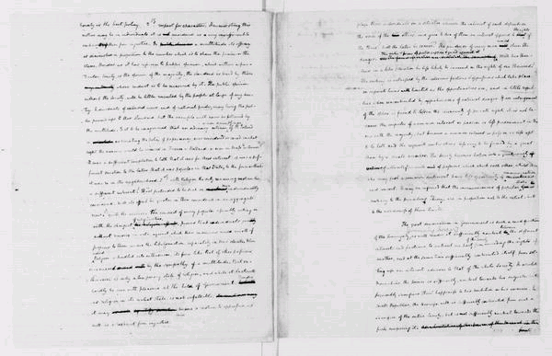

Slide 20
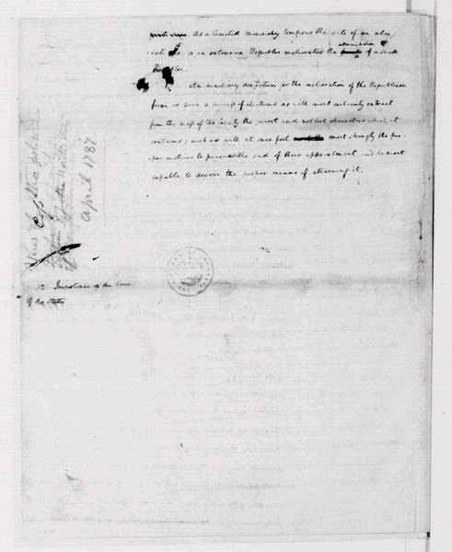

Slide 21
Madison to Washington April 16, 1787

Slide 23
