Slide 1

Texas in the
Civil War:
Soldiers, Supply, Slavery, & Dissent
Susannah J. Ural, Ph.D.
Professor of History
The University of Southern Mississippi

Slide 2
How did the Civil War have a major impact on Texans and Texas history if the state was relatively untouched by the fighting?

Slide 3
Texas secedes from Union, Feb. 1, 1861
Texas Secession Delegates:
166-8
for
secession
Can Texas Secede?
Gov. Houston insists on
popular vote
Results:
44,317 to 13,020
for secession
TEKS 7.13 A&B
Texas vs. US Constitution
Texas Almanac

Slide 4
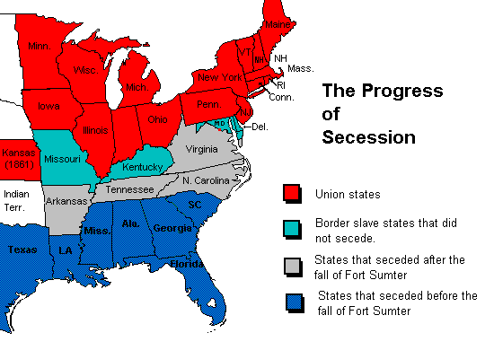

Slide 5
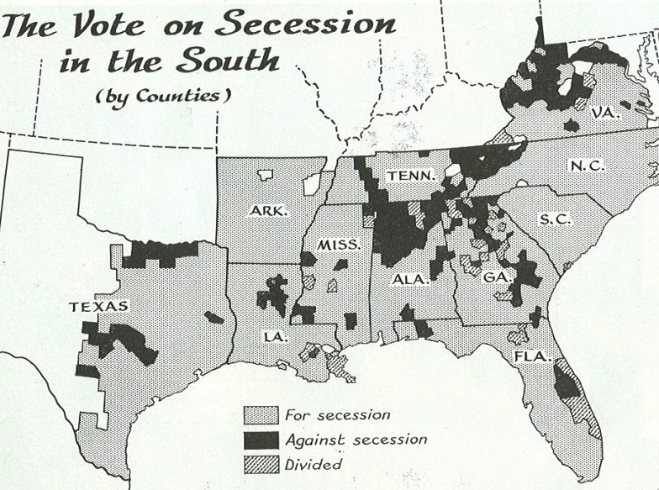
Note party & class divisions; also note large enslaved populations
(TEKS 7.5, 7.16)

Slide 6
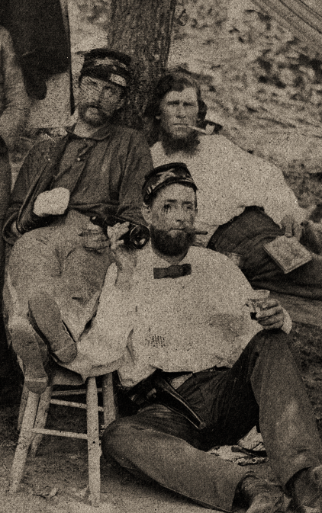
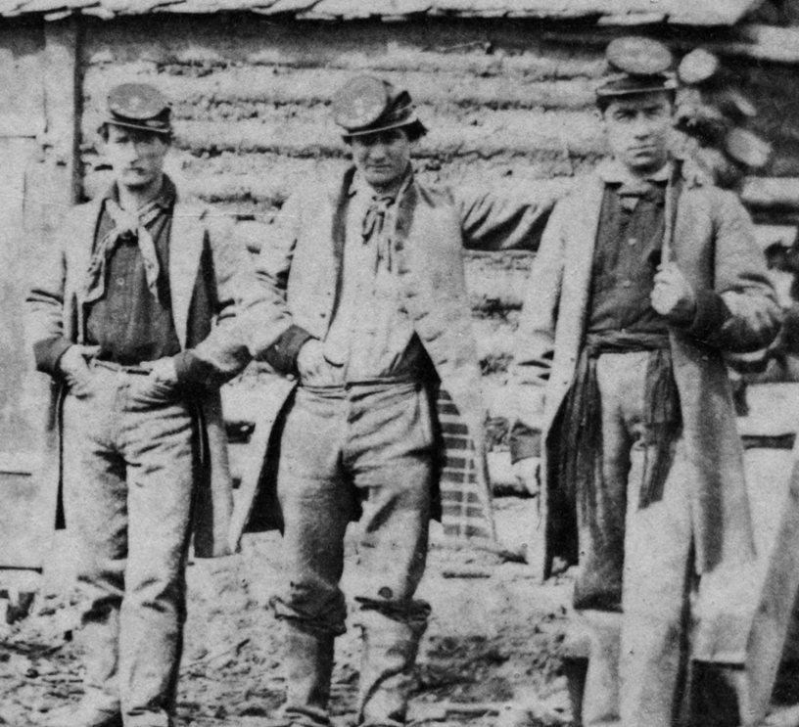
The War in 1861: A Rush to Arms
“If you go to war with the United States, you will never conquer her, as she has the money and the men. If she does not whip you by guns, powder, and steel, she will starve you to death. It will take the flower of the country — the young men.”
— Sam Houston
Left: Volunteers in 3rd NY Independent Battery
Right: Volunteers in the 1st Texas Inf.

Slide 7
Texas in the Civil War:
Soldiers, Supply, Slavery, and Dissent

Slide 8
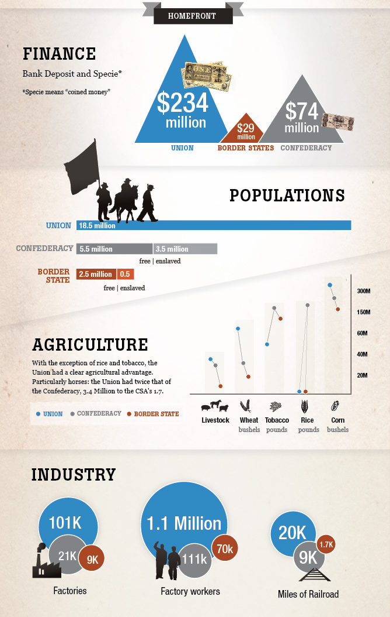
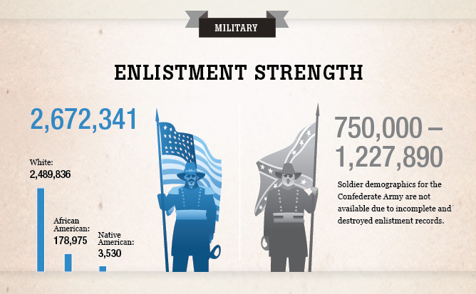
Civil War Begins, Apr 12, 1861
Causes? How do these evolve?
What is Each Side Trying
to Accomplish?
Upon What Resources
Can They Rely?
What Strategy Will
Each Side Implement & How Will That Evolve 1861-1865?
Statistics/Graphics: American Battlefield Trust

Slide 9
Texas Soldiers in the Civil War
IN THE EAST:
John Bell Hood & the Texas Brigade
IN THE WEST:
Albert Sidney Johnston & Battle of Shiloh
Granbury’s Texas Brigade
IN THE TRANS
-MISSISSIPPI:
Battles for Galveston, Sabine Pass, & Palmito Ranch
TEKS 7.5
Map: Gene Thorp, Washington Post, April 12, 2011

Slide 10
The Impact of Slavery & Emancipation
Confeds Winning in East, Feds Winning in West
Antietam: Bloodiest Day: September 17, 1862 (Hood’s Texas Brigade)
The Emancipation Proclamation, Jan. 1, 1863
What did it do? What were the reactions?
Impact on Union & Confed military service?
Impact on Texas & the forced migration of
enslaved peoples
TEKS 7.5 Central role of slavery & pol, econ, soc. effect of Civil War & Recon

Slide 11
War Weariness, Dissent, & the Un-Solid South
Confederate Conscription, April 1862
Twenty Slave Law, Oct. 1862
“Rich Man’s War, Poor Man’s Fight”
Dissent vs. Unionism
TEKS: 7.16A&B:
Free speech
in a democratic society
Great Hanging at Gainesville, October 1862

Slide 12
The War in 1863
Confederates Re-Take Galveston, January 1, 1863
The Siege and Fall of Vicksburg, April - July 4, 1863
  Battle of Milliken's Bend, June 7, 1863
  Cutting-Off Supplies from Texas
The Battle of Gettysburg, July 1-3, 1863
The Battle of Sabine Pass, September 8, 1863
TEKS
Significant events 7.5B

Slide 13
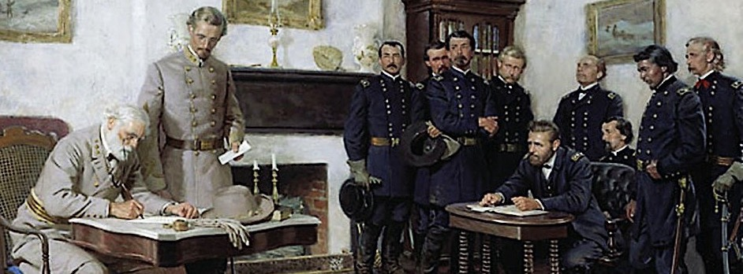
The War in 1865
I. Death & Disease:
The Cost of War
A. 650,000-750,000 Americans killed
II. April Slow Surrender
A. April 9, Confed. forces surrender in VA
B. April 26, Confed. forces surrender in NC
C. May 4, Confed. forces surrender in AL & MS
D. May 13, Last battle of the war: Palmito Ranch, TX
E. June 2, Confed forces surrender in TX & LA
F. June 23, Last Confed forces surrender in Oklahoma
TEKS 7.5C
Pol, econ, social
Effects of CW & Recon
Arlington National Cemetery; Surrender at Appomattox Court House, Virginia

Slide 14
A New Birth of Freedom:
Texas, Emancipation, Juneteenth
“The people of Texas are informed that, in accordance with a proclamation from the Executive of the United States, all slaves are free. This involves an absolute equality of personal rights and rights of property between former masters and slaves, and the connection heretofore existing between them becomes that between employer and hired labor.”
Gen. John Granger, General Orders, Number 3; Headquarters District of Texas,
Galveston, June 19, 1865
TEKS 7.5C + 7.15A&B
Pol, econ, social effects of
CW & Recon;
Rights & civic responsibilities of Texas citizens

Slide 15
A New Birth of Freedom:
Texas, Emancipation, & Juneteenth
“The people of Texas are informed…”
“in accordance with a proclamation from the Executive of the United States…”
“… all slaves are free.”
“This involves an absolute equality of personal rights and rights of property between former masters and slaves…”
“and the connection heretofore existing between them becomes that between employer and hired labor.”
Gen. John Granger, General Orders, Number 3; Headquarters District of Texas,
Galveston, June 19, 1865

Slide 16
How did the Civil War have a major impact on Texans and Texas history if the state was relatively untouched by the fighting?

Slide 17
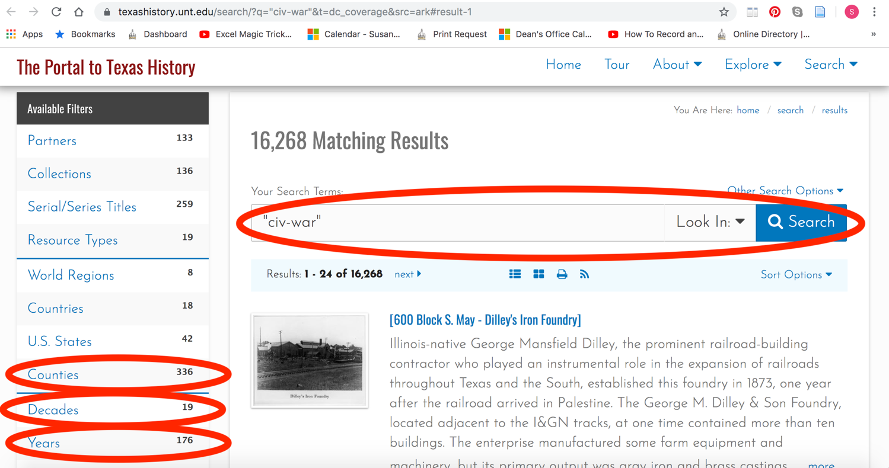
Primary Sources @ Portal to Texas History https://texashistory.unt.edu/

