Slide 1
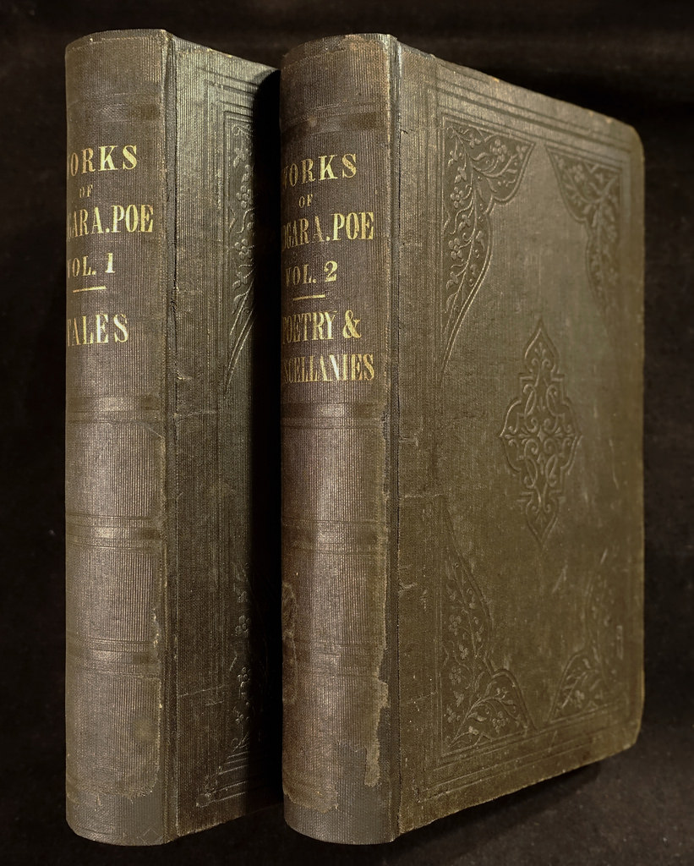
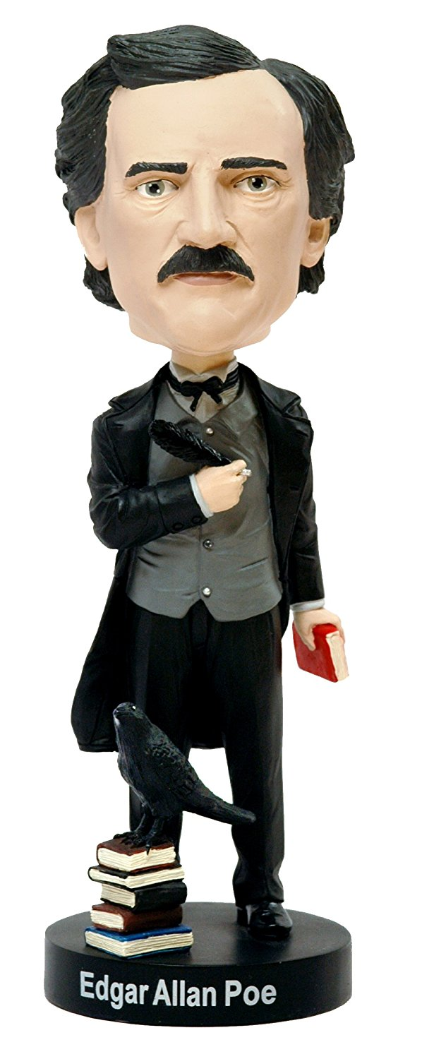
2021 Humanities Texas Webinar
Teaching
Edgar Allan Poe:
The Short Stories
Coleman Hutchison
The University of Texas at Austin

Slide 2
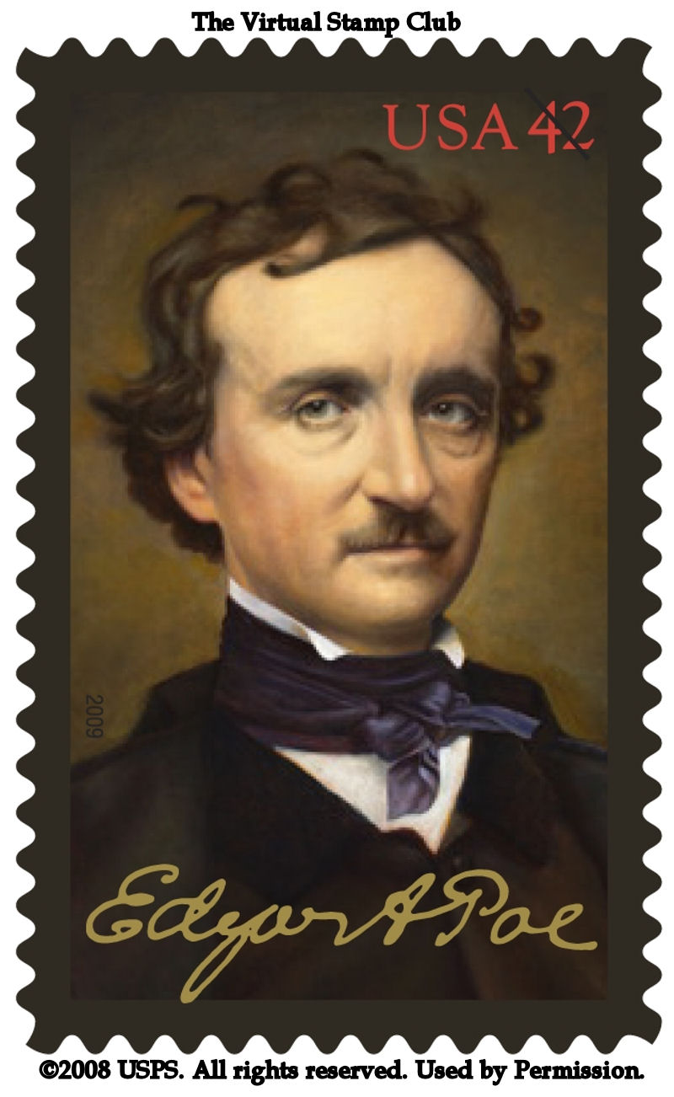
Poe as a “Renaissance Man”
Tales of terror (horror, sensation)
Detective fiction (ratiocination)
Poetry
Science fiction
Hoaxes
Criticism
"questions about the way something means, rather than what it means, or even why." She continues: "It is not that literary studies is uninterested in the what and the why. . . . But literariness, which lies at the heart of literary studies, is a matter of style, form, genre, and verbal interplay, as well as of social and political context--not only the realm of reference and context but also intrinsic structural elements like grammar, rhetoric, and syntax; tropes and figures; assonance and echo" (12).

Slide 3
Poe as a “Renaissance Man”
Tales of terror (horror, sensation)
Detective fiction (ratiocination)
Poetry
Science fiction
Hoaxes
Criticism
"questions about the way something means, rather than what it means, or even why." She continues: "It is not that literary studies is uninterested in the what and the why. . . . But literariness, which lies at the heart of literary studies, is a matter of style, form, genre, and verbal interplay, as well as of social and political context--not only the realm of reference and context but also intrinsic structural elements like grammar, rhetoric, and syntax; tropes and figures; assonance and echo" (12).

Slide 4
The Problem of Poe Revisited
Some Prosaic Claims
Contexts for Reading Poe’s Short Stories

Slide 5
The Problem of Poe Revisited
Some Prosaic Claims
Contexts for Reading Poe’s Short Stories

Slide 6
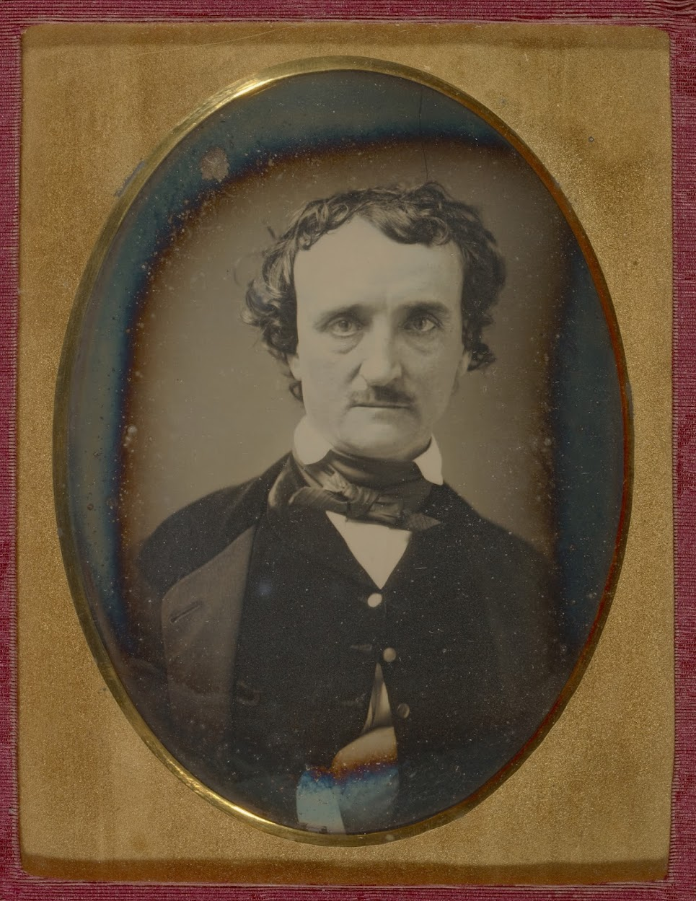
Edgar Allan Poe (1809–1849)
Born in Boston to two actors, Poe is orphaned young and then estranged from his adoptive family
Although peripatetic, Poe is a self-fashioned southerner with “pretentions to the planter class”
He struggles mightily to make ends meet as a writer throughout his life
He also works in a number of genres and modes: tales of terror, horror, and sensation; detective fiction; poetry; science fiction; hoaxes; literary criticism
Both a critical problem and a cultural phenomenon, Poe remains exceptionally influential
"questions about the way something means, rather than what it means, or even why." She continues: "It is not that literary studies is uninterested in the what and the why. . . . But literariness, which lies at the heart of literary studies, is a matter of style, form, genre, and verbal interplay, as well as of social and political context--not only the realm of reference and context but also intrinsic structural elements like grammar, rhetoric, and syntax; tropes and figures; assonance and echo" (12).

Slide 7
Poe as a Biographical Subject
Edgar Allan Poe is dead. He died in Baltimore the day before yesterday. This announcement will startle many, but few will be grieved by it.
~ Rufus W. Griswold, “Death of Edgar Allan Poe”
New York Tribune 9 October 1849
Incomplete record
Historical inaccuracies
Lurid details
Biographical fallacy
"questions about the way something means, rather than what it means, or even why." She continues: "It is not that literary studies is uninterested in the what and the why. . . . But literariness, which lies at the heart of literary studies, is a matter of style, form, genre, and verbal interplay, as well as of social and political context--not only the realm of reference and context but also intrinsic structural elements like grammar, rhetoric, and syntax; tropes and figures; assonance and echo" (12).

Slide 8
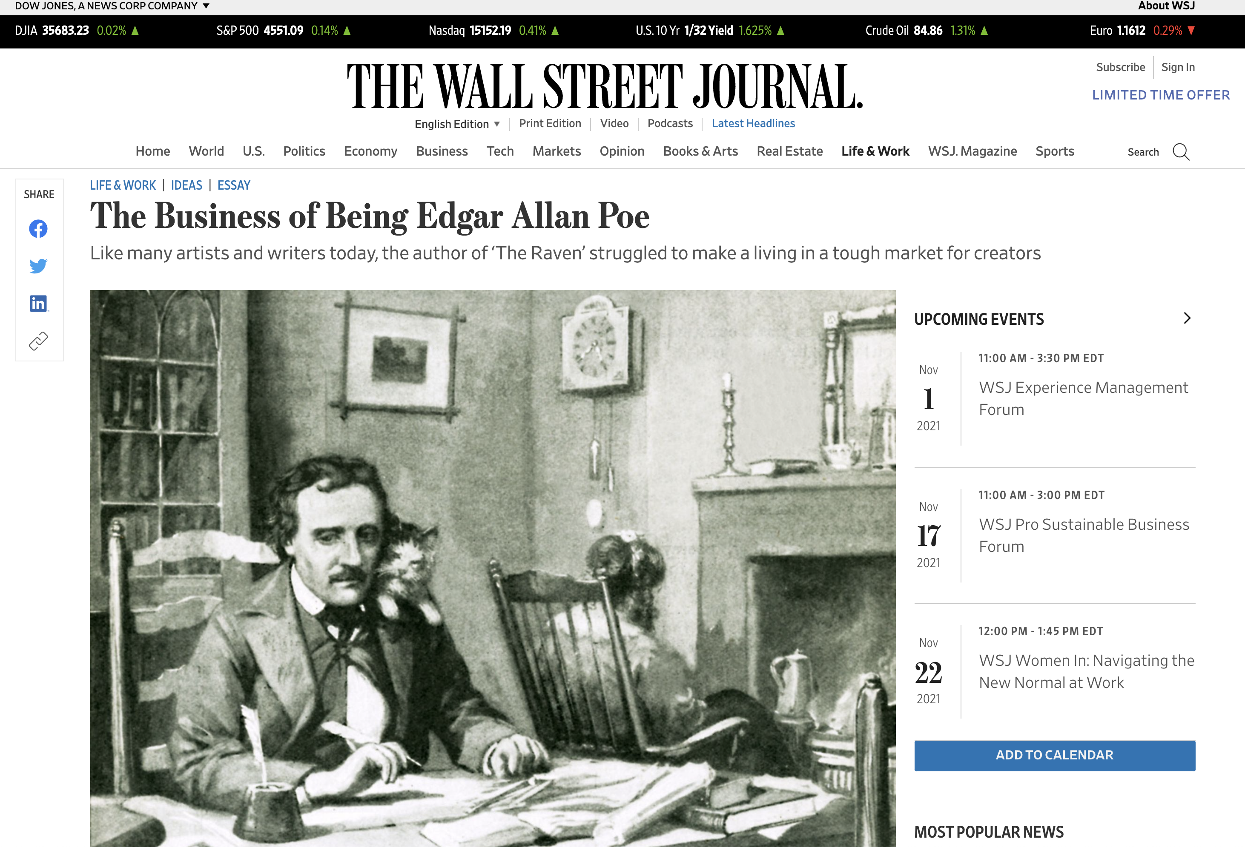
"questions about the way something means, rather than what it means, or even why." She continues: "It is not that literary studies is uninterested in the what and the why. . . . But literariness, which lies at the heart of literary studies, is a matter of style, form, genre, and verbal interplay, as well as of social and political context--not only the realm of reference and context but also intrinsic structural elements like grammar, rhetoric, and syntax; tropes and figures; assonance and echo" (12).

Slide 9
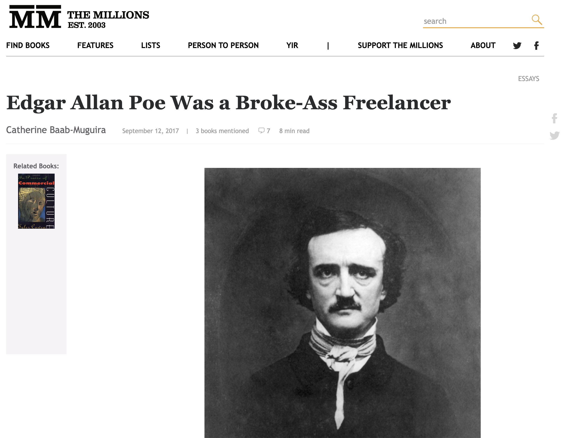
"questions about the way something means, rather than what it means, or even why." She continues: "It is not that literary studies is uninterested in the what and the why. . . . But literariness, which lies at the heart of literary studies, is a matter of style, form, genre, and verbal interplay, as well as of social and political context--not only the realm of reference and context but also intrinsic structural elements like grammar, rhetoric, and syntax; tropes and figures; assonance and echo" (12).

Slide 10
Poe as a "Critical Problem”
There comes Poe, with his raven, like Barnaby Rudge
Three-fifths of him genius and two-fifths sheer fudge,
Who talks like a book of iambs and pentameters,
In a way to make people of common sense damn metres,
Who has written some things quite the best of their kind, But the heart somehow seems all squeezed out by the mind.
~ James Russell Lowell, A Fable for Critics (1848)
I do not need to add, I presume, that American critics have often disparaged his poetry….We are familiar with that kind of sparring. The reproaches that bad critics heap upon good poets are the same in all countries.
~ Charles Baudelaire, Nouvelles Histories Extraordinares (1857)
Oh, you mean the jingle-man.
~ Ralph Waldo Emerson (1859)
"questions about the way something means, rather than what it means, or even why." She continues: "It is not that literary studies is uninterested in the what and the why. . . . But literariness, which lies at the heart of literary studies, is a matter of style, form, genre, and verbal interplay, as well as of social and political context--not only the realm of reference and context but also intrinsic structural elements like grammar, rhetoric, and syntax; tropes and figures; assonance and echo" (12).

Slide 11
You might call him "The Leader of the Cult of the Unusual."
~ Jules Verne (1864)
An enthusiasm for Poe is the mark of a decidedly primitive stage of reflection. Baudelaire thought him a profound philosopher, the neglect of whose golden utterances stamped his native land with infamy. Nevertheless, Poe was vastly the greater charlatan of the two, as well as the greater genius.
~ Henry James, "Charles Baudelaire" (1876)
With the exception of Henry James and Hawthorne, Poe is our only master of pure prose…. Poe found short story writing a bungling makeshift. He left it a perfect art. He wrote the first perfect short stories in the English language. He first gave the short story purpose, method, and artistic form.
~ Willa Cather (1895)
Poe constantly and inevitably produced magic where his greatest contemporaries produced only beauty.
~ George Bernard Shaw, "Edgar Allan Poe" (1909)
"questions about the way something means, rather than what it means, or even why." She continues: "It is not that literary studies is uninterested in the what and the why. . . . But literariness, which lies at the heart of literary studies, is a matter of style, form, genre, and verbal interplay, as well as of social and political context--not only the realm of reference and context but also intrinsic structural elements like grammar, rhetoric, and syntax; tropes and figures; assonance and echo" (12).

Slide 12
Where was the detective story until Poe breathed the breath of life into it?
~ Arthur Conan Doyle (1909)
In [Poe] American literature is anchored, in him alone, on solid ground.
~ William Carlos Williams, In the American Grain (1925)
The problem of Poe, fascinating as it is, lies quite outside the main current of American thought.
~ Vernon Parrington, Main Currents of American Thought (1927)
[Poe's work] relates at very few points to the main assumptions about literature that were held by any of my group. Poe was bitterly hostile to democracy, and in that respect could serve as a revelatory contrast.
~ F.O. Matthiessen, The American Renaissance (1941)
That Poe had a powerful intellect is undeniable: but it seems to me the intellect of a highly gifted person before puberty.
~ T. S. Eliot, "From Poe to Valery" (1948)
"questions about the way something means, rather than what it means, or even why." She continues: "It is not that literary studies is uninterested in the what and the why. . . . But literariness, which lies at the heart of literary studies, is a matter of style, form, genre, and verbal interplay, as well as of social and political context--not only the realm of reference and context but also intrinsic structural elements like grammar, rhetoric, and syntax; tropes and figures; assonance and echo" (12).

Slide 13
I am an invisible man. No, I am not a spook like those who haunted Edgar Allan Poe.
~ Ralph (Waldo) Ellison, Invisible Man (1952)
Poe was the black sheep in the American literary flock, and very black indeed he seemed when placed beside the great New Englanders.
~ Jay B. Hubbell, Eight American Authors (1956)
It's because I liked Edgar Allan Poe's stories so much that I began to make suspense films.
~ Alfred Hitchcock (1960)
No early American writer is more important to the concept of American Africanism than Poe.
~ Toni Morrison, Playing the Dark (1992)
Edgar Allan Poe was and is a turbulence, an anomaly among the major American writers of his period, an anomaly to this day.
~ Marilynne Robinson (2015)
"questions about the way something means, rather than what it means, or even why." She continues: "It is not that literary studies is uninterested in the what and the why. . . . But literariness, which lies at the heart of literary studies, is a matter of style, form, genre, and verbal interplay, as well as of social and political context--not only the realm of reference and context but also intrinsic structural elements like grammar, rhetoric, and syntax; tropes and figures; assonance and echo" (12).

Slide 14
“The Cult of the Unusual”: Some of Poe’s Avowed Inheritors
Charles Baudelaire
Stéphane Mallarmé
Paul Verlaine
Arthur Rimbaud
Jules Verne
Fyodor Dostoevsky
Arthur Conan Doyle
H.G. Wells
Oscar Wilde
George Bernard Shaw
William Carlos Williams
H.P. Lovecraft
Jorge Luis Borges
W.H. Auden
Vladimir Nabokov
Ralph Ellison
Alfred Hitchcock
Toni Morrison
Stephen King
Joyce Carol Oates
"questions about the way something means, rather than what it means, or even why." She continues: "It is not that literary studies is uninterested in the what and the why. . . . But literariness, which lies at the heart of literary studies, is a matter of style, form, genre, and verbal interplay, as well as of social and political context--not only the realm of reference and context but also intrinsic structural elements like grammar, rhetoric, and syntax; tropes and figures; assonance and echo" (12).

Slide 15
The Problem of Poe Revisited
Some Prosaic Claims
Contexts for Reading Poe’s Short Stories

Slide 16
Some Poe-tic Claims
Poetry is “the rhythmical creation of beauty.”
Poems should “be written solely for the poem’s sake”; they should not aim to teach or persuade or “inculcate a moral.”
Poems should be short: no longer than what can be read in “a single sitting.”
Artists should always have a “unity of effect” in mind—that is, the “totality” of impressions or emotions they want the reader to experience.
The death of a beautiful woman “is, unquestionably, the most poetical topic in the world.”
Sources: “The Philosophy of Composition” (1846); “The Poetic Principle” (c. 1849)
"questions about the way something means, rather than what it means, or even why." She continues: "It is not that literary studies is uninterested in the what and the why. . . . But literariness, which lies at the heart of literary studies, is a matter of style, form, genre, and verbal interplay, as well as of social and political context--not only the realm of reference and context but also intrinsic structural elements like grammar, rhetoric, and syntax; tropes and figures; assonance and echo" (12).

Slide 17
Some Prosaic Claims
Artists should always have a “unity of effect” in mind—that is, the “totality” of impressions or emotions they want the reader to experience.
Fiction should also be short: no longer than what can be read in “a single sitting.”
Initial sentences matter a great deal.
The death of a beautiful woman “is, unquestionably, the most poetical topic in the world.”
“…terror is not of Germany, but of the soul.”
Sources: “Preface” to Tales of the Grotesque and Arabesque (1840); “The Philosophy of Composition” (1846); “Tale-Writing—Nathaniel Hawthorne” (1847); “The Poetic Principle” (c. 1849)
"questions about the way something means, rather than what it means, or even why." She continues: "It is not that literary studies is uninterested in the what and the why. . . . But literariness, which lies at the heart of literary studies, is a matter of style, form, genre, and verbal interplay, as well as of social and political context--not only the realm of reference and context but also intrinsic structural elements like grammar, rhetoric, and syntax; tropes and figures; assonance and echo" (12).

Slide 18
Some Prosaic Claims
Artists should always have a “unity of effect” in mind—that is, the “totality” of impressions or emotions they want the reader to experience.
Fiction should also be short: no longer than what can be read in “a single sitting.”
Initial sentences matter a great deal.
The death of a beautiful woman “is, unquestionably, the most poetical topic in the world.”
“…terror is not of Germany, but of the soul.”
Sources: “Preface” to Tales of the Grotesque and Arabesque (1840); “The Philosophy of Composition” (1846); “Tale-Writing—Nathaniel Hawthorne” (1847); “The Poetic Principle” (c. 1849)
"questions about the way something means, rather than what it means, or even why." She continues: "It is not that literary studies is uninterested in the what and the why. . . . But literariness, which lies at the heart of literary studies, is a matter of style, form, genre, and verbal interplay, as well as of social and political context--not only the realm of reference and context but also intrinsic structural elements like grammar, rhetoric, and syntax; tropes and figures; assonance and echo" (12).

Slide 19
Were we called upon, however, to designate that class of composition which, next to such a poem as we have suggested, should best fulfil the demands of high genius—should offer it the most advantageous field of exertion—we should unhesitatingly speak of the prose tale, as Mr. Hawthorne has here exemplified it. We allude to the short prose narrative, requiring from a half-hour to one or two hours in its perusal. The ordinary novel is objectionable, from its length, for reasons already stated in substance. As it cannot be read at one sitting, it deprives itself, of course, of the immense force derivable from totality. Worldly interests intervening during the pauses of perusal, modify, annul, or counteract, in a greater or less degree, the impressions of the book. But simple cessation in reading, would, of itself, be sufficient to destroy the true unity. In the brief tale, however, the author is enabled to carry out the fulness of his intention, be it what it may. During the hour of perusal the soul of the reader is at the writer's control. There are no external or extrinsic influences resulting from weariness or interruption.
~ Poe, “Tale-Writing—Nathaniel Hawthorne” (1847)
"questions about the way something means, rather than what it means, or even why." She continues: "It is not that literary studies is uninterested in the what and the why. . . . But literariness, which lies at the heart of literary studies, is a matter of style, form, genre, and verbal interplay, as well as of social and political context--not only the realm of reference and context but also intrinsic structural elements like grammar, rhetoric, and syntax; tropes and figures; assonance and echo" (12).

Slide 20
Some Prosaic Claims
Artists should always have a “unity of effect” in mind—that is, the “totality” of impressions or emotions they want the reader to experience.
Fiction should also be short: no longer than what can be read in “a single sitting.”
Initial sentences matter a great deal.
The death of a beautiful woman “is, unquestionably, the most poetical topic in the world.”
“…terror is not of Germany, but of the soul.”
Sources: “Preface” to Tales of the Grotesque and Arabesque (1840); “The Philosophy of Composition” (1846); “Tale-Writing—Nathaniel Hawthorne” (1847); “The Poetic Principle” (c. 1849)
"questions about the way something means, rather than what it means, or even why." She continues: "It is not that literary studies is uninterested in the what and the why. . . . But literariness, which lies at the heart of literary studies, is a matter of style, form, genre, and verbal interplay, as well as of social and political context--not only the realm of reference and context but also intrinsic structural elements like grammar, rhetoric, and syntax; tropes and figures; assonance and echo" (12).

Slide 21
A skilful literary artist has constructed a tale. If wise, he has not fashioned his thoughts to accommodate his incidents; but having conceived, with deliberate care, a certain unique or single effect to be wrought out, he then invents such incident—he then combines such events as may best aid him in establishing this preconceived effect. If his very initial sentence tend not to the out-bringing of this effect, then he has failed in his first step. In the whole composition there should be no word written, of which the tendency, direct or indirect, is not to the one pre-established design. And by such means, with such care and skill, a picture is at length painted which leaves in the mind of him who contemplates it with a kindred art, a sense of the fullest satisfaction. The idea of the tale has been presented unblemished, because undisturbed; and this is an end unattainable by the novel. Undue brevity is just as exceptionable here as in the poem; but undue length is yet more to be avoided.
~ Poe, “Tale-Writing—Nathaniel Hawthorne” (1847)
"questions about the way something means, rather than what it means, or even why." She continues: "It is not that literary studies is uninterested in the what and the why. . . . But literariness, which lies at the heart of literary studies, is a matter of style, form, genre, and verbal interplay, as well as of social and political context--not only the realm of reference and context but also intrinsic structural elements like grammar, rhetoric, and syntax; tropes and figures; assonance and echo" (12).

Slide 22
Some Prosaic Claims
Artists should always have a “unity of effect” in mind—that is, the “totality” of impressions or emotions they want the reader to experience.
Fiction should also be short: no longer than what can be read in “a single sitting.”
Initial sentences matter a great deal.
The death of a beautiful woman “is, unquestionably, the most poetical topic in the world.”
“…terror is not of Germany, but of the soul.”
Sources: “Preface” to Tales of the Grotesque and Arabesque (1840); “The Philosophy of Composition” (1846); “Tale-Writing—Nathaniel Hawthorne” (1847); “The Poetic Principle” (c. 1849)
"questions about the way something means, rather than what it means, or even why." She continues: "It is not that literary studies is uninterested in the what and the why. . . . But literariness, which lies at the heart of literary studies, is a matter of style, form, genre, and verbal interplay, as well as of social and political context--not only the realm of reference and context but also intrinsic structural elements like grammar, rhetoric, and syntax; tropes and figures; assonance and echo" (12).

Slide 23
Just a few of the many dead or dying beautiful women in Poe
Annabel Lee
Irene in “The Sleeper”
Lenore in “Lenore”
Lenore in “The Raven”
Ulalume
Unnamed addressee of “To One in Paradise”
Unnamed addressee of “Spirits of the Dead”
Berenice
Eleonora
Lady Rowena in “Ligeia”
Ligeia
Morella
Madeline Usher in “The Fall of the House of Usher”
Unnamed fairy in "The Island of the Fay"
Unnamed subject of “The Oval Portrait”
"questions about the way something means, rather than what it means, or even why." She continues: "It is not that literary studies is uninterested in the what and the why. . . . But literariness, which lies at the heart of literary studies, is a matter of style, form, genre, and verbal interplay, as well as of social and political context--not only the realm of reference and context but also intrinsic structural elements like grammar, rhetoric, and syntax; tropes and figures; assonance and echo" (12).

Slide 24
Some Prosaic Claims
Artists should always have a “unity of effect” in mind—that is, the “totality” of impressions or emotions they want the reader to experience.
Fiction should also be short: no longer than what can be read in “a single sitting.”
Initial sentences matter a great deal.
The death of a beautiful woman “is, unquestionably, the most poetical topic in the world.”
“…terror is not of Germany, but of the soul.”
Sources: “Preface” to Tales of the Grotesque and Arabesque (1840); “The Philosophy of Composition” (1846); “Tale-Writing—Nathaniel Hawthorne” (1847); “The Poetic Principle” (c. 1849)
"questions about the way something means, rather than what it means, or even why." She continues: "It is not that literary studies is uninterested in the what and the why. . . . But literariness, which lies at the heart of literary studies, is a matter of style, form, genre, and verbal interplay, as well as of social and political context--not only the realm of reference and context but also intrinsic structural elements like grammar, rhetoric, and syntax; tropes and figures; assonance and echo" (12).

Slide 25
I speak of these things here, because I am led to think it is this prevalence of the “Arabesque” in my serious tales, which has induced one or two critics to tax me, in all friendliness, with what they have been pleased to term “Germanism” and gloom….My friends would be quite as wise in taxing an astronomer with too much astronomy, or an ethical author with treating too largely of morals….If in many of my productions terror has been the thesis, I maintain that terror is not of Germany, but of the soul, — that I have deduced this terror only from its legitimate sources, and urged it only to its legitimate results.
~ Poe, “Preface” to Tales of the Grotesque and Arabesque (1840)
"questions about the way something means, rather than what it means, or even why." She continues: "It is not that literary studies is uninterested in the what and the why. . . . But literariness, which lies at the heart of literary studies, is a matter of style, form, genre, and verbal interplay, as well as of social and political context--not only the realm of reference and context but also intrinsic structural elements like grammar, rhetoric, and syntax; tropes and figures; assonance and echo" (12).

Slide 26
Some Prosaic Claims
Artists should always have a “unity of effect” in mind—that is, the “totality” of impressions or emotions they want the reader to experience.
Fiction should also be short: no longer than what can be read in “a single sitting.”
Initial sentences matter a great deal.
The death of a beautiful woman “is, unquestionably, the most poetical topic in the world.”
“…terror is not of Germany, but of the soul.”
Sources: “Preface” to Tales of the Grotesque and Arabesque (1840); “The Philosophy of Composition” (1846); “Tale-Writing—Nathaniel Hawthorne” (1847); “The Poetic Principle” (c. 1849)
"questions about the way something means, rather than what it means, or even why." She continues: "It is not that literary studies is uninterested in the what and the why. . . . But literariness, which lies at the heart of literary studies, is a matter of style, form, genre, and verbal interplay, as well as of social and political context--not only the realm of reference and context but also intrinsic structural elements like grammar, rhetoric, and syntax; tropes and figures; assonance and echo" (12).

Slide 27
The Problem of Poe Revisited
Some Prosaic Claims
Contexts for Reading Poe’s Short Stories

Slide 28
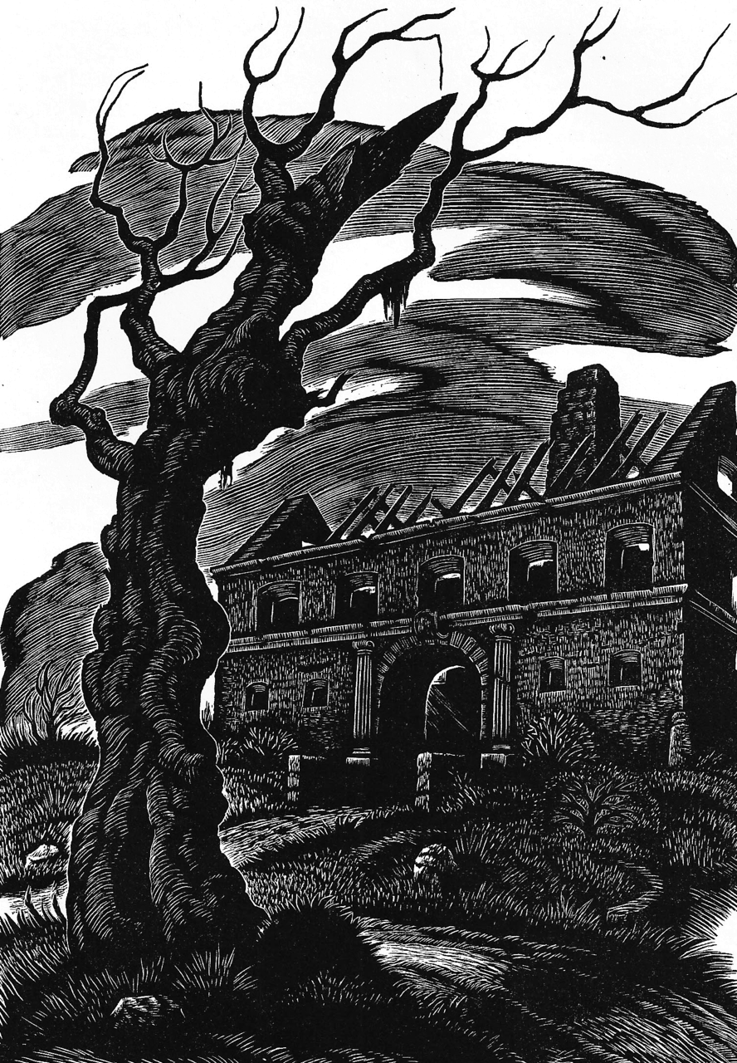
Contexts for Reading Poe’s Short Stories
American literary nationalism
Enlightenment discourses of rationality and rights
Gothicism/“Dark Romanticism”
Women’s rights and representation
Magazine publication

Slide 29
Contexts for Reading Poe’s Short Stories
American literary nationalism
Enlightenment discourses of rationality and rights
Gothicism/“Dark Romanticism”
Women’s rights and representation
Magazine publication

Slide 30
Producing a “Self-Reliant” American Literature
Our day of dependence, our long apprenticeship to the learning of other lands, draws to a close. The millions, that around us are rushing into life, cannot always be fed on the sere remains of foreign harvests. Events, actions arise, that must be sung, that will sing themselves.
Genius is always sufficiently the enemy of genius by over influence. The literature of every nation bear me witness. The English dramatic poets have Shakspearized now for two hundred years.
We have listened too long to the courtly muses of Europe.
~ Ralph Waldo Emerson, “The American Scholar” (1837)
"questions about the way something means, rather than what it means, or even why." She continues: "It is not that literary studies is uninterested in the what and the why. . . . But literariness, which lies at the heart of literary studies, is a matter of style, form, genre, and verbal interplay, as well as of social and political context--not only the realm of reference and context but also intrinsic structural elements like grammar, rhetoric, and syntax; tropes and figures; assonance and echo" (12).

Slide 31
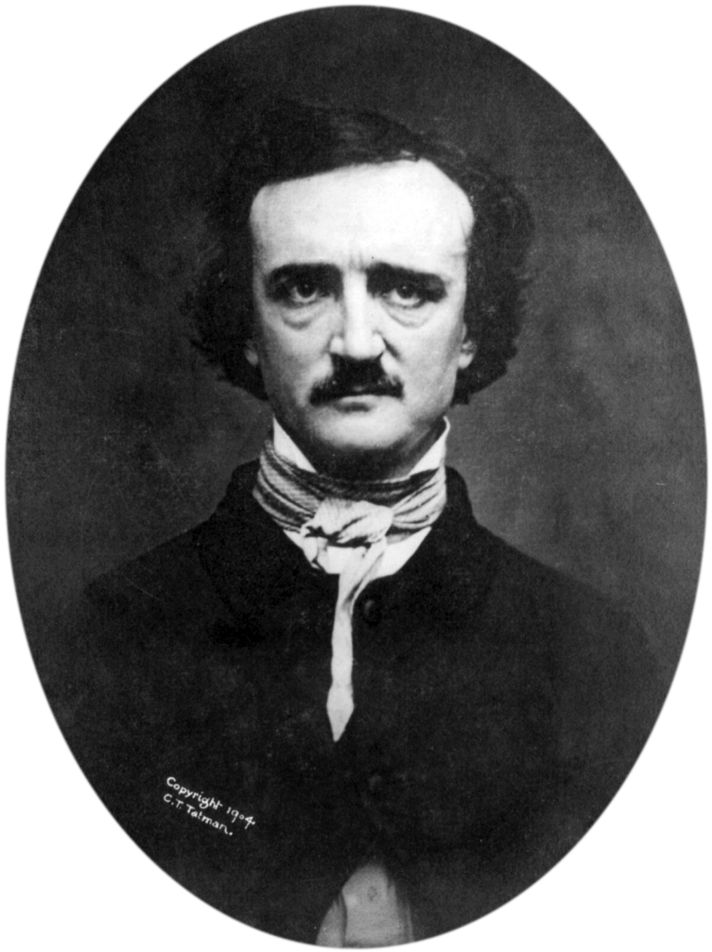
In a word, so far from being ashamed of the many disgraceful literary failures to which our own inordinate vanities and misapplied patriotism have lately given birth, and so far from deeply lamenting that these daily puerilities are of home manufacture, we adhere pertinaciously to our original blindly conceived idea, and thus often find ourselves involved in the gross paradox of liking a stupid book the better, because, sure enough, its stupidity is American.
~ Edgar Allan Poe, c. 1836
"questions about the way something means, rather than what it means, or even why." She continues: "It is not that literary studies is uninterested in the what and the why. . . . But literariness, which lies at the heart of literary studies, is a matter of style, form, genre, and verbal interplay, as well as of social and political context--not only the realm of reference and context but also intrinsic structural elements like grammar, rhetoric, and syntax; tropes and figures; assonance and echo" (12).

Slide 32
Contexts for Reading Poe’s Short Stories
American literary nationalism
Enlightenment discourses of rationality and rights
Gothicism/“Dark Romanticism”
Women’s rights and representation
Magazine publication

Slide 33
The Enlightenment (aka the Age of Enlightenment, the Age of Reason)
A largely European intellectual movement of the 17th and 18th centuries
Ideas about nature, god, and humanity synthesized into a widely adopted worldview that valued freedom, knowledge, and happiness
Helped to bring about revolutionary developments in art, economics, philosophy, science, society, and politics
Reason: “the power by which humans understand the universe and improve their own condition”
Major Enlightenment figures include d'Alembert, Condorcet, Diderot, Montesquieu, Rousseau, and Voltaire; Beccaria; Kant; Spinoza; Hume and Smith; Bentham, Hobbes, Locke, and Wollstonecraft; Jefferson and Paine
"questions about the way something means, rather than what it means, or even why." She continues: "It is not that literary studies is uninterested in the what and the why. . . . But literariness, which lies at the heart of literary studies, is a matter of style, form, genre, and verbal interplay, as well as of social and political context--not only the realm of reference and context but also intrinsic structural elements like grammar, rhetoric, and syntax; tropes and figures; assonance and echo" (12).

Slide 34
Freedom is a gift from heaven, and every individual of the same species has the right to enjoy it as soon as he is in enjoyment of his reason.
~ Denis Diderot, c. 1751
"questions about the way something means, rather than what it means, or even why." She continues: "It is not that literary studies is uninterested in the what and the why. . . . But literariness, which lies at the heart of literary studies, is a matter of style, form, genre, and verbal interplay, as well as of social and political context--not only the realm of reference and context but also intrinsic structural elements like grammar, rhetoric, and syntax; tropes and figures; assonance and echo" (12).

Slide 35
Contexts for Reading Poe’s Short Stories
American literary nationalism
Enlightenment discourses of rationality and rights
Gothicism/“Dark Romanticism”
Women’s rights and representation
Magazine publication

Slide 36
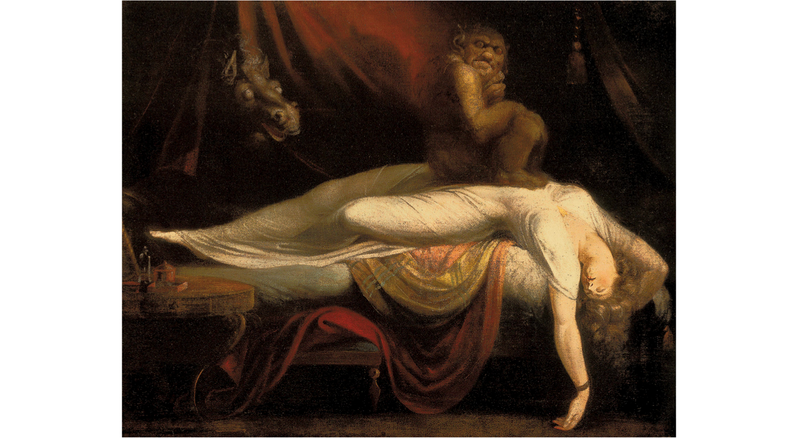

Slide 37
The Gothic featured accounts of terrifying experiences in ancient castles—experiences connected with subterranean dungeons, secret passageways, flickering lamps, screams, moans, bloody hands, ghosts, graveyards, and the rest. By extension, it came to designate the macabre, mysterious, fantastic, supernatural, and, again, the terrifying, especially the pleasurably terrifying, in literature more generally.
~ Norton Anthology of English Literature

Slide 38
Per G. R. Thompson, gothic fiction developed in two stages:
Gothic 1.0 (popular at the end of the eighteenth century): supernatural occurrences are explained away via reason and logic
Horace Walpole’s Castle of Otranto (1764); Ann Radcliffe’s The Mysteries of Udolpho (1794)
Gothic 2.0 (popular in the mid- to late-nineteenth century): supernatural occurrences cannot be explained away via reason and logic; that is, the supernatural is real, actual. There is an additional emphasis on genuine acts of violence and depravity, which speak to the “dark recesses of the human soul”
Matthew Lewis’s The Monk (1794); Mary Wollstonecraft Shelley’s Frankenstein (1818); Charles Maturin’s Melmoth the Wanderer (1820); Bram Stoker’s Dracula (1897)

Slide 39
Both versions share a remarkable “coherence” of conventions:
decaying architecture or bleak landscapes
supernatural occurrences
mystery
suspense
an ancient prophecy or omen
overwrought emotion
physically or emotionally debilitated characters
tyrannical men
women in distress

Slide 40
I speak of these things here, because I am led to think it is this prevalence of the “Arabesque” in my serious tales, which has induced one or two critics to tax me, in all friendliness, with what they have been pleased to term “Germanism” and gloom….My friends would be quite as wise in taxing an astronomer with too much astronomy, or an ethical author with treating too largely of morals….If in many of my productions terror has been the thesis, I maintain that terror is not of Germany, but of the soul, — that I have deduced this terror only from its legitimate sources, and urged it only to its legitimate results.
~ Poe, “Preface” to Tales of the Grotesque and Arabesque (1840)
"questions about the way something means, rather than what it means, or even why." She continues: "It is not that literary studies is uninterested in the what and the why. . . . But literariness, which lies at the heart of literary studies, is a matter of style, form, genre, and verbal interplay, as well as of social and political context--not only the realm of reference and context but also intrinsic structural elements like grammar, rhetoric, and syntax; tropes and figures; assonance and echo" (12).

Slide 41
Contexts for Reading Poe’s Short Stories
American literary nationalism
Enlightenment discourses of rationality and rights
Gothicism/“Dark Romanticism”
Women’s rights and representation
Magazine publication

Slide 43
We hold these truths to be self-evident, that all men are created equal, that they are endowed by their Creator with certain unalienable Rights, that among these are Life, Liberty and the pursuit of Happiness.
~The Declaration of Independence (1776)
1792: Mary Wollstonecraft publishes A Vindication of the Rights of Woman
1809: Edgar Allan Poe born in Boston, Massachusetts
1845: Margaret Fuller publishes Woman in the Nineteenth Century
1848: Seneca Falls Convention produces A Declaration of Sentiments
1849: Edgar Allan Poe dies in Baltimore, Maryland

Slide 44
I had now gone so far as the conception of a Raven, the bird of ill-omen, monotonously repeating the one word “Nevermore” at the conclusion of each stanza in a poem of melancholy tone, and in length about one hundred lines. Now, never losing sight of the object—supremeness or perfection at all points, I asked myself—“Of all melancholy topics what, according to the universal understanding of mankind, is the most melancholy?” Death, was the obvious reply. “And when,” I said, “is this most melancholy of topics most poetical?” From what I have already explained at some length the answer here also is obvious—“When it most closely allies itself to Beauty: the death then of a beautiful woman is, unquestionably, the most poetical topic in the world, and equally is it beyond doubt that the lips best suited for such topic are those of a bereaved lover.” ~ Edgar Allan Poe, “The Philosophy of Composition” (1846)

Slide 45
Poe’s ladies, those dream-dimmed, ethereal living dead of his poems, have been taken as exemplars of what Poe called “supernal Beauty”—an entitlement that he would degrade again and again. Think about Lady Madeline Usher returning from the grave as a brute and bloodied thing, reduced from a woman of beauty to the frenziedly iterated ”it” of her brother Roderick. Many of the dissolutions and decays so marked in Poe's tales about women subvert the status of women as a saving ideal, thus undermining his own “Philosophy of Composition”: the “death of a beautiful woman is, unquestionably, the most poetical topic in the world.” No longer pure or passive, she returns as an earthy—and very unpoetical—subject. (240) Perhaps all of Poe's work is finally about radical dehumanization: You can de-materialize—idealize—by turning humans into animals or by turning them into angels. (243) ~ Joan Dayan, “Amorous Bondage: Poe, Ladies and Slaves”

Slide 46
Contexts for Reading Poe’s Short Stories
American literary nationalism
Enlightenment discourses of rationality and rights
Gothicism/“Dark Romanticism”
Women’s rights and representation
Magazine publication

Slide 47
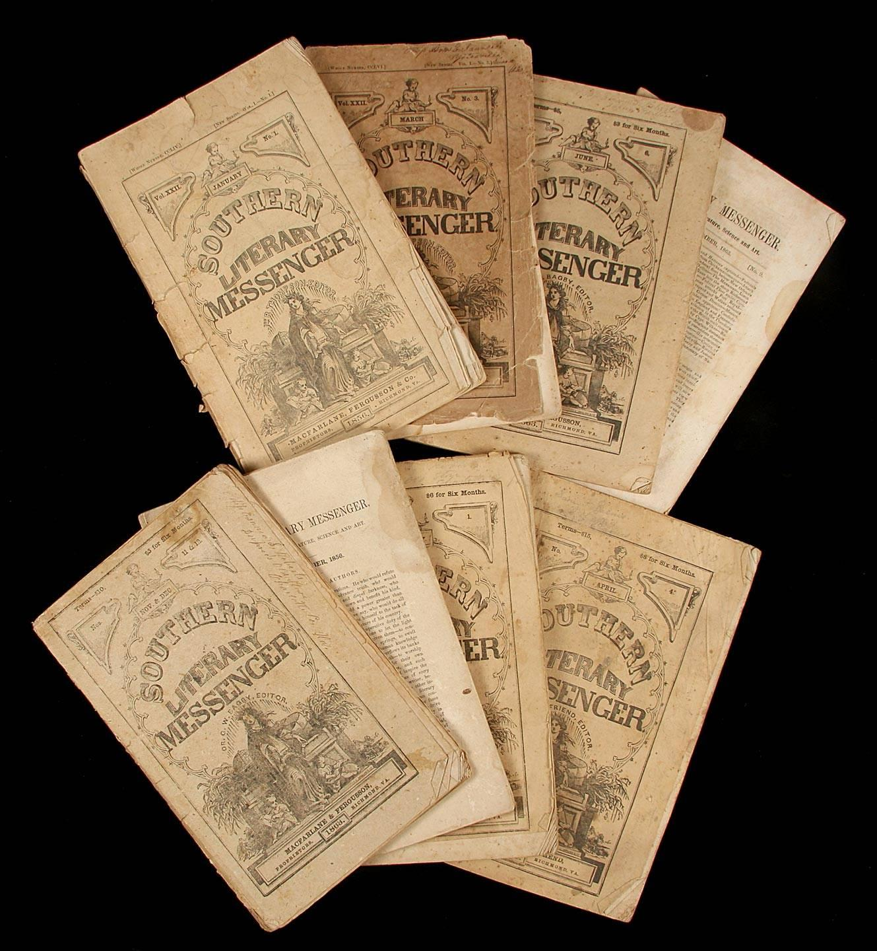
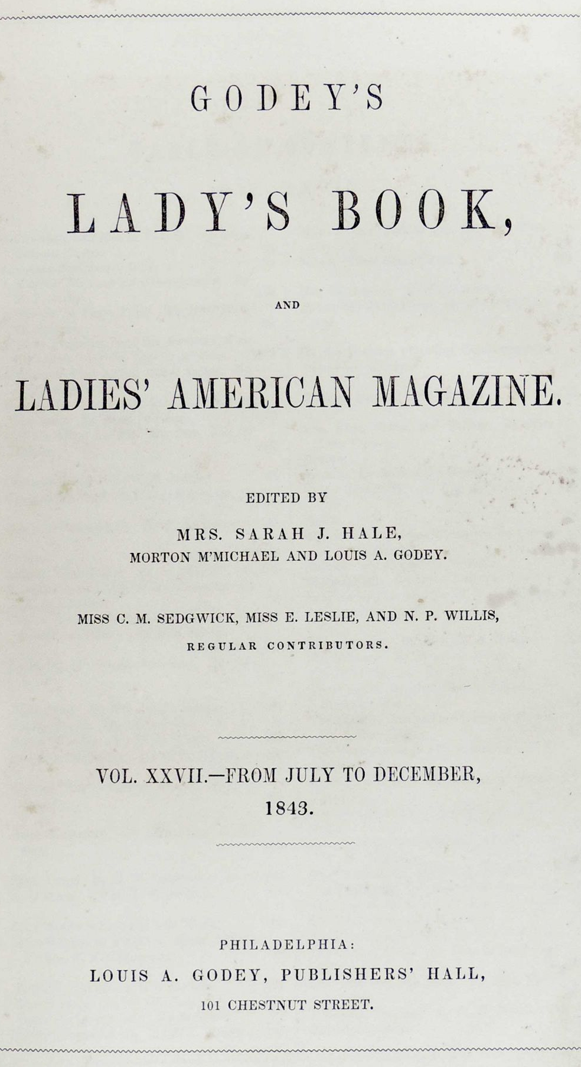
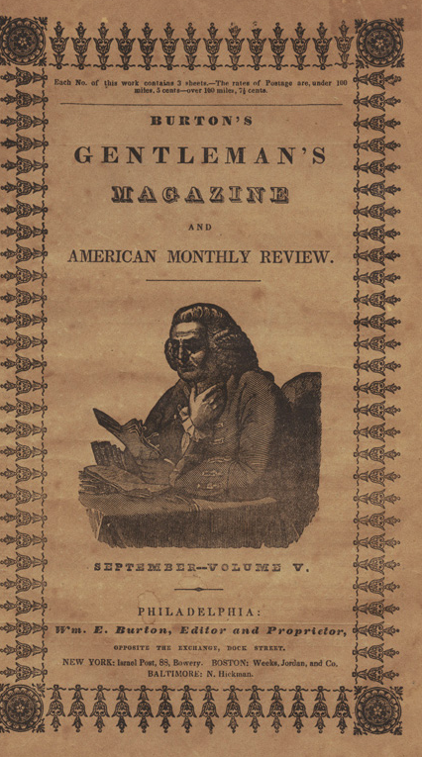

Slide 48
The Problem of Poe Revisited
Some Prosaic Claims
Contexts for Reading Poe’s Short Stories

Slide 49
Suggestions for Teaching Poe’s Short Stories
“Poe-try” Presentations
Parody or creative writing prompts on Poe-ian themes
Adaptation
Screenwriting and playwriting
Character studies
Magazine reports
Reading aloud
Reader response activities

Slide 50
Resources for Teaching Poe
The Edgar Allan Poe Society of Baltimore
Harry Ransom Center Edgar Allan Poe Collection
The Edgar Allan Poe Collection of Susan Jaffe Tane
Knowing Poe: Classroom Connections
Kevin J. Hayes, Edgar Allan Poe in Context

Slide 51
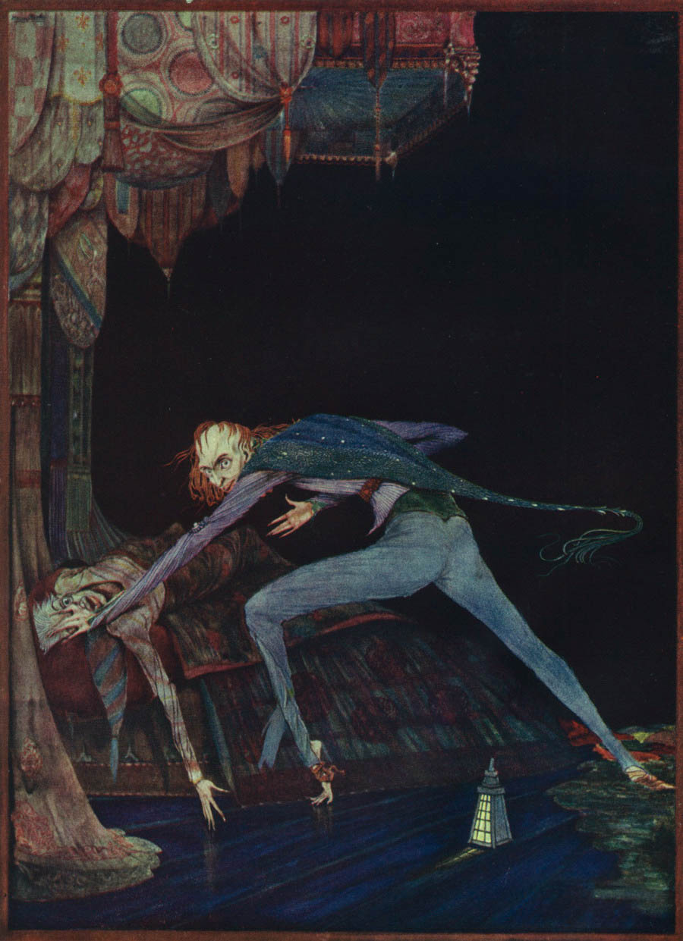
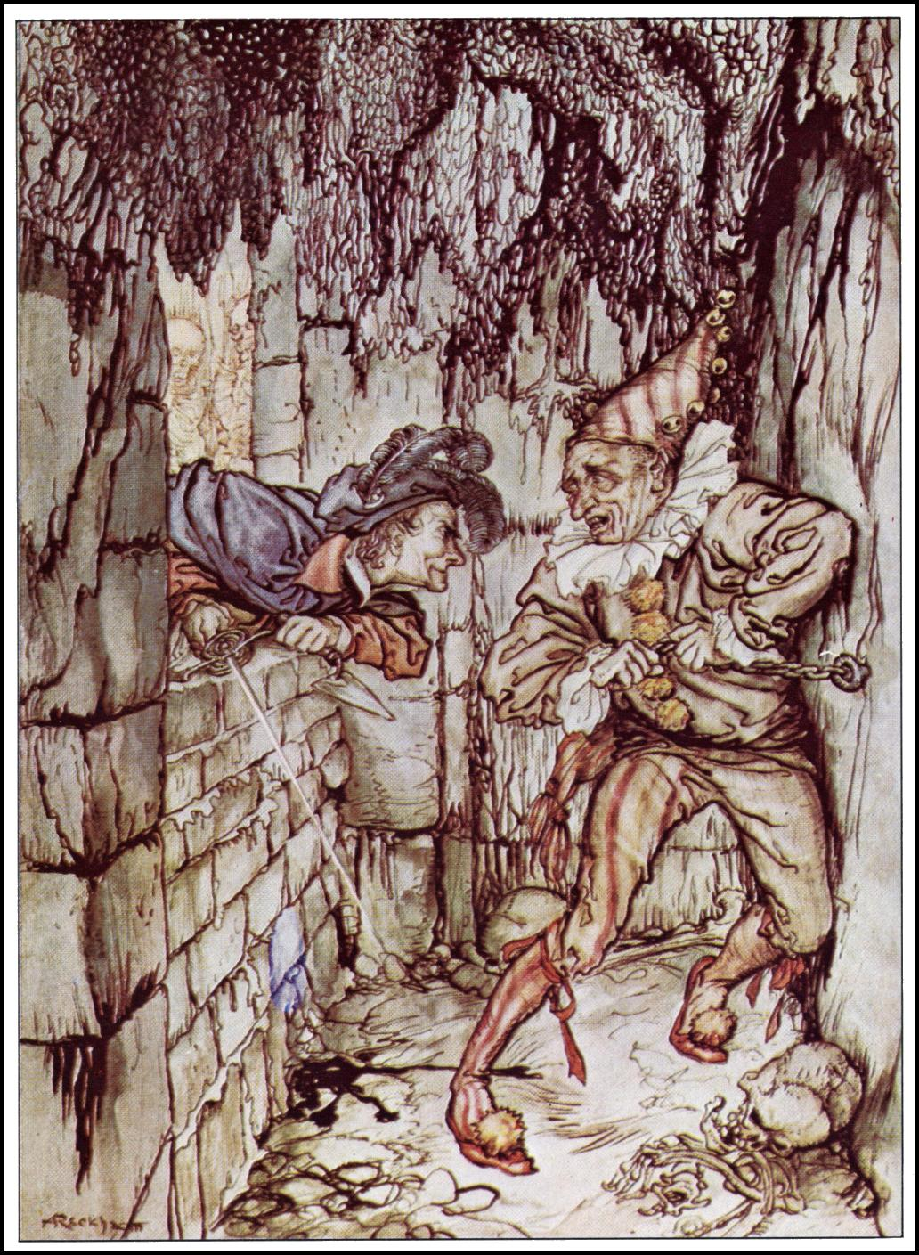
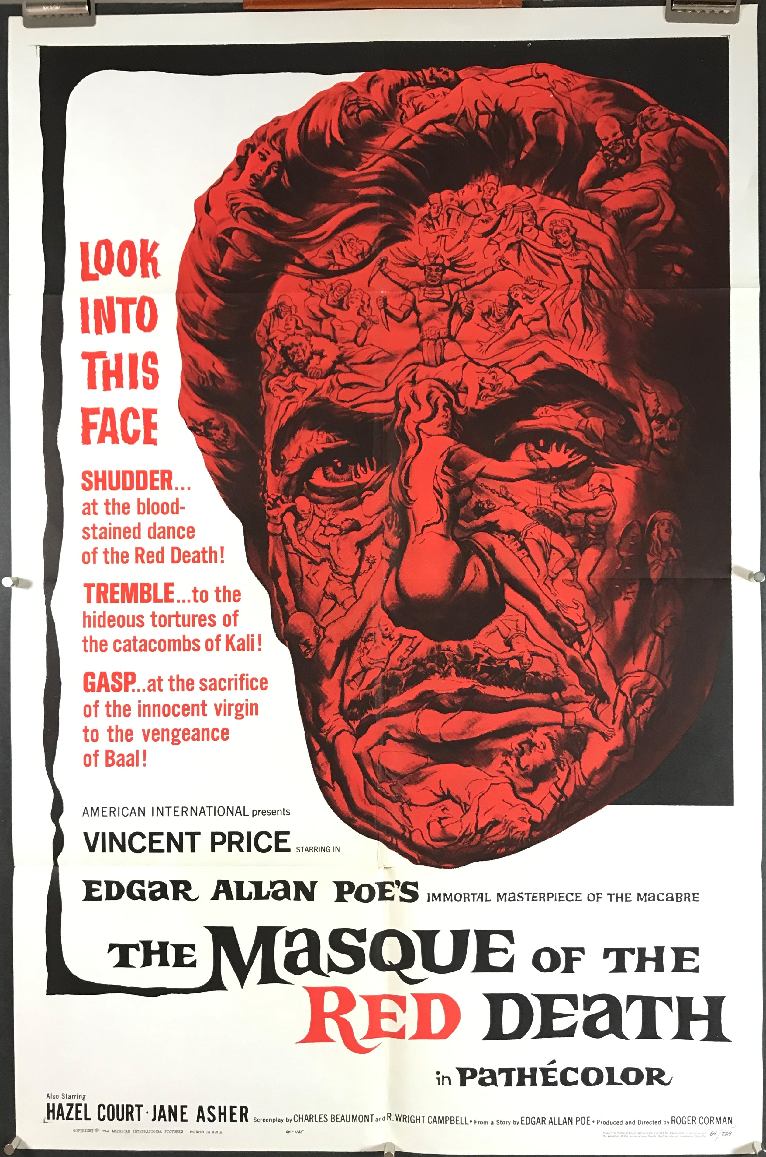

Slide 52
A skilful literary artist has constructed a tale. If wise, he has not fashioned his thoughts to accommodate his incidents; but having conceived, with deliberate care, a certain unique or single effect to be wrought out, he then invents such incident—he then combines such events as may best aid him in establishing this preconceived effect. If his very initial sentence tend not to the out-bringing of this effect, then he has failed in his first step. In the whole composition there should be no word written, of which the tendency, direct or indirect, is not to the one pre-established design. And by such means, with such care and skill, a picture is at length painted which leaves in the mind of him who contemplates it with a kindred art, a sense of the fullest satisfaction. The idea of the tale has been presented unblemished, because undisturbed; and this is an end unattainable by the novel. Undue brevity is just as exceptionable here as in the poem; but undue length is yet more to be avoided.
~ Poe, “Tale-Writing—Nathaniel Hawthorne” (1847)
"questions about the way something means, rather than what it means, or even why." She continues: "It is not that literary studies is uninterested in the what and the why. . . . But literariness, which lies at the heart of literary studies, is a matter of style, form, genre, and verbal interplay, as well as of social and political context--not only the realm of reference and context but also intrinsic structural elements like grammar, rhetoric, and syntax; tropes and figures; assonance and echo" (12).

Slide 54
From “The Tell-Tale Heart”
TRUE! — nervous — very, very dreadfully nervous I had been, and am; but why will you say that I am mad? The disease had sharpened my senses — not destroyed — not dulled them. Above all was the sense of hearing acute. I heard all things in the heaven and in the earth. I heard many things in hell. How, then, am I mad? Harken! and observe how healthily — how calmly I can tell you the whole story.
It is impossible to say how first the idea entered my brain; but, once conceived, it haunted me day and night. Object there was none. Passion there was none. I loved the old man. He had never wronged me. He had never given me insult. For his gold I had no desire. I think it was his eye! — yes, it was this! He had the eye of a vulture — a pale blue eye, with a film over it. Whenever it fell upon me, my blood ran cold; and so, by degrees — very gradually — I made up my mind to take the life of the old man, and thus rid myself of the eye forever.
(1843)
"questions about the way something means, rather than what it means, or even why." She continues: "It is not that literary studies is uninterested in the what and the why. . . . But literariness, which lies at the heart of literary studies, is a matter of style, form, genre, and verbal interplay, as well as of social and political context--not only the realm of reference and context but also intrinsic structural elements like grammar, rhetoric, and syntax; tropes and figures; assonance and echo" (12).

Slide 56
From “The Cask of Amontillado”
The thousand injuries of Fortunato I had borne as I best could, but when he ventured upon insult I vowed revenge. You, who so well know the nature of my soul, will not suppose, however, that I gave utterance to a threat. At length I would be avenged; this was a point definitively settled — but the very definitiveness with which it was resolved precluded the idea of risk. I must not only punish but punish with impunity. A wrong is unredressed when retribution overtakes its redresser. It is equally unredressed when the avenger fails to make himself felt as such to him who has done the wrong.
It must be understood that neither by word nor deed had I given Fortunato cause to doubt my good will. I continued, as was my wont, to smile in his face, and he did not perceive that my smile now was at the thought of his immolation.
He had a weak point — this Fortunato — although in other regards he was a man to be respected and even feared. He prided himself on his connoisseurship in wine. Few Italians have the true virtuoso spirit. For the most part their enthusiasm is adopted to suit the time and opportunity, to practice imposture upon the British and Austrian millionaires. In painting and gemmary, Fortunato, like his countrymen, was a quack, but in the matter of old wines he was sincere. In this respect I did not differ from him materially; — I was skillful in the Italian vintages myself, and bought largely whenever I could.
It was about dusk, one evening during the supreme madness of the carnival season, that I encountered my friend. He accosted me with excessive warmth, for he had been drinking much. The man wore motley. He had on a tight-fitting parti-striped dress, and his head was surmounted by the conical cap and bells. I was so pleased to see him that I thought I should never have done wringing his hand.
(1846)
"questions about the way something means, rather than what it means, or even why." She continues: "It is not that literary studies is uninterested in the what and the why. . . . But literariness, which lies at the heart of literary studies, is a matter of style, form, genre, and verbal interplay, as well as of social and political context--not only the realm of reference and context but also intrinsic structural elements like grammar, rhetoric, and syntax; tropes and figures; assonance and echo" (12).

Slide 58
From “The Masque of the Red Death”
The “Red Death” had long devastated the country. No pestilence had ever been so fatal, or so hideous. Blood was its Avator and its seal — the redness and the horror of blood. There were sharp pains, and sudden dizziness, and then profuse bleeding at the pores, with dissolution. The scarlet stains upon the body and especially upon the face of the victim, were the pest ban which shut him out from the aid and from the sympathy of his fellow-men. And the whole seizure, progress and termination of the disease, were the incidents of half an hour.
But the Prince Prospero was happy and dauntless and sagacious. When his dominions were half depopulated, he summoned to his presence a thousand hale and light-hearted friends from among the knights and dames of his court, and with these retired to the deep seclusion of one of his castellated abbeys. This was an extensive and magnificent structure, the creation of the prince’s own eccentric yet august taste. A strong and lofty wall girdled it in. This wall had gates of iron. The courtiers, having entered, brought furnaces and massy hammers and welded the bolts. They resolved to leave means neither of ingress or egress to the sudden impulses of despair or of frenzy from within. The abbey was amply provisioned. With such precautions the courtiers might bid defiance to contagion. The external world could take care of itself. In the meantime it was folly to grieve, or to think. The prince had provided all the appliances of pleasure. There were buffoons, there were improvisatori, there were ballet-dancers, there were musicians, there was Beauty, there was wine. All these and security were within. Without was the “Red Death.”
It was toward the close of the fifth or sixth month of his seclusion, and while the pestilence raged most furiously abroad, that the Prince Prospero entertained his thousand friends at a masked ball of the most unusual magnificence.
(1845)
"questions about the way something means, rather than what it means, or even why." She continues: "It is not that literary studies is uninterested in the what and the why. . . . But literariness, which lies at the heart of literary studies, is a matter of style, form, genre, and verbal interplay, as well as of social and political context--not only the realm of reference and context but also intrinsic structural elements like grammar, rhetoric, and syntax; tropes and figures; assonance and echo" (12).

