Slide 1
Tule Canyon

Slide 2
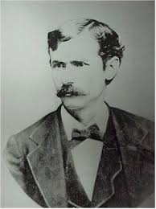
Lyman Wagon Train Siege September 9-14, 1874

Slide 3
Lyman Wagon Train Siege Battles of the Red River War by J. Brett Cruse (2008)

Slide 4
Buffalo Wallow Fight September 10, 1874
Kiowa Ledger Drawing
Texas Memorial Museum, UT Austin
The Last Stand
by Frederic Remington
MFA Houston

Slide 5
Col. Ranald S. Mackenzie
Tule Canyon Skirmish, September 25, 1874
Battle of Palo Duro Canyon, September 28, 1874

Slide 6
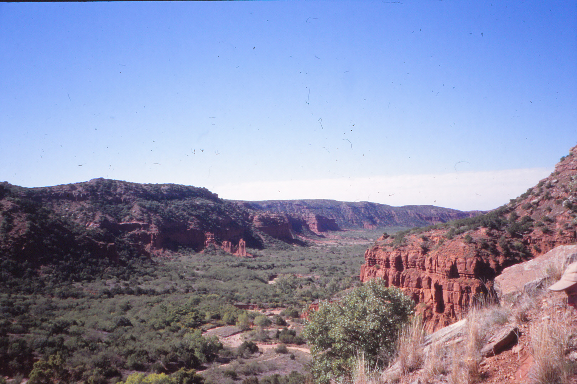

Slide 7
Palo Duro Canyon September 28, 1874
Iron Shirt
Southern Cheyennes
Ohamatai
Comanches
Mamanti
Kiowas

Slide 8
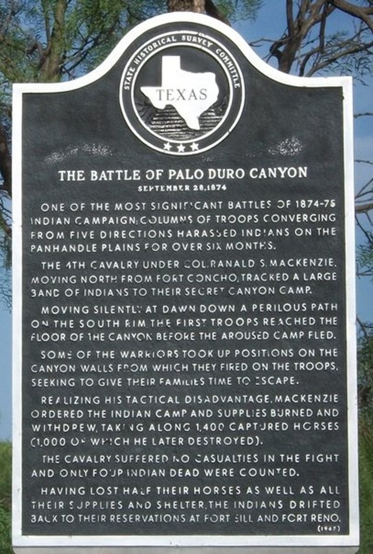
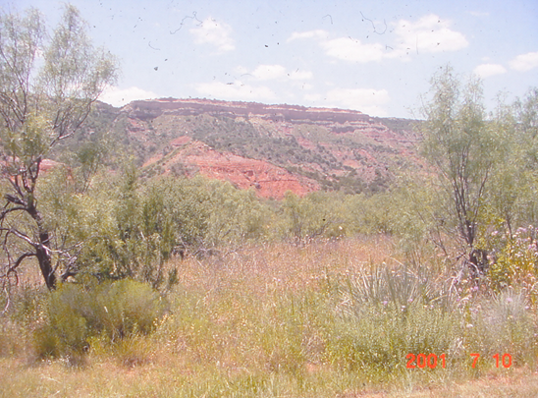
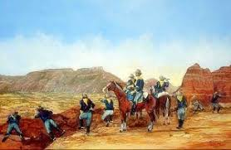

Slide 9
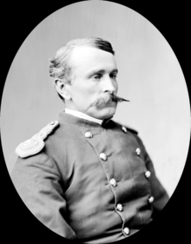
The Wrinkled Hand Chase
McClellan Creek
November 8, 1874
Lt. Frank Baldwin
Grey Beard, Cheyenne
Rescue of Adelaide and Julia German

Slide 10
Mackenzie’s Ultimatum April 1875
Wild Horse
J. J. Sturm

Slide 11
Kwahadi Surrender Quanah and Isatai May 1875

Slide 12
Today’s Readings
Joe Attocknie (1912-1984)
The Life of Ten Bears (2018)
Col. Wilbur Sturtevant Nye (1898-1970)
Carbine and Lance (orig. 1937)
gggs of Ten Bears
unofficial tribal historian
collected family anecdotes
McClellan Creek 9/24/1872
Attack warning, fight in the village
9 pages
West Point graduate
U.S. Army field artillery
Fort Sill post historian
McClellan Creek 9/24/1872
Mackenzie’s official report
Comanche stories
4 pages

Slide 13
Questions for Readings Discussion
Why does the Comanche woman “fear for her nose”? How does this issue come up again later in the Attocknie anecdotes?
Find the reference in Attocknie to war prophecy. Where else in the Red River War story does prophecy play a part?
Find an example of stoic Comanche humor. What does this tell us about Comanche cultural values?
Army reports record many instances of heroism. What analogous examples of Comanche bravery are recorded by Attocknie?

Slide 14
Questions for Readings Discussion (cont.)
5. How would you characterize Mackenzie’s official report in comparison to Attocknie’s oral history?
6. How does the matter of Indians capturing horses during the McClellan Creek fight come up again before and after that event?
7. How are the Comanche oral histories in Attocknie and Nye alike? How are they different?
8. How could you use these reading to form student assignments?

Slide 15
Essential Question:
How can oral history, geography, and archaeology enliven the study of Indian conflict in Texas?

