Slide 1
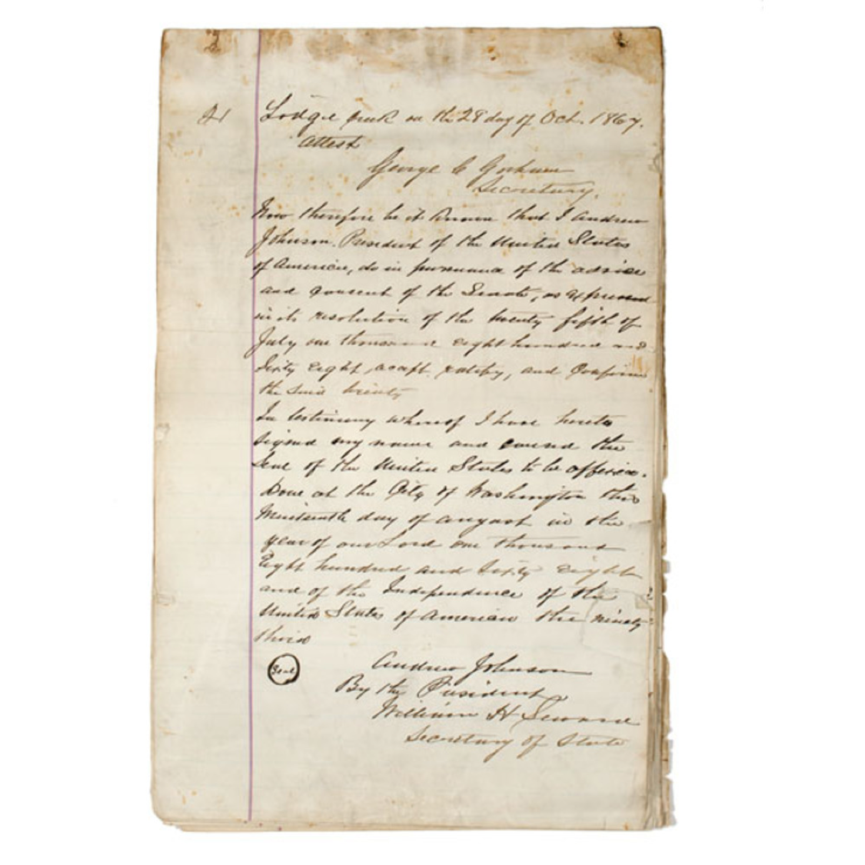

Slide 2
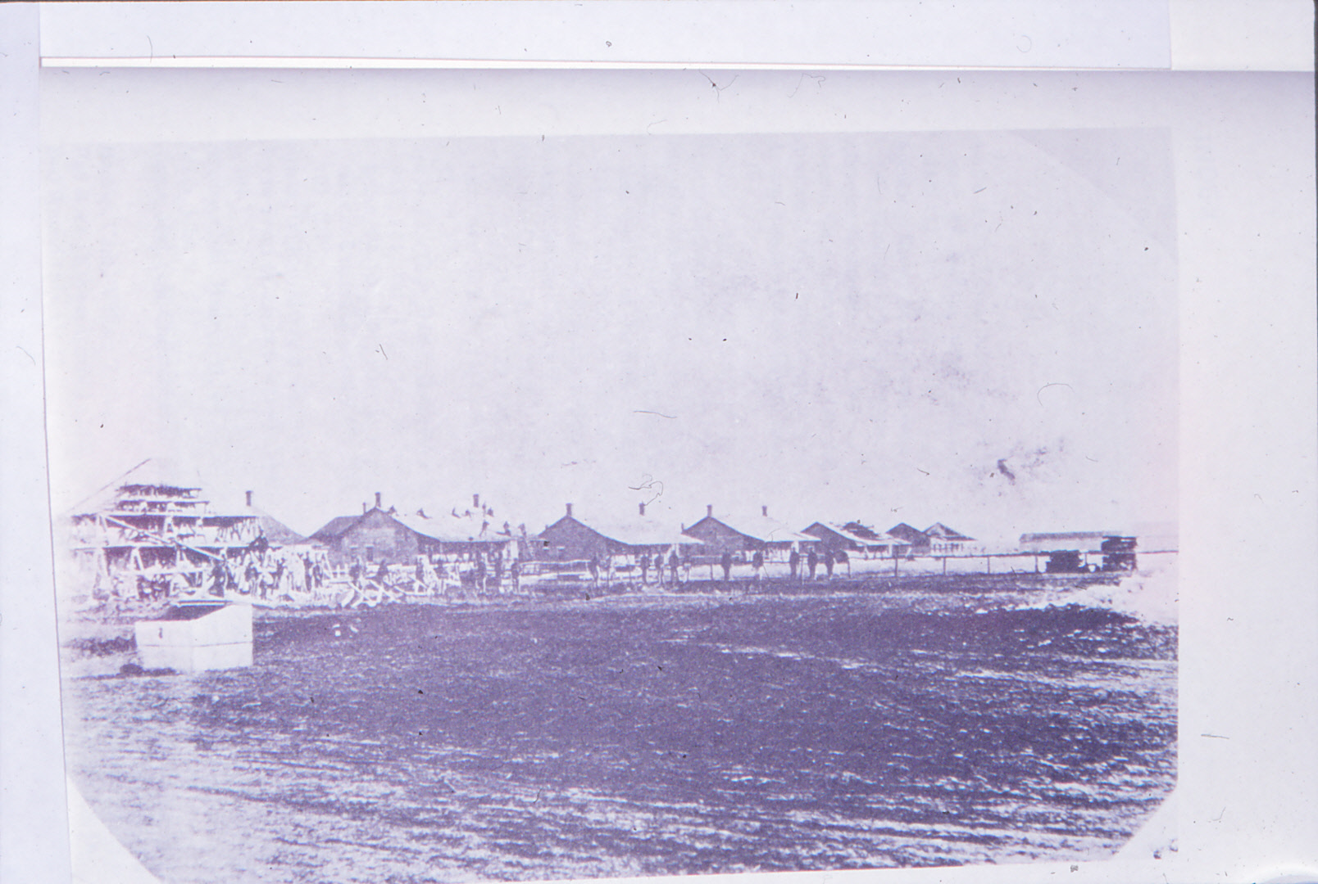
Fort Sill, OK Est. 1869

Slide 3
Post-Civil War
Frontier Forts
In Texas

Slide 4
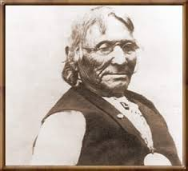
Parua Suumaru, Ten Bears, Yamparika

Slide 5
Native American Groups
Plains Indians Scouts
Comanches (northern) Delawares
Kiowas and Kiowa Apaches Tonkawas
Cheyennes Seminoles
Arapahos Comanches (southern)

Slide 6
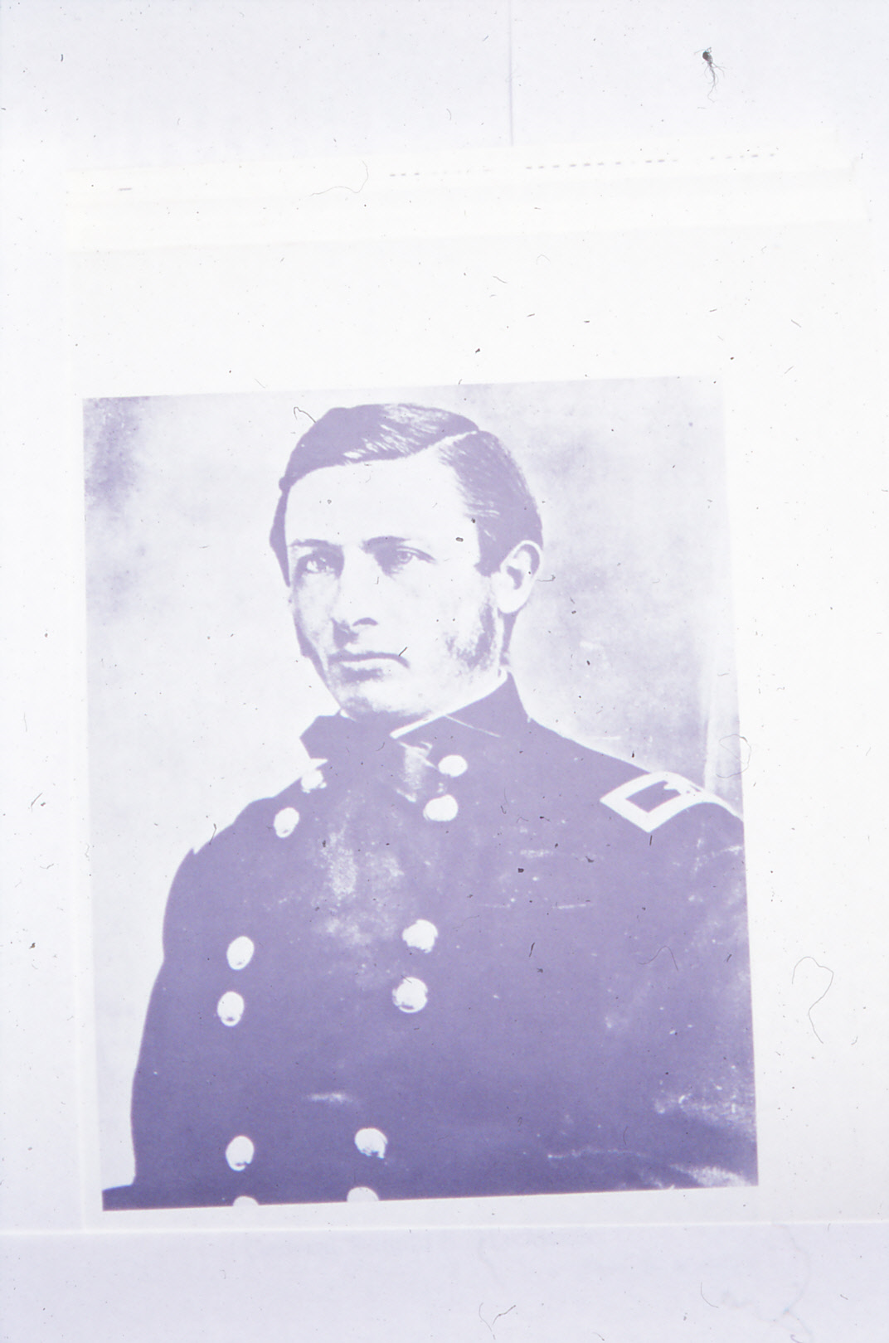
Col. Ranald S. Mackenzie “Bad Hand”

Slide 7
Battle of Blanco Canyon
Crosby County, Texas
October 9-15, 1871

Slide 8
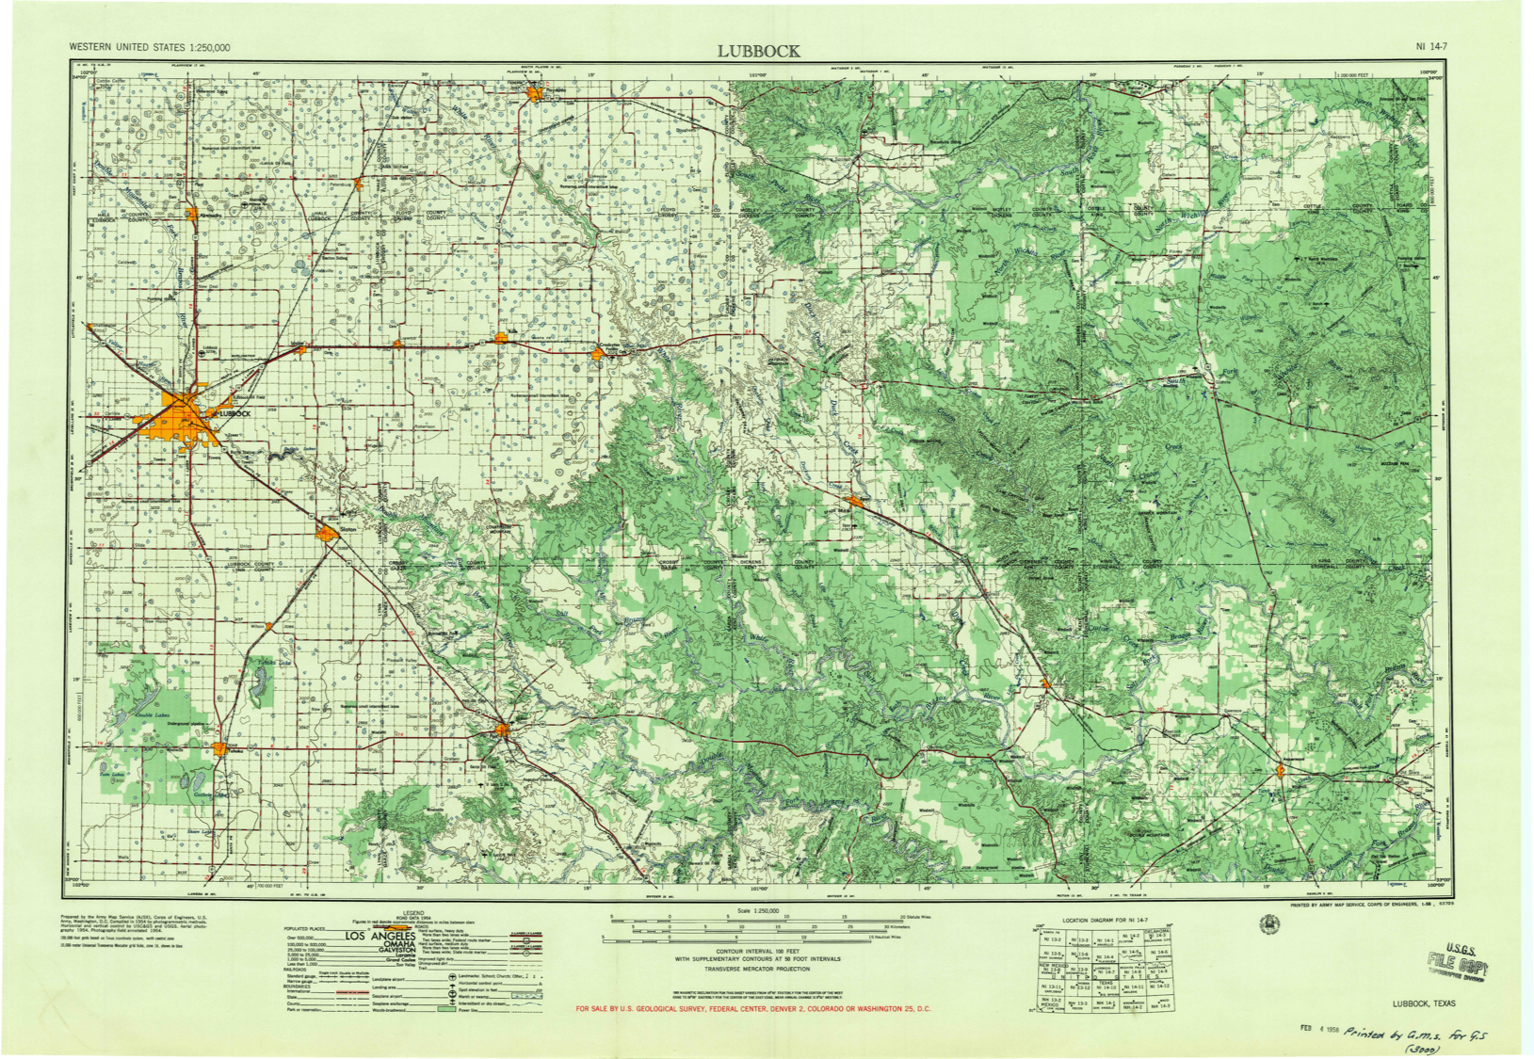

Slide 9
(First) Battle of McClellan Creek aka Battle of the North Fork of Red River
Gray County, Texas
September 29, 1872
Mowway

Slide 10
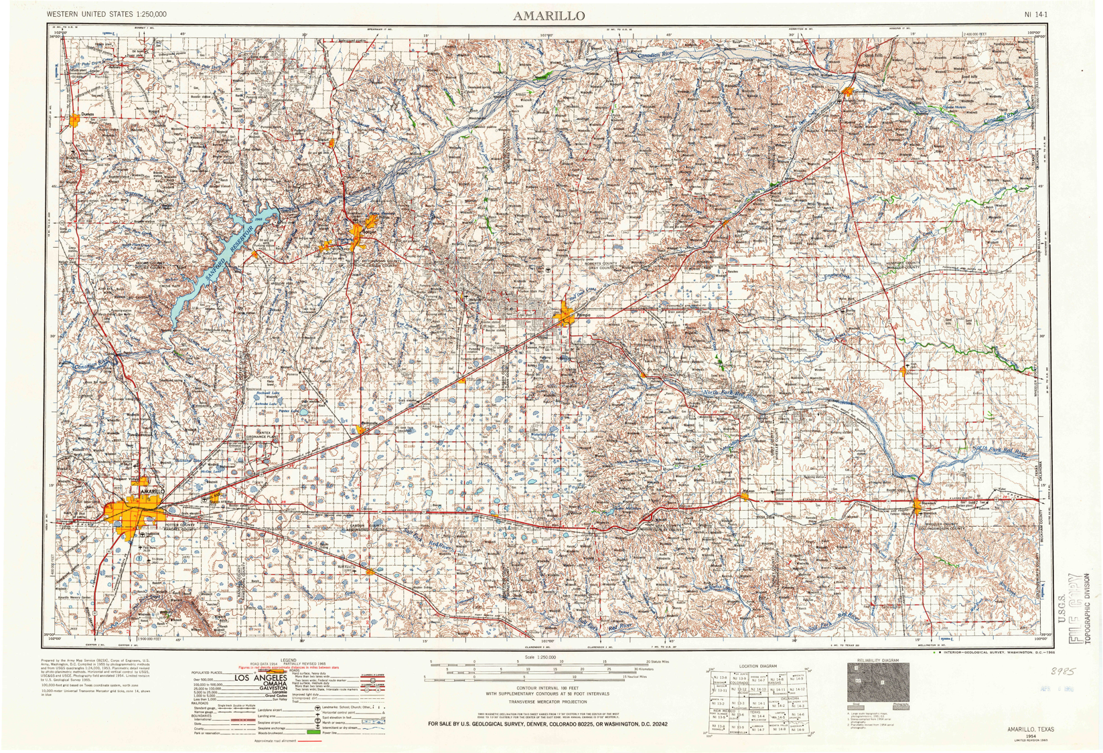

Slide 11
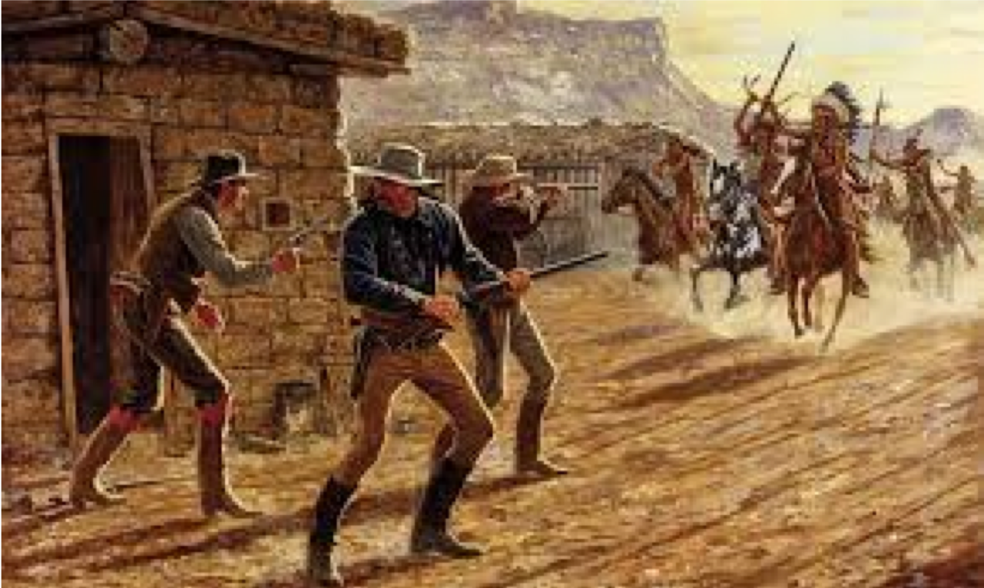
Second Battle of Adobe Walls June 27, 1874

Slide 12
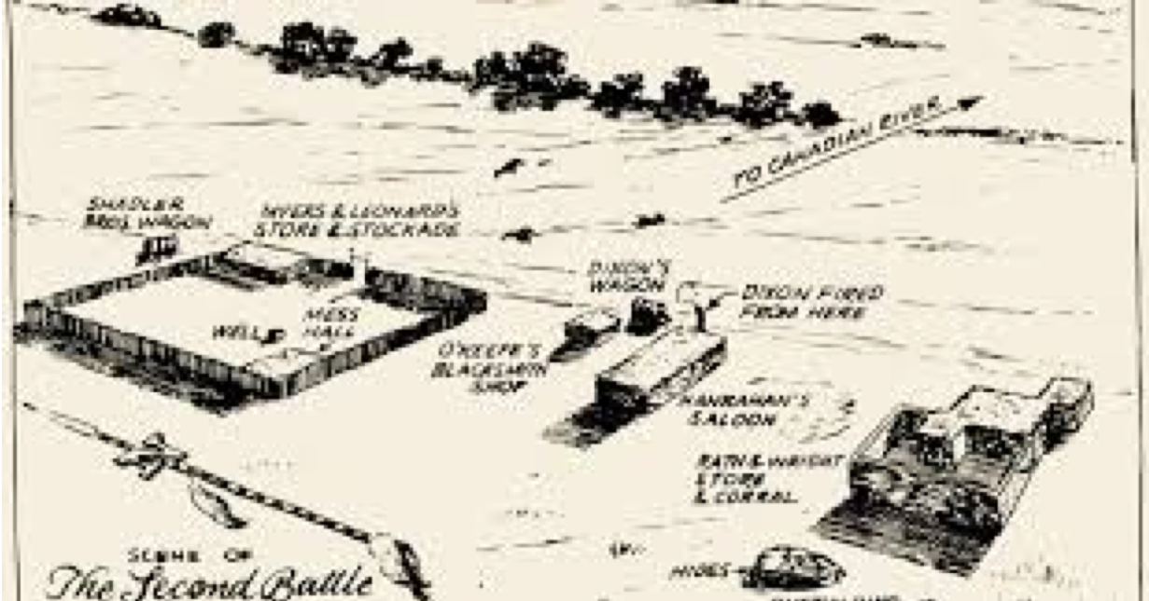

Slide 13
Second Battle of Adobe Walls June 27, 1874
Quanah
Quenatosabit/Isatai

Slide 14
Second Battle of Adobe Walls June 27, 1874
Bat Masterson
Billy Dixon

Slide 15
Red River War
Fall 1874
Plan of Attack

Slide 16
Col. Nelson A. Miles
Battle of Red River
(Tule Canyon)
Armstrong and Briscoe counties
August 30, 1874
Vs. 400-600 Cheyennes

