Slide 1
Understanding and Teaching
The Red River War
Humanities Texas Online Program
Daniel J. Gelo, PhD
March 1, 2021

Slide 2
Why the Red River War is good to teach
-Lots of documentation
-Combines archaeology, ethnology, geography, ethnogeography, primary and secondary historical sources
-Can be broken into individual episodes, personalities (20 engagements)
-Can be extended to include preceding events and contributing factors, e.g. annihilation of buffalo (I will do some of this)

Slide 3
Why the Red River War is good to teach
-Introduces different viewpoints of participant observation: officers, enlisted men, buffalo soldiers, Native combatants, Native non-combatants, Hispanic traders (Comancheros), captives (the German sisters)
-Illustrates the complexity of Native identities: Comanches, Kiowas, Cheyennes, Arapahos, Tonkawas and Delawares, Seminole scouts
-Was a decisive series of battles, so opens discussion of Manifest Destiny, “winning of the west,” the reservation system, adoption of current state constitution, before-and after contrasts (on the Southern Plains; took longer on the Northern Plains)

Slide 4
Essential Question:
How can oral history, geography, and archaeology enliven the study of Indian conflict in Texas?

Slide 5
TEKS
Social Studies 7th Grade §113.19
“6 (A) “identify significant individuals, events, and issues, including the factors leading to the expansion of the Texas frontier, the effects of westward expansion on American Indians, the buffalo soldiers, and Quanah Parker”
1 (A) Major era
2 (F) Contrast purposes and methods of settlement
8 Geography
18 (B) Cultural heritage maintenance and adaptation

Slide 6
TEKS
High School §113.48
Social Studies Research Methods
Examples:
2 (E) “use information from sources that take into account multiple perspectives”
3 (C) “investigate, interpret, and analyze multiple historical and contemporary viewpoints within and across cultures”

Slide 7
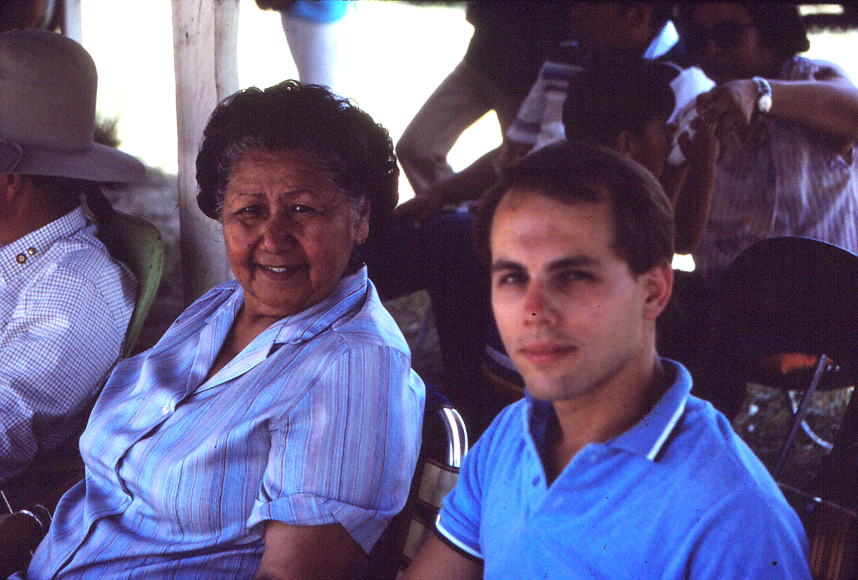

Slide 8
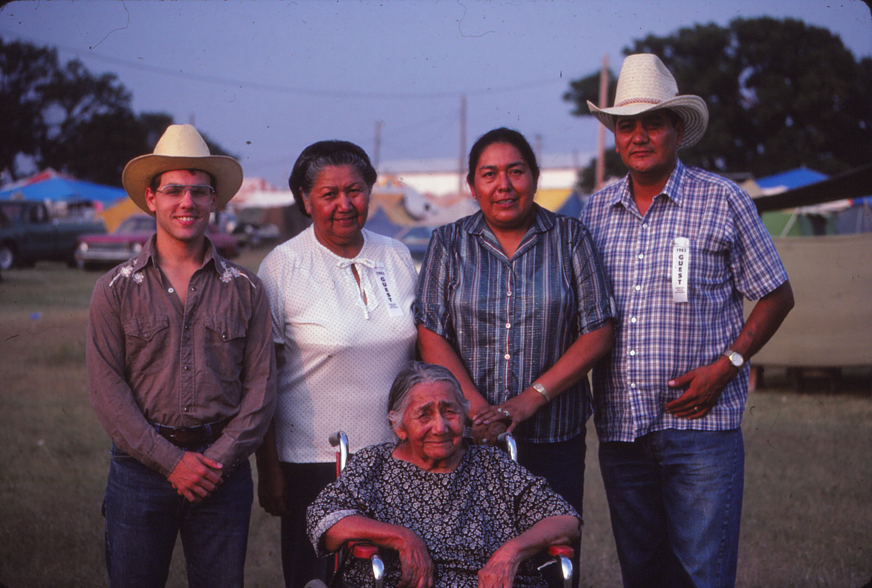

Slide 9
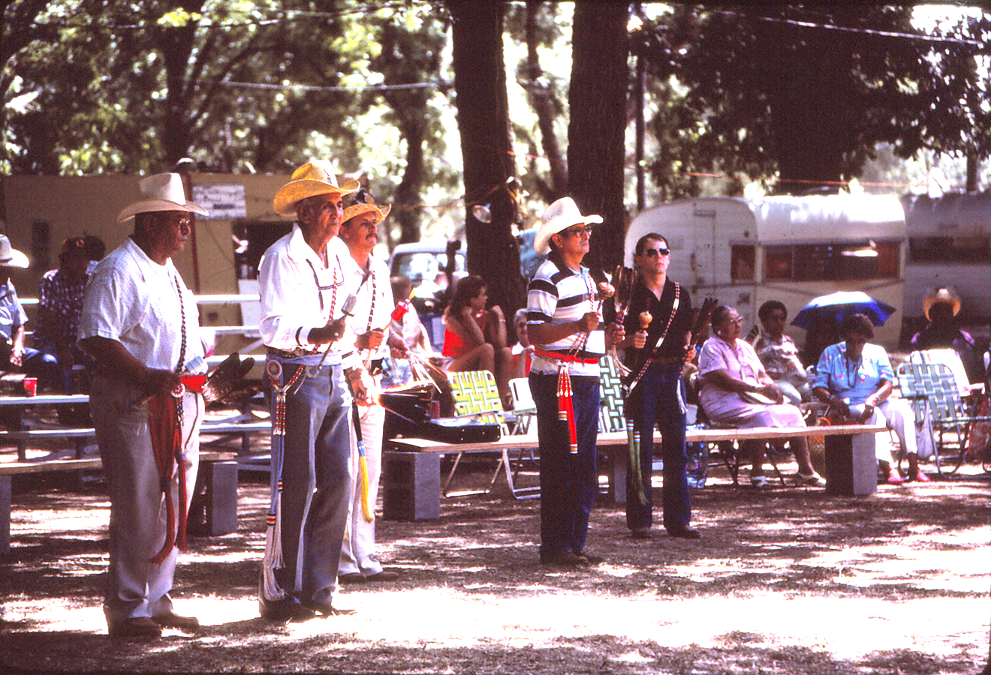

Slide 10
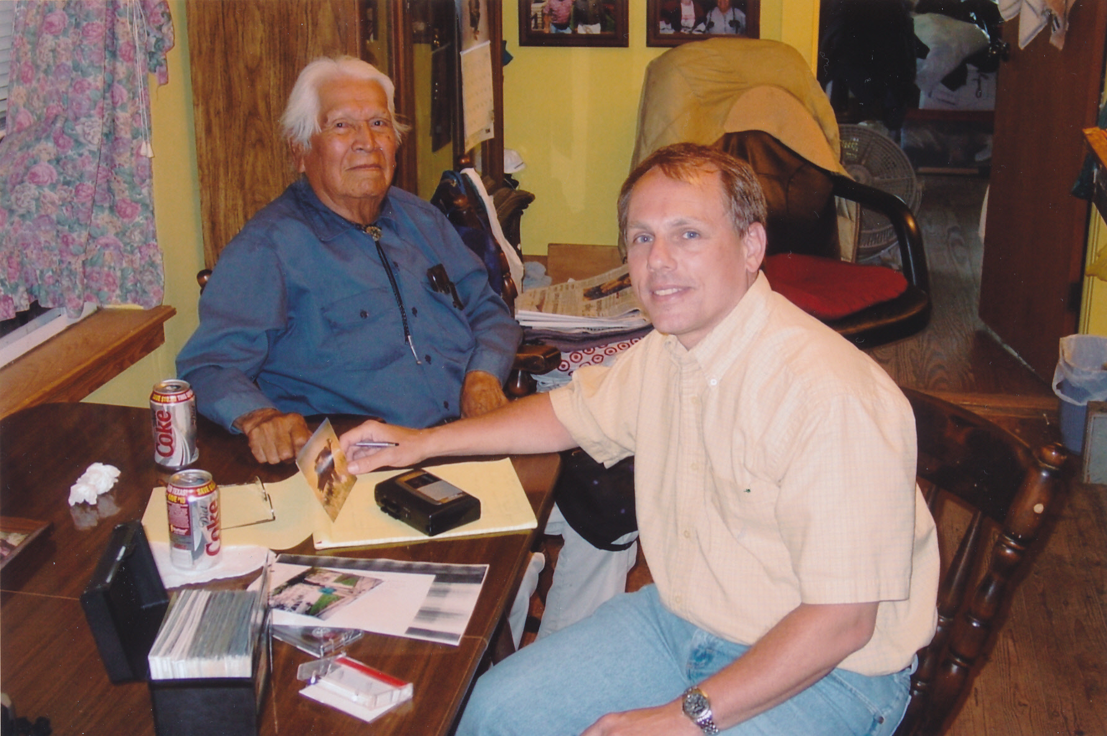

Slide 11
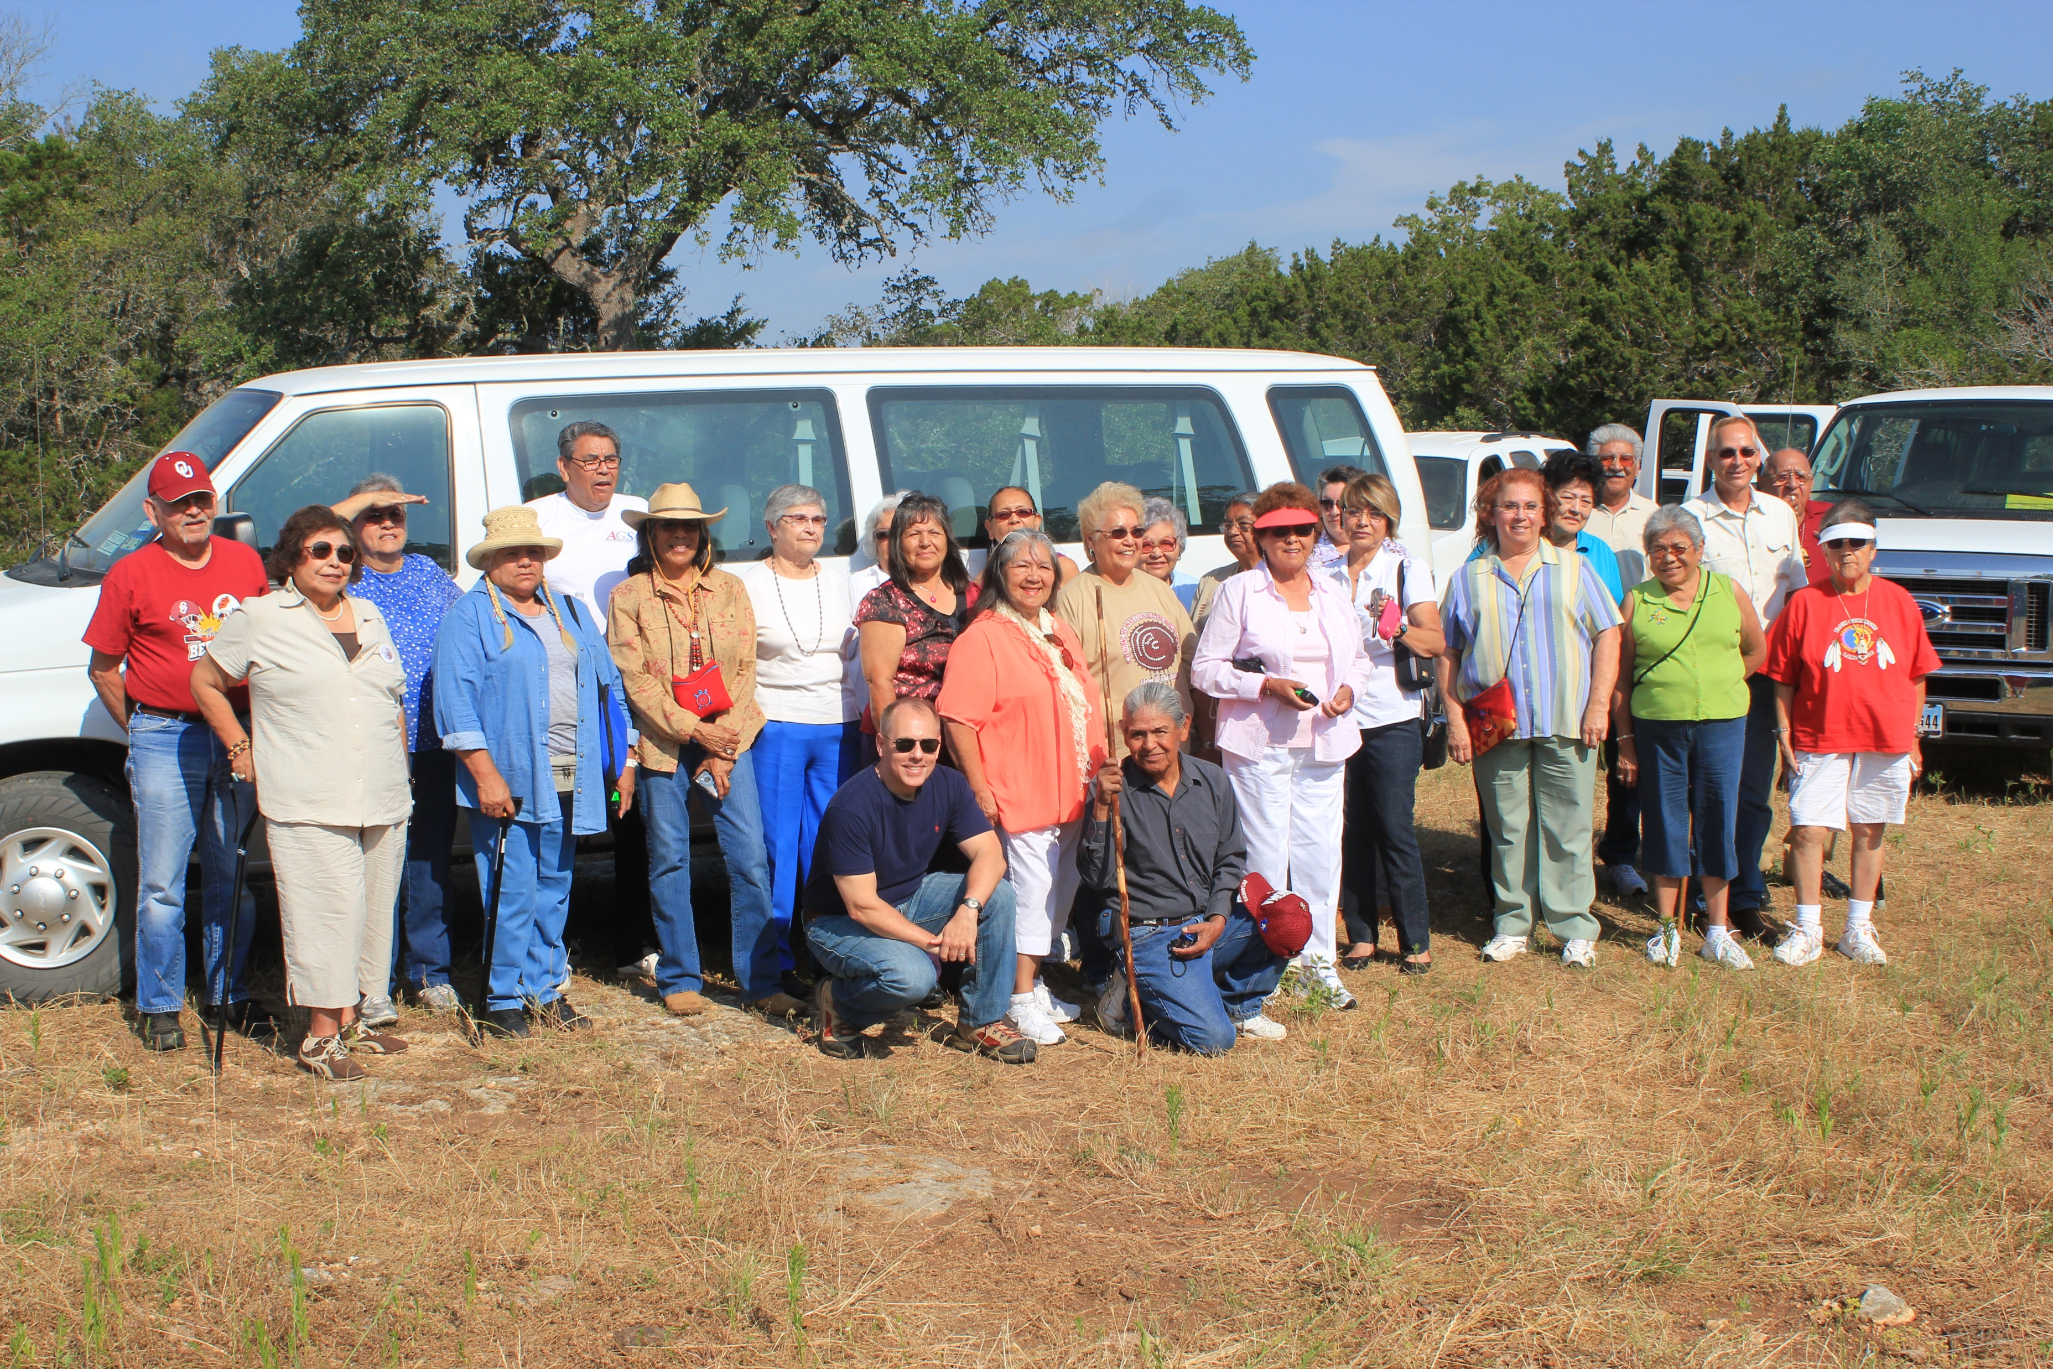

Slide 12
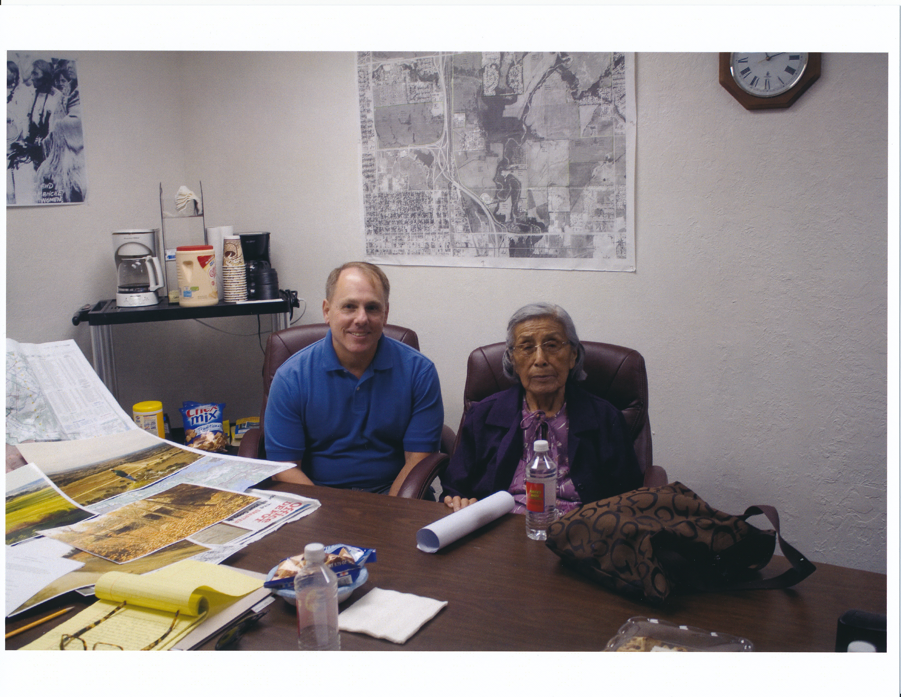

Slide 13
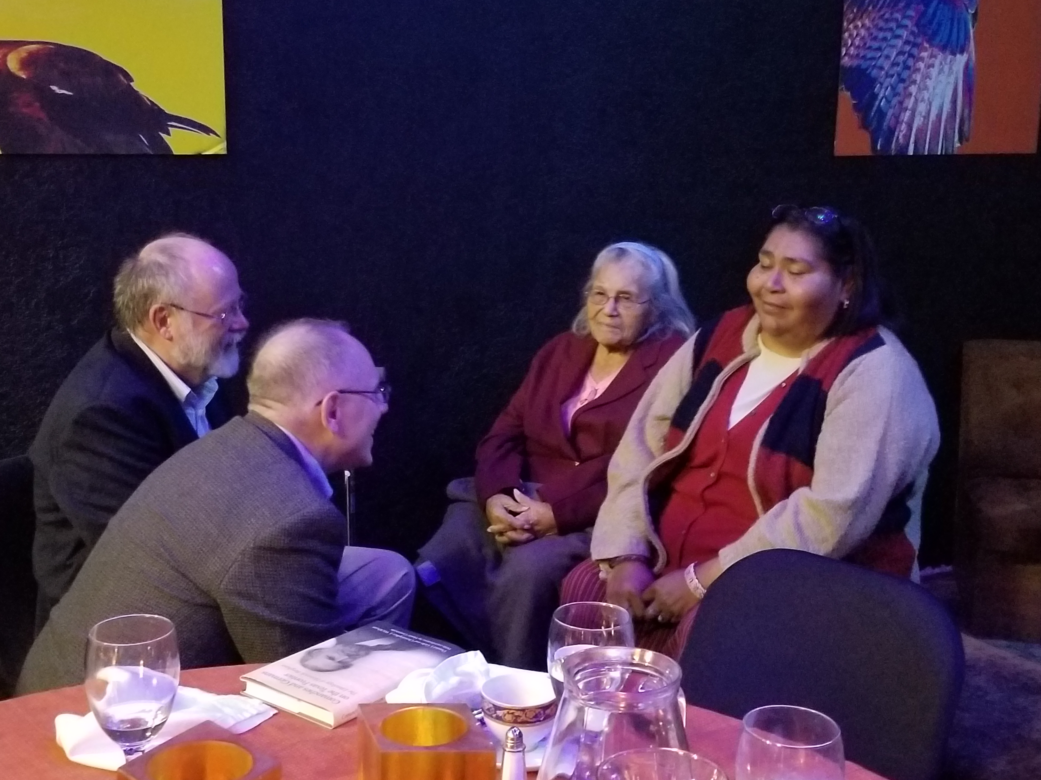

Slide 14
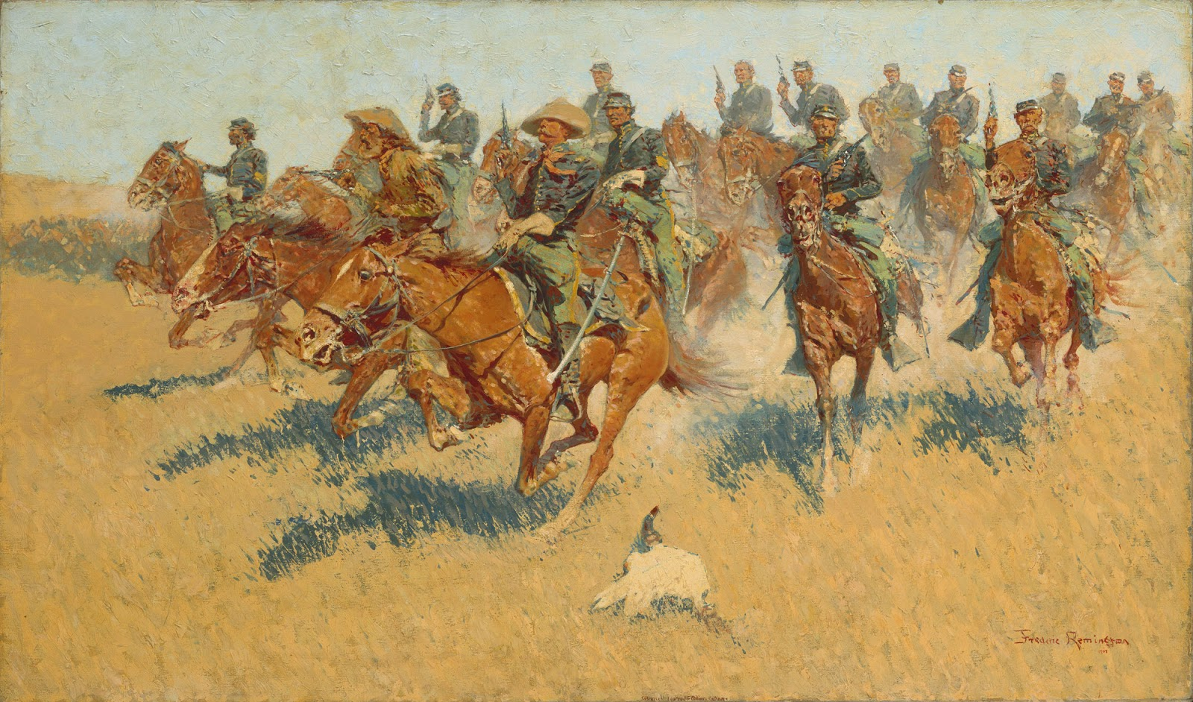

Slide 15
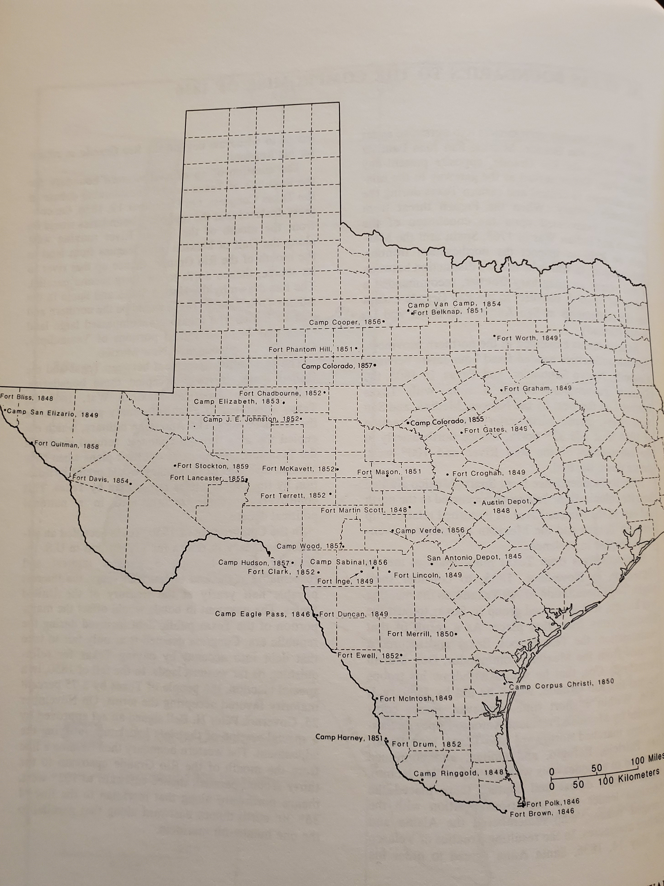

Slide 16
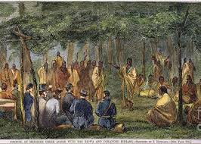
Medicine Lodge Treaty October 1867

