Slide 1
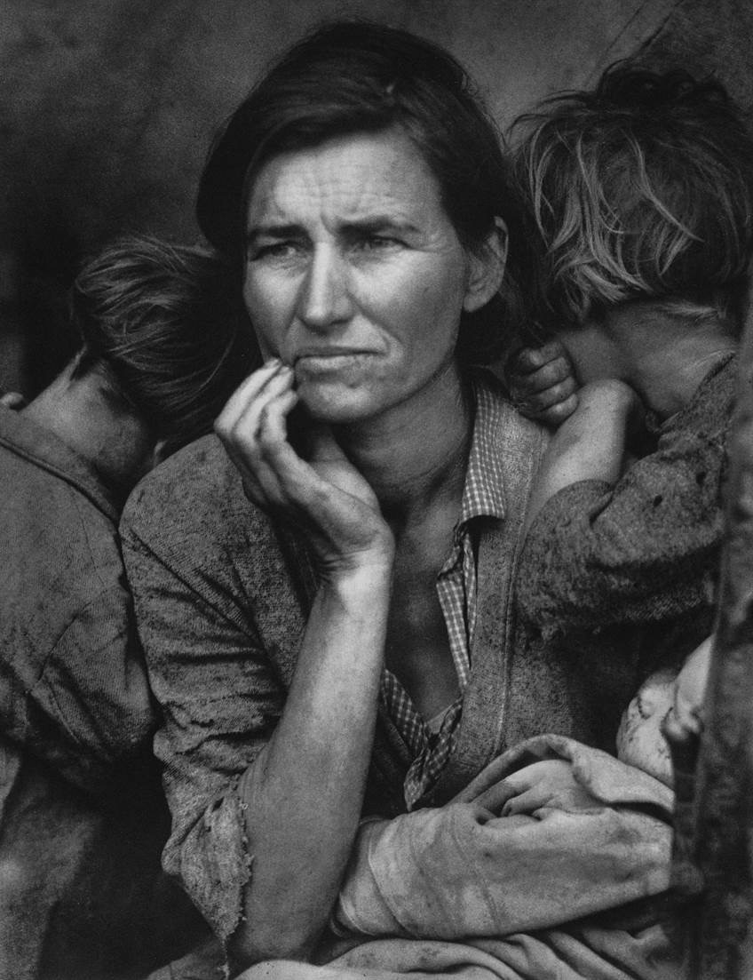
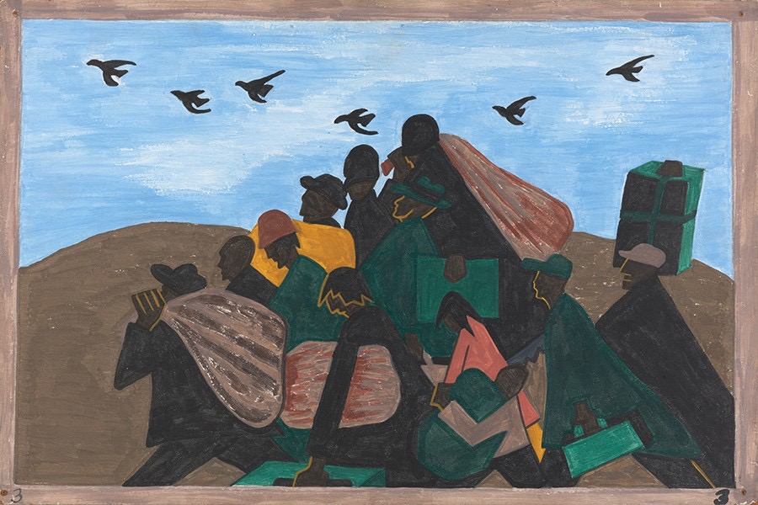
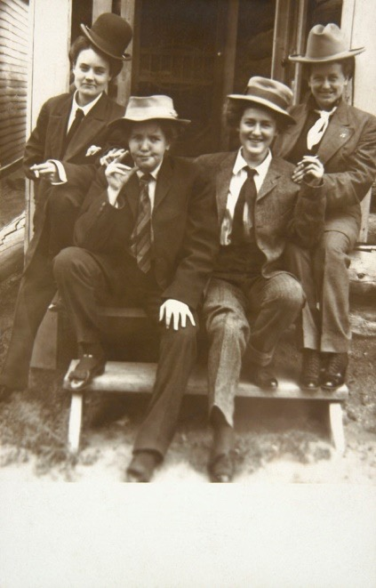
American Art: 1920­­-1939

Slide 2
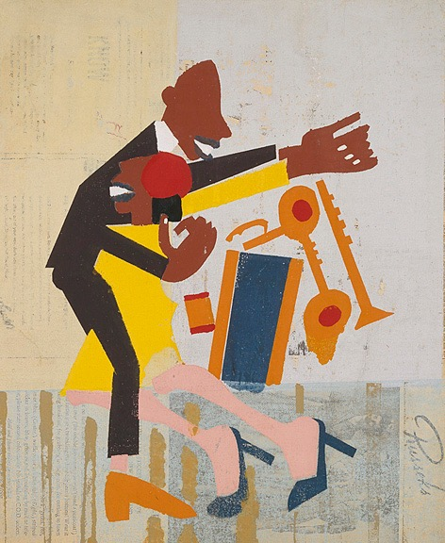
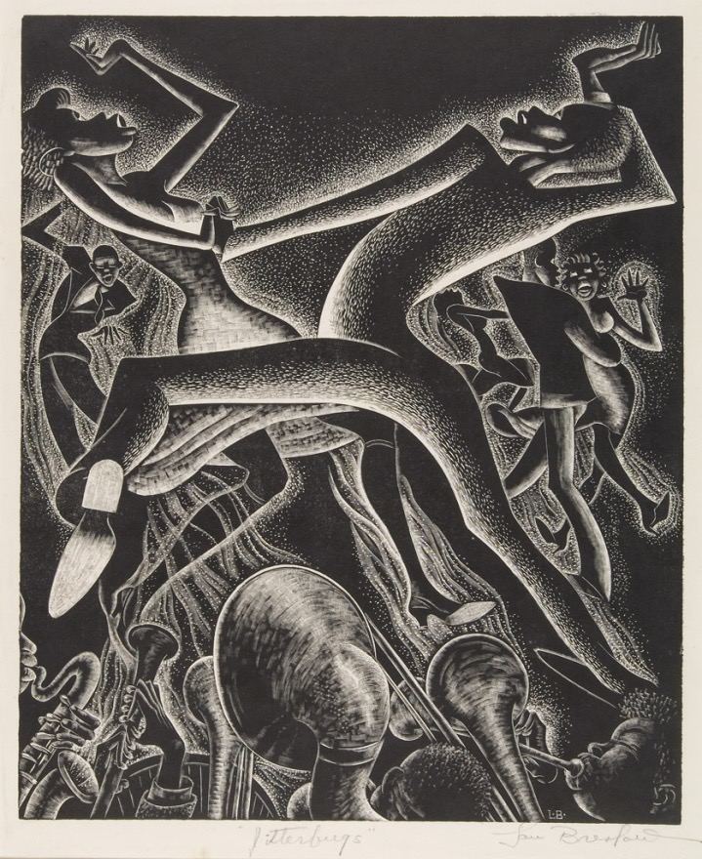
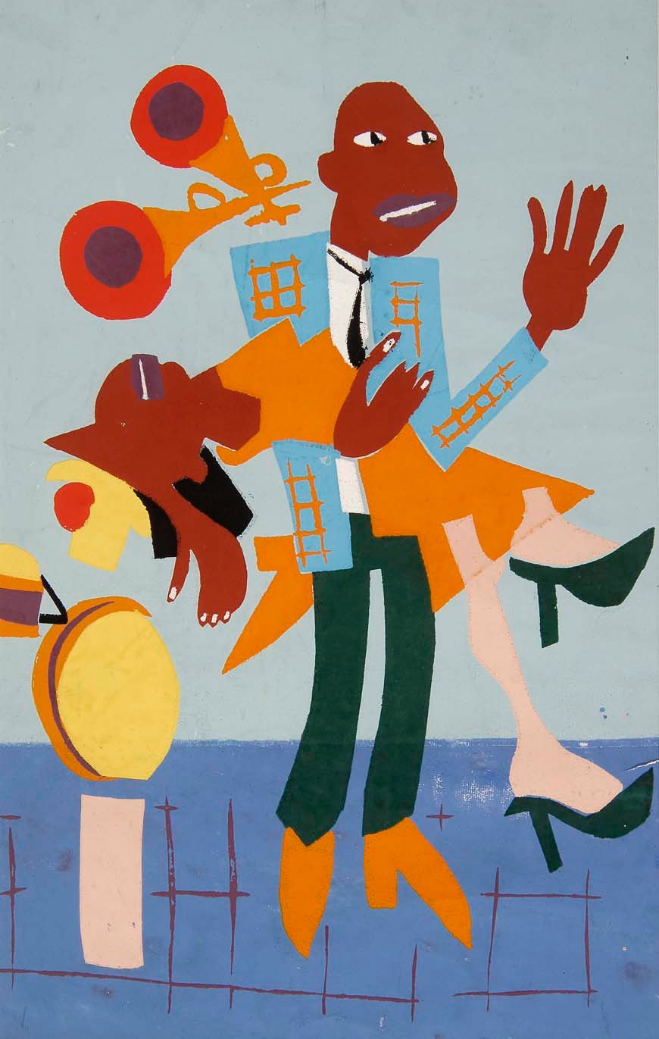
Helzapoppin (1941)
Present-Day Jitterbug
Notes:
Let’s begin this morning by talking about the jitterbug. According to Wikipedia, the jitterbug is a kind of dance popularized in the United States in the early twentieth century and is associated with various types of swing dances such as the Lindy Hop, jive, and East Coast Swing.
Now let’s add in a first-hand account by a young man learning to do the jitterbug in Pittsburgh, Pennsylvania, in 1939: “The hardest thing to learn is the pelvic motion. I suppose I always felt these motions are somehow obscene. You have to sway, forwards and backwards, with a controlled hip movement, while your shoulders stay level and your feet glide along the floor. Your right hand is held low on the girl's back, and your left hand down at your side, enclosing her hand.”
Now let’s add in a few prints by Harlem Renaissance artists showing the jitterbug in action.
Next, let’s look at a portion of a clip of the jitterbug from the 1941 film Helzapoppin.
Finally, let’s watch a portion of a clip of the jitterbug from a recent dance competition.
I want you to think back to the first description I read of the jitterbug and then how your understanding of the dance increased as I added in different perspectives. There are many reasons to include artworks in your history classes from the fact that it’s a requirement from state and national teaching standards to that it helps students who are visual learners. I believe that incorporating multiple perspectives, in addition to textbook information, brings history topics to life and makes them more memorable and understandable.

Slide 3
Notes:
You do not need to have a degree in art history to incorporate images into your daily history curriculum. As history teachers, you already possess knowledge that will help provide context for your students as they look at and interpret works of art. I understand that you may not have the time to find and research images related to your curriculum. To help with this challenge, I have provided resources related to this teaching institute. [Quickly go through resources]
This morning we will look closely at two topics---the Great Migration and Great Depression---and we will discuss the ties between literature and art of the Harlem Renaissance during the afternoon workshops.

Slide 4
I pick up my life
And take it away
On a one-way ticket—
Gone up North,
Gone out West,
Gone!
—Langston Hughes
Notes:
Following the outbreak of World War I, over a million African-Americans migrated from the rural south to northern industrial and urban centers in search of employment and better living conditions. Called the Great Migration, this movement brought numerous African-Americans to Harlem in Northern Manhattan.

Slide 5
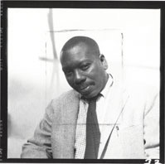
Notes:
Through a series of paintings called The Great Migration Jacob Lawrence (seen here) illustrates the mass exodus of African-Americans who moved to the North in search for a better life. Lawrence's parents were among those who migrated between 1916 and 1919, which is considered the first wave of the migration. (Lawrence arrived in Harlem when he was thirteen.) Since it was almost impossible then for black Americans to attend regular art academies, the art schools and workshops of Harlem provided crucial training for the majority of black artists in the United States.

Slide 6
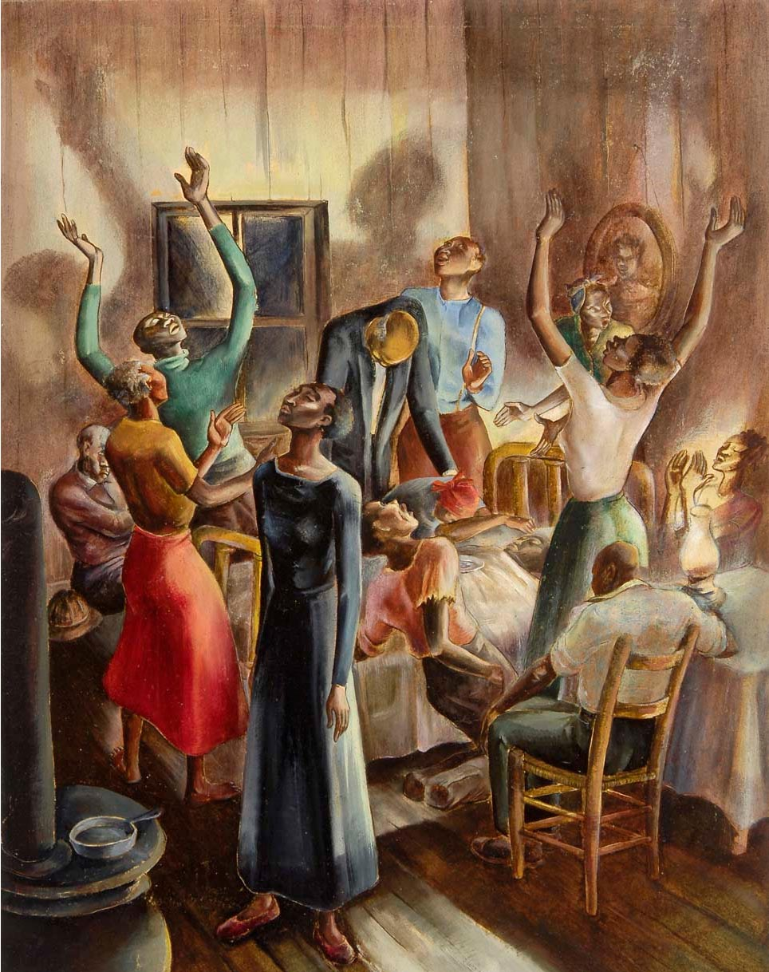
Notes:
Lawrence was one of the first artists trained in and by the African-American community in Harlem. He received his earliest art instruction from Charles Alston at Utopia Children's House, a community daycare center that Lawrence attended after school. Charles Alston (whose work Midnight Vigil is seen here) was one of the most important and influential art teachers in Harlem during the 1930s and 40s. He offered instruction in his own studio and at the Harlem Community Art Center. Opened in 1937, the Center was established under the New Deal to offer free instruction in the arts and crafts for children and adults. It provided unique opportunities for artists to work in a variety of media, including painting, sculpture, printmaking, and photography.
Charles Alston (1907–1977), Midnight Vigil, ca. 1936, watercolor on paper, © The Harmon and Harriet Kelley Collection

Slide 7
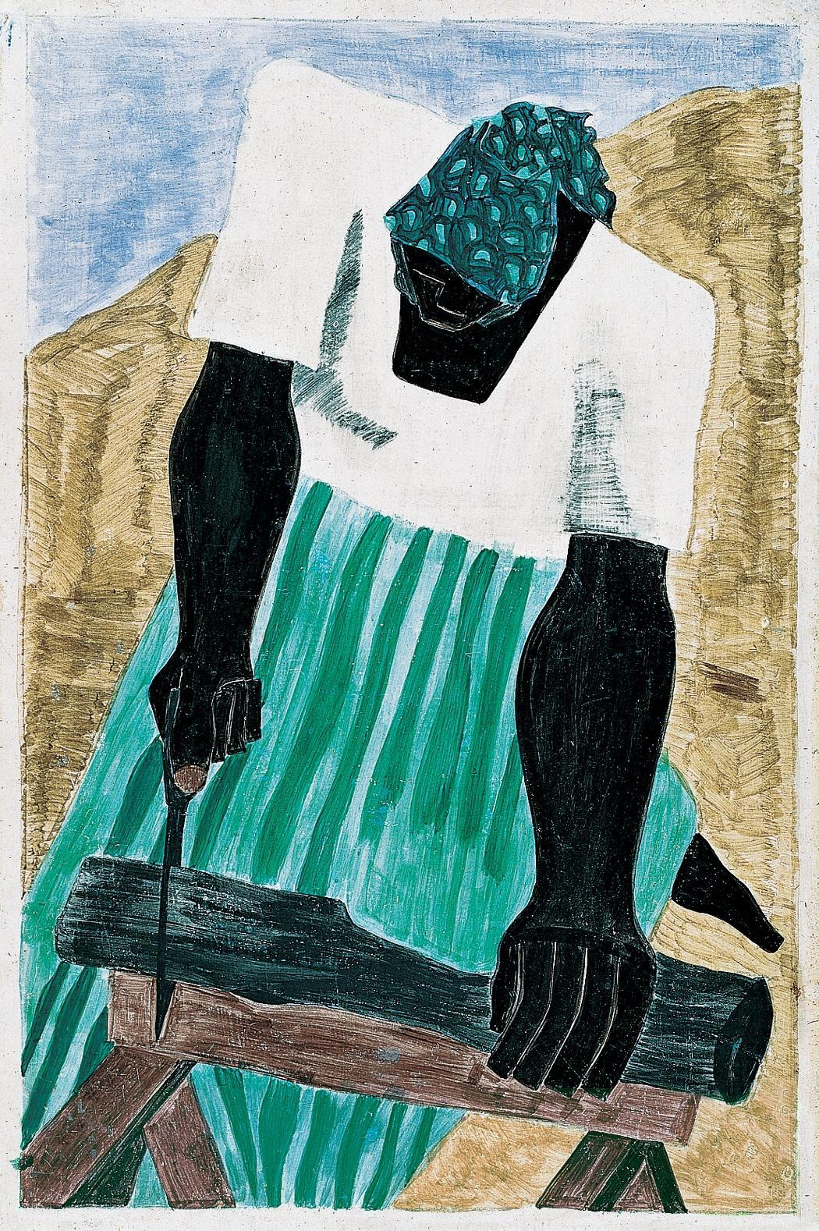
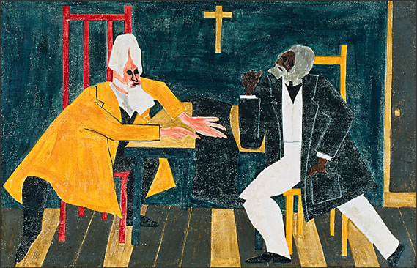
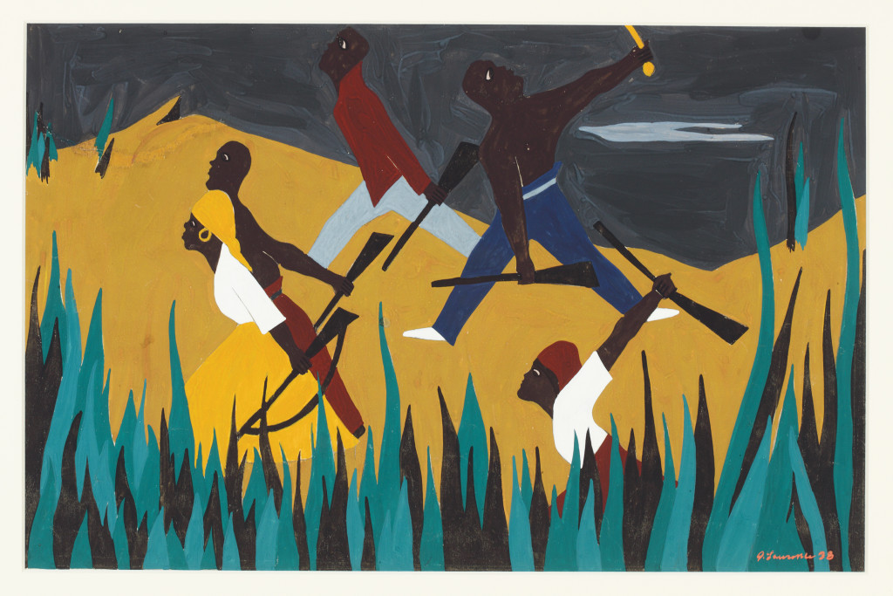
Notes:
Beginning in 1936, Lawrence completed three series that addressed similar themes of struggle, hope, triumph, and adversity. The series focused on narrative portraits of Harriet Tubman, leader of the Underground Railroad (1940); abolitionist Frederick Douglass (1939); and Toussaint L’Ouverture, liberator of Haiti (1938).
Left: Jacob Lawrence (1917–2000), Harriet Tubman Series No. 7, 1940, casein tempera on hardboard, Hampton University Museum, Hampton, Virginia
Upper right: Jacob Lawrence (1917–2000), No. 24 John Brown discussed with Frederick Douglass his plan to attach Harper’s Ferry, an arsenal of the United States Government. Brown’s idea was to attack the arsenal and seize the guns. Douglass argued against this plan, his reason being that the abolishment of slavery should not occur through revolution., 1939
Lower right: Jacob Lawrence (1917–2000), To Preserve Their Freedom, Toussaint L’Ouverture Series, 1938

Slide 8
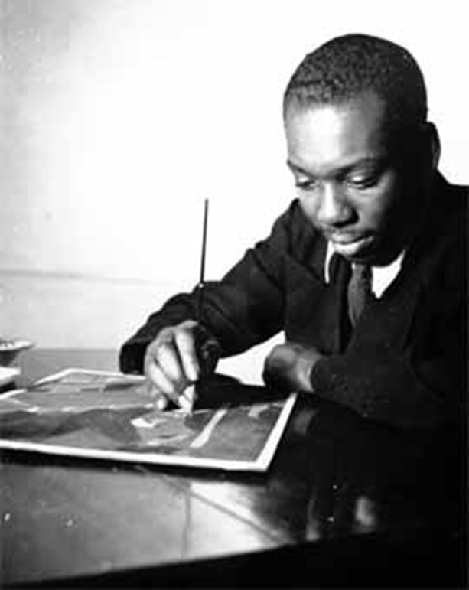
Notes:
In late 1939, after completing these major series on historical African-American figures, Lawrence’s idea for a series on the Great Migration would serve as the basis for a grant application he submitted to the Julius Rosenwald Fund. On April 17, 1940, he received word that he had been selected to receive a grant of $1,500 to assist him in carrying forward his painting for one year. The grant allowed him for the first time to establish his own studio, a space large enough to spread out all sixty hardboard panels he intended for the series at once.

Slide 9
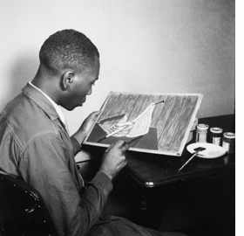
Notes:
Lawrence himself was not a direct witness to the migration, and by his own admission, this was a broad and complex subject to tackle in paint, one never before attempted in the visual arts. He found a way to tell his own story through the power and vibrancy of the painted image, weaving together 60 same-sized panels into one grand epic statement. Before painting the series, he first immersed himself in the history, studying the Migration at the Schomburg Center for Research in Black Culture at the 135th Street branch of the New York Public Library, and he wrote captions that would accompany each panel.
Only then did he undertake the process of---in his own words---“careful selection, simplification and distillation” to crystallize his ideas for the series into the words of the caption phrases and preparatory drawings. Assisted by the artist Gwendolyn Knight, whom he would marry the following year, he brushed several layers of a rabbit-skin-glue gesso onto each hardboard panel and sanded them smooth once they were dry. Then, after transferring his drawings onto the gesso, he filled the panels with bold color, building up forms in alternating vertical and horizontal compositions. To unify the color throughout, he applied one color at a time to all sixty panels, moving from dark hues to light. In this way he conveyed a sense of the series as one unit rather than as sixty separate panels.
Now I want to quickly show you all sixty of the panels in order with the captions that Lawrence created. As I do, I would like you to write down any recurring elements that you see and think about how they reinforce Lawrence’s story of the Great Migration.

Slide 10
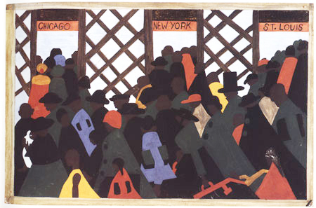
Notes:
The Great Migration Series: Panel 1
“During the World War there was a great migration North by Southern Negroes.” –Jacob Lawrence

Slide 11
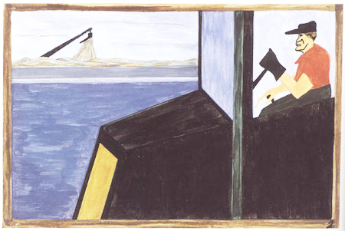
Notes:
The Great Migration Series: Panel 2
“The World War had caused a great shortage in Northern industry and also citizens of foreign countries were returning home.” –Jacob Lawrence

Slide 12
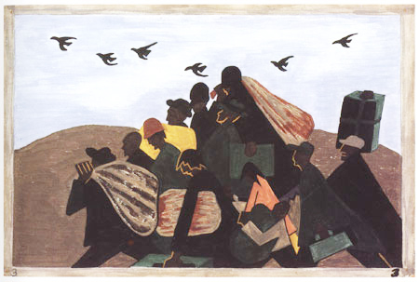
Notes:
The Great Migration Series: Panel 3
“In every town Negroes were leaving by the hundreds to go North and enter into Northern industry.” –Jacob Lawrence

Slide 13
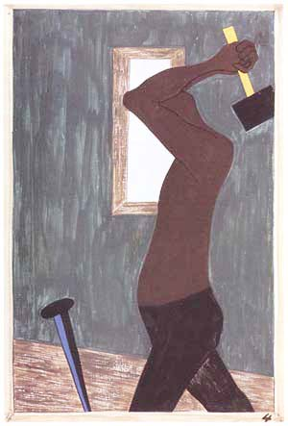
Notes:
The Great Migration Series: Panel 4
“The Negro was the largest source of labor to be found after all others had been exhausted.” –Jacob Lawrence

Slide 14
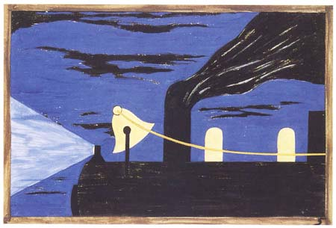
Notes:
The Great Migration Series: Panel 5
“The Negroes were given free passage on the railroads which was paid back by Northern industry. It was an agreement that the people brought North on these railroads were to pay back their passage after they had received jobs.” –Jacob Lawrence

Slide 15
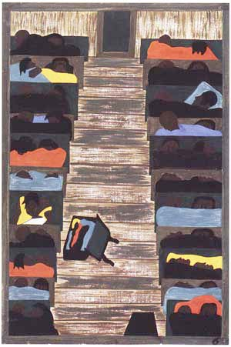
Notes:
The Great Migration Series: Panel 6
“The trains were packed continually with migrants.” –Jacob Lawrence

Slide 16
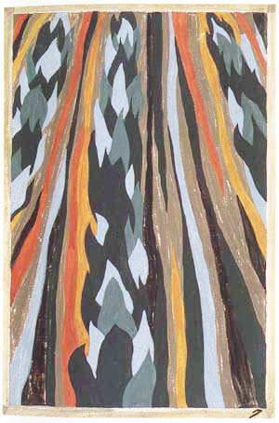
Notes:
The Great Migration Series: Panel 7
“The Negro, who had been part of the soil for many years, was now going into and living a new life in urban centers.” –Jacob Lawrence

Slide 17
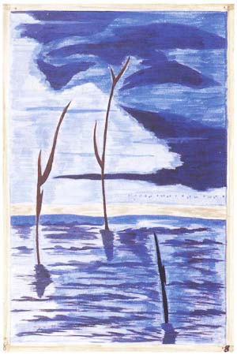
Notes:
The Great Migration Series: Panel 8
“They did not always leave because they were promised work in the North. Many of them left because of Southern conditions, one of them being great floods that ruined the crops, and therefore they were unable to make a living where they were.” –Jacob Lawrence

Slide 18
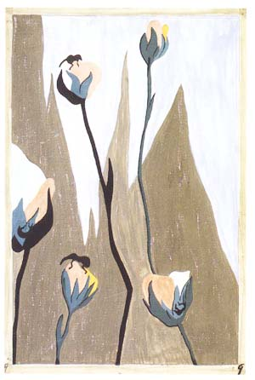
Notes:
The Great Migration Series: Panel 9
“Another great ravager of the crops was the boll weevil.” –Jacob Lawrence

Slide 19
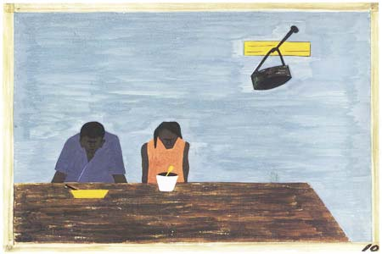
Notes:
The Great Migration Series: Panel 10
“They were very poor.” –Jacob Lawrence

Slide 20
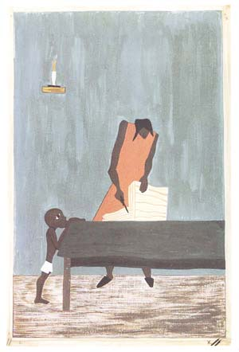
Notes:
The Great Migration Series: Panel 11
“In many places, because of the war, food had doubled in price.” –Jacob Lawrence

Slide 21
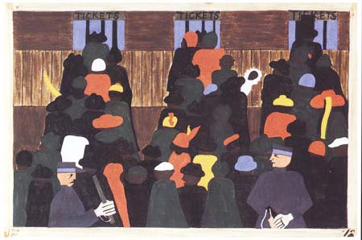
Notes:
The Great Migration Series: Panel 12
“The railroad stations were at times so over-packed with people leaving that special guards had to be called in to keep order.” –Jacob Lawrence

Slide 22
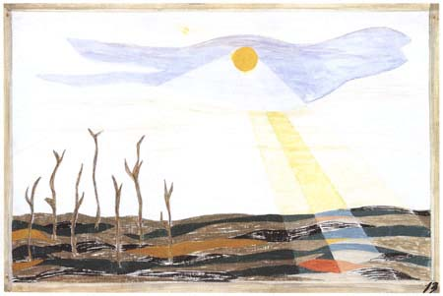
Notes:
The Great Migration Series: Panel 13
“Due to the South’s losing so much of its labor, the crops were left to dry and spoil.” –Jacob Lawrence

Slide 23
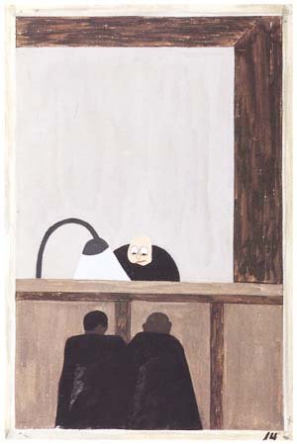
Notes:
The Great Migration Series: Panel 14
“Among the social conditions that existed which was partly the cause of the migration was the injustice done to the Negroes in the courts.” –Jacob Lawrence

Slide 24
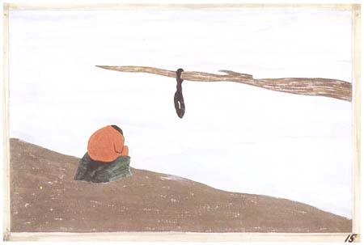
Notes:
The Great Migration Series: Panel 15
“Another cause was lynching. It was found that where there had been a lynching, the people who were reluctant to leave at first left immediately after this.” –Jacob Lawrence

Slide 25
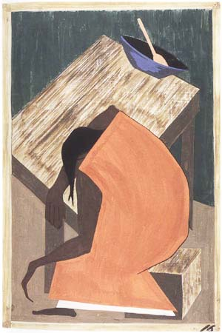
Notes:
The Great Migration Series: Panel 16
"Although the Negro was used to lynching, he found this an opportune time for him to leave where one had occurred.” –Jacob Lawrence

Slide 26
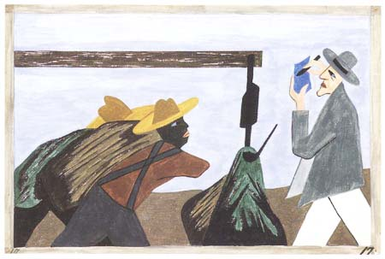
Notes:
The Great Migration Series: Panel 17
“The migration was spurred on by the treatment of the tenant farmers by the planter.” –Jacob Lawrence

Slide 27
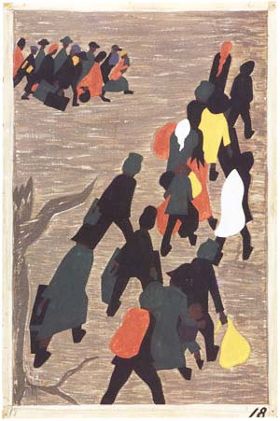
Notes:
The Great Migration Series: Panel 18
“The migration gained in momentum.” –Jacob Lawrence

Slide 28
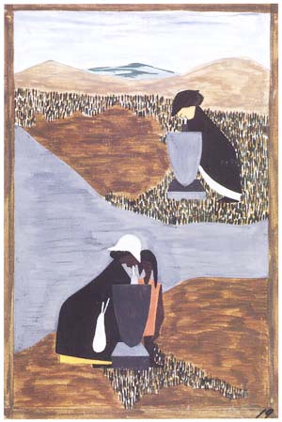
Notes:
The Great Migration Series: Panel 19
“There had always been discrimination.” –Jacob Lawrence

Slide 29
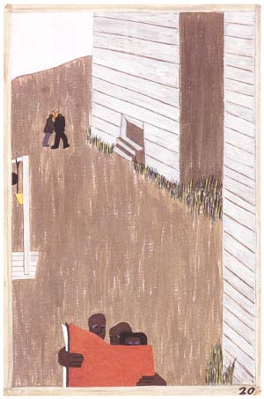
Notes:
The Great Migration Series: Panel 20
“In many of the communities the Negro press was read continually because of its attitude and its encouragement of the movement.” –Jacob Lawrence

Slide 30
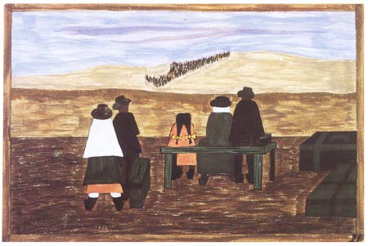
Notes:
The Great Migration Series: Panel 21
"Families arrived at the station very early in order not to miss their train North.” –Jacob Lawrence

Slide 31
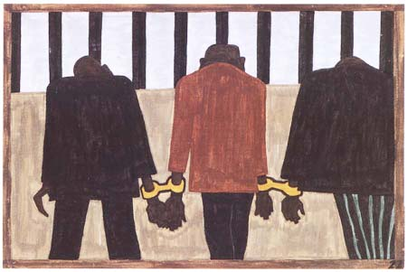
Notes:
The Great Migration Series: Panel 22
"Another of the social causes of the migrants’ leaving was that at times they did not feel safe, or it was not the best thing to be found on the streets late at night. They were arrested on the slightest provocation.” –Jacob Lawrence

Slide 32
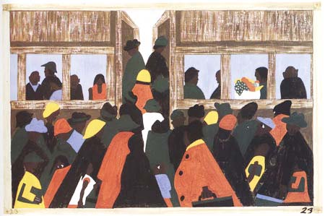
Notes:
The Great Migration Series: Panel 23
“And the migration spread.” –Jacob Lawrence

Slide 33
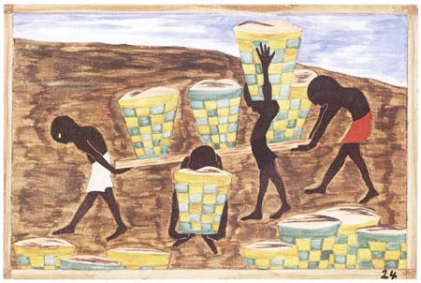
Notes:
The Great Migration Series: Panel 24
“Child labor and a lack of education was one of the other reasons for people wishing to leave their homes.” –Jacob Lawrence

Slide 34
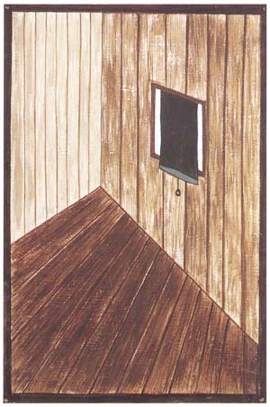
Notes:
The Great Migration Series: Panel 25
“After a while some communities were left almost bare.” –Jacob Lawrence

Slide 35
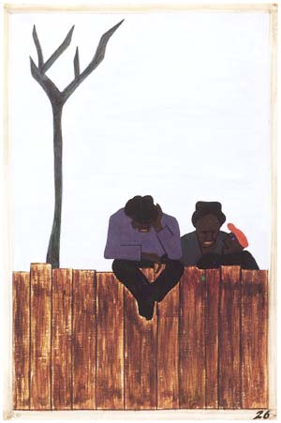
Notes:
The Great Migration Series: Panel 26
“And people all over the South began to discuss this great movement.” –Jacob Lawrence

Slide 36
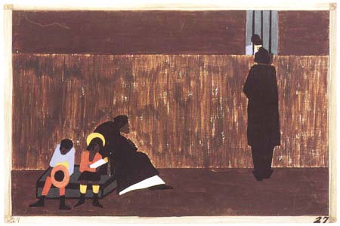
Notes:
The Great Migration Series: Panel 27
“Many men stayed behind until they could bring their families North.” –Jacob Lawrence

Slide 37
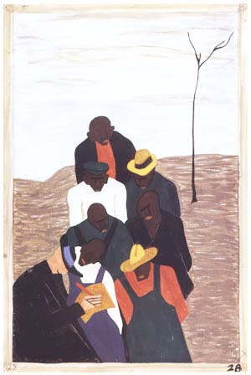
Notes:
The Great Migration Series: Panel 28
“The labor agent who had been sent South by Northern industry was a very familiar person in the Negro counties.” –Jacob Lawrence

Slide 38
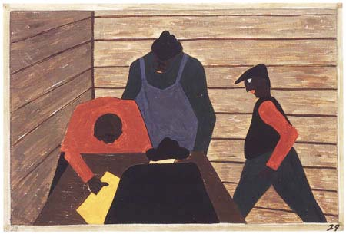
Notes:
The Great Migration Series: Panel 29
“The labor agent also recruited laborers to break strikes which were occurring in the North.” –Jacob Lawrence

Slide 39
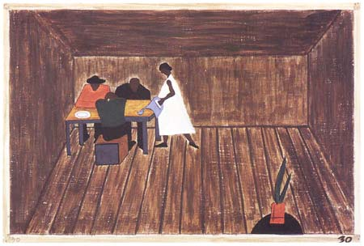
Notes:
The Great Migration Series: Panel 30
“In every home people who had not gone North met and tried to decide if they should go North or not.” –Jacob Lawrence

Slide 40
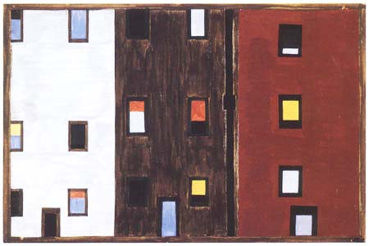
Notes:
The Great Migration Series: Panel 31
“After arriving North the Negroes had better housing conditions.” –Jacob Lawrence

Slide 41
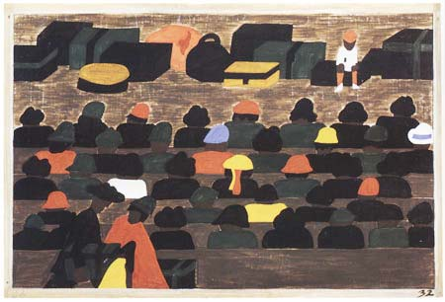
Notes:
The Great Migration Series: Panel 32
“The railroad stations in the South were crowded with people leaving for the North.” –Jacob Lawrence

Slide 42
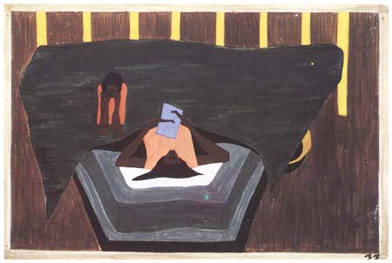
Notes:
The Great Migration Series: Panel 33
“People who had not yet come North received letters from their relatives telling them of the better conditions that existed in the North.” –Jacob Lawrence

Slide 43
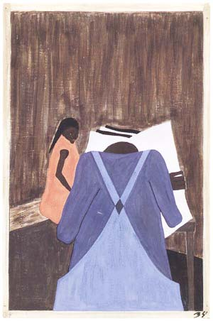
Notes:
The Great Migration Series: Panel 34
“The Negro press was also influential in urging the people to leave the South.” –Jacob Lawrence

Slide 44
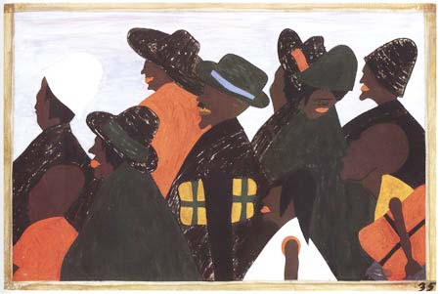
Notes:
The Great Migration Series: Panel 35
“They left the South in large numbers and they arrived in the North in large numbers.” –Jacob Lawrence

Slide 45
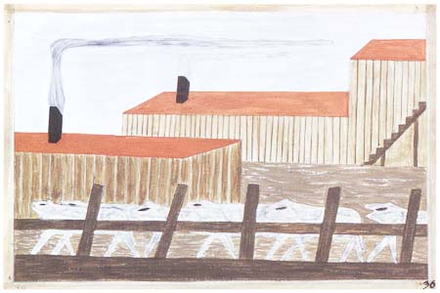
Notes:
The Great Migration Series: Panel 36
“They arrived in great numbers into Chicago, the gateway of the West.” –Jacob Lawrence

Slide 46
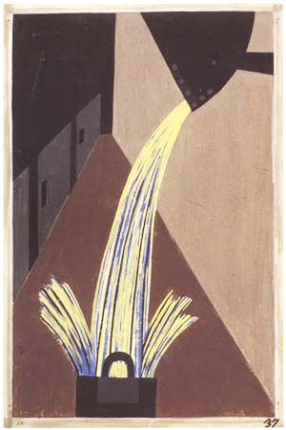
Notes:
The Great Migration Series: Panel 37
“The Negroes that had been brought North worked in large numbers in one of the principal industries, which was steel.” –Jacob Lawrence

Slide 47

Notes:
The Great Migration Series: Panel 38
“They also worked in large numbers on the railroad.” –Jacob Lawrence

Slide 48

Notes:
The Great Migration Series: Panel 39
“Luggage crowded the railroad platforms.” –Jacob Lawrence

Slide 49

Notes:
The Great Migration Series: Panel 40
“The migrants arrived in great numbers.” –Jacob Lawrence

Slide 50

Notes:
The Great Migration Series: Panel 41
“The South that was interested in keeping cheap labor was making it very difficult for labor agents recruiting Southern labor for Northern firms. In many instances, they were put in jail and were forced to operate incognito.” –Jacob Lawrence

Slide 51

Notes:
The Great Migration Series: Panel 42
“They also made it very difficult for migrants leaving the South. They often went to railroad stations and arrested the Negroes wholesale, which in turn made them miss their trains.” –Jacob Lawrence

Slide 52

Notes:
The Great Migration Series: Panel 43
“In a few sections of the South the leaders of both groups met and attempted to make conditions better for the Negro so that he would remain in the South.” –Jacob Lawrence

Slide 53

Notes:
The Great Migration Series: Panel 44
“Living conditions were better in the North.” –Jacob Lawrence

Slide 54

Notes:
The Great Migration Series: Panel 45
“They arrived in Pittsburgh, one of the great industrial centers of the North, in large numbers.” –Jacob Lawrence

Slide 55

Notes:
The Great Migration Series: Panel 46
“Industries attempted to board their labor in quarters that were oftentimes very unhealthy. Labor camps were numerous.” –Jacob Lawrence

Slide 56

Notes:
The Great Migration Series: Panel 47
“As well as finding better housing conditions in the North, the migrants found very poor housing conditions in the North. They were forced into overcrowded and dilapidated tenement houses.” –Jacob Lawrence

Slide 57

Notes:
The Great Migration Series: Panel 48
“Housing for the Negroes was a very difficult problem.” –Jacob Lawrence

Slide 58

Notes:
The Great Migration Series: Panel 49
“They also found discrimination in the North although it was much different from that which they had known in the South.” –Jacob Lawrence

Slide 59

Notes:
The Great Migration Series: Panel 50
“Race riots were very numerous all over the North because of the antagonism that was caused between the Negro and white workers. Many of these riots occurred because the Negro was used as a strike breaker in many of the Northern industries.” –Jacob Lawrence

Slide 60

Notes:
The Great Migration Series: Panel 51
“In many cities in the North where the Negroes had been overcrowded in their own living quarters they attempted to spread out. This resulted in many of the race riots and the bombings of Negro homes.” –Jacob Lawrence

Slide 61

Notes:
The Great Migration Series: Panel 52
“One of the largest race riots occurred in East St. Louis.” –Jacob Lawrence

Slide 62

Notes:
The Great Migration Series: Panel 53
“The Negroes who had been North for quite some time met their fellowmen with disgust and aloofness.” –Jacob Lawrence

Slide 63

Notes:
The Great Migration Series: Panel 54
“One of the main forms of social and recreational activities in which the migrants indulged occurred in the church.” –Jacob Lawrence

Slide 64

Notes:
The Great Migration Series: Panel 55
“The Negro being suddenly moved out of doors and cramped into urban life, contracted a great deal of tuberculosis. Because of this the death rate was very high.” –Jacob Lawrence

Slide 65

Notes:
The Great Migration Series: Panel 56
“Among one of the last groups to leave the South was the Negro professional who was forced to follow his clientele to make a living.” –Jacob Lawrence

Slide 66

Notes:
The Great Migration Series: Panel 57
“The female worker was also one of the last groups to leave the South.” –Jacob Lawrence

Slide 67

Notes:
The Great Migration Series: Panel 58
“In the North the Negro had better educational facilities.” –Jacob Lawrence

Slide 68

Notes:
The Great Migration Series: Panel 59
“In the North the Negro had freedom to vote.” –Jacob Lawrence

Slide 69

Notes:
The Great Migration Series: Panel 60
“And the migrants kept coming.” –Jacob Lawrence
What are some of the recurring elements that you saw in the panels? (Answers may include the train, the station, ladders, stairs, windows, and the surge of people on the move carrying bags and luggage.) In your opinion, what do these elements reinforce about the Great Migration. (All symbolize movement.) Your resources includes a PowerPoint with the entire Migration Series in order with Lawrence’s captions in the notes field. Consider having students complete the same activity, or you might give them a historical topic to research first and then create related captions and artworks like Lawrence.

Slide 70

Notes:
Lawrence’s Great Migration series was first exhibited at the Time & Life Building, midtown at Rockefeller Center, in 1941, where they were seen by Deborah Calkins, assistant art editor at Fortune magazine. The magazine subsequently included twenty-six panels from the series, along with a text, in their November 1941 issue. The next month it was featured in Edith Halpert’s Downtown Gallery in Manhattan. There they were seen by Duncan Phillips of the Phillips Collection in Washington D. C., and he arranged to bring them for an exhibition there. Meanwhile, Halpert was courting the Museum of Modern Art in New York to purchase half of the panels for what she called the “ridiculously low price” of $1,000.
Lawrence did not want the series to be divided. Halpert was the one who devised the idea of dividing the series into two groups for sale (this would make the price an average of $33 per panel). MoMA agreed to purchase first with the Phillips Collection following shortly thereafter. They split the series between even and odd numbers, rather than the first and second half. This allowed both museums to preserve the integrity of the south-to-north progression of the narrative. (The migrants arrive in the north in panel 31.) While Lawrence was disappointed in the split, he was happy that they were not sold individually, which would have increased the chance that the series would have disappeared into obscurity.
Lawrence stated, “To me, migration means movement. There was conflict and struggle. But out of the struggle came a kind of power and even beauty. 'And the migrants kept coming' is a refrain of triumph over adversity. If it rings true for you today, then it must still strike a chord in our American experience.”

Slide 71
Notes:
Now we will turn our attention to the Great Depression. Each of you should have an image in your binder. Please take a few minutes to quickly write down the impressions you get from the photograph. How does it make you feel? What do you think the artist was trying to communicate? [Give teachers a few minutes.] We will return to these images a little later.

Slide 72

Notes:
The unprecedented financial crisis in the years following the American stock market crash in October 1929 is called the Great Depression. The collapse of financial institutions resulted in widespread fear. The industrial sector faced severe losses as consumer spending fell sharply. Wages dropped, and unemployment soared to new record levels. Homelessness became a widespread problem in urban areas, and demands on housing and social services were stretched thin by migration to the cities as those fleeing rural areas arrived in search of work.
Reginald Marsh (1898–1954), Bread Line—No One Has Starved, 1932, etching, Amon Carter Museum of American Art, Fort Worth, Texas, 1983.83

Slide 73

Notes:
From the onset of his presidency, Franklin Delano Roosevelt (1882–1945) enacted what he referred to in his 1932 acceptance speech as a “new deal” for the American people. The New Deal was a way of responding to the Great Depression through political means by creating new agencies and policies to combat the Depression’s ill effects. The Great Depression resulted in a loss of patronage for professional artists, and competition for patrons who could support substantial projects was tremendous. To help artist unemployment and spread messages to the public, the U.S. government established institutions and policies that began to support the arts in a systematic manner. Federal support of the arts was motivated by the Great Depression with the goal of creating new jobs during a period of high unemployment, and it was believed that public art projects made visible throughout the country could raise morale and help build a strong sense of pride in America in the face of the ongoing crisis. During this period, artists were defined as workers, and they generally received set wages for specific periods of labor, rather than working for private patrons or selling their work on the private market as done previously. Due to the support of government patronage, the visual arts, theater, and literature thrived in the 1930s. These programs resulted in about 3,500 murals, 18,000 sculptures, 108,000 paintings, 250,000 prints, and 500,000 photographs—all produced between 1933 and 1945.
This morning I’d like to focus on photography produced during the Great Depression.

Slide 74

Notes:
Photography’s history has often revolved around documentation. From the earliest photographic processes that documented people through portraits…
Unknown artist, [Two couples with dog, seated, full-length], ca. 1880s, tintype, Amon Carter Museum of American Art, Fort Worth, Texas, P1976.22.21

Slide 75

Notes:
to the glass-plate negatives that recorded the American Civil War and from the…
Alexander Gardner (1821–1882), President Lincoln on Battle-Field of Antietam, 1862, from Gardner’s Photographic Sketchbook of the American Civil War, 1861–1865, albumen silver print, Amon Carter Museum of American Art, Fort Worth, Texas, P1984.30.23

Slide 76

Notes:
documentation of territory and resources in the American West for the government’s geological and graphical survey teams and railroad construction to the…
William Henry Jackson (1843–1942), Canon of the Rio Las Animas, 1882, albumen silver print, Amon Carter Museum of American Art, Fort Worth, Texas, P1971.94.18

Slide 77

Notes:
photographs by those like Jacob Riis and Lewis Hine whose images garnered support for social causes.
One of the developments that impacted the work of the documentary photographers of the 1930s was the introduction of roll film by the Eastman Kodak Company in the late 1880s. Instead of using glass plate negatives that were extremely fragile and had to be prepared in the field, roll film used a flexible support that was lightweight, non-breakable, flexible, and could be rolled, so that many images could be made on one length of film. This not only made cameras more transportable, but it also allowed artists greater control over the final image. The second development was Roy Stryker’s role as the director of the Farm Security Administration’s photographic projects.
Lewis Hine (1874–1940), [Albert Schafer], October 1913 , gelatin silver print, Amon Carter Museum of American Art, Fort Worth, Texas, gift of Mr. and Mrs. Allan M. Disman, P1978.111.13

Slide 78

Notes:
The Farm Security Administration or FSA (which was earlier called the RA or Resettlement Administration) was a body of the federal government that worked to find employment and improve the living conditions primarily of rural workers. Lower prices for agricultural products during the Depression, several years of drought, and poor farming practices resulted in the displacement of many farm workers in the Midwest, who then migrated west and often couldn’t find work. The FSA wanted to help by aiding tenant farmers and sharecroppers to purchase land, providing education on land use, and giving assistance that would help them purchase better equipment to increase productivity. From 1935 to 1943 Roy Stryker’s goal was to increase public awareness of the work and garner support. The goal was to record through the medium of photography the ravages of the Depression on America’s rural population as a political tool for spurring Congress and the American public to support government relief and resettlement efforts, which were thought controversial: big brother’s intervention on the little guy. Stryker often provided the photographers with readings so they could be educated on social issues. In some cases, he provided the photographers with “shooting scripts” indicating exactly what kinds of subjects and poses he thought would best meet the agency’s needs. And, in many cases, he made final decisions about how the images would be used, whether reproduced in new magazines like Life and Fortune or exhibited in museums and galleries.
Here’s a portion of a letter from Stryker to photographer Jack Delano in September 1940 while Delano was on assignment in the Northeast:
Please watch for “Autumn” pictures, as calls are beginning to come in for them and we are short. These should be rather the symbol of Autumn, particularly in the Northeast—cornfields, pumpkins, raking leaves, roadside stands with fruits of the land. Emphasize the ideas of abundance—the “horn of plenty” and pour maple syrup over it—you know—mix well with white clouds and put on a sky blue platter. I know your damned photographer’s soul writhes, but to hell with it. Do you think I give a damn about a photographer’s soul with Hitler at our doorstep? You are nothing but camera fodder to me (except that you are on the other end of the camera).
Arthur Rothstein (1915–1985), Father and Sons Walking in the Face of a Dust Storm, Cimarron County, Oklahoma, April 1936, gelatin silver print, printed 1976, Amon Carter Museum of American Art, Fort Worth, Texas, © Estate of Arthur Rothstein, P1980.56.3

Slide 79


Notes:
In 1935, photographer Walker Evans met Stryker, who hired him to work for the FSA. Evans then traveled for over a year, making photographs mostly in the southern states. In 1936, Evans began to collaborate with the writer James Agee on an essay for Fortune magazine. The essay was to document the lives of white sharecroppers in Hale County, Alabama. Over a period of several weeks, the two men worked closely with three families whose lives they documented in detail. Ultimately, Fortune decided not to publish the essay, but Evans and Agee published it in book form in September 1941 under the title Let Us Now Praise Famous Men. Evans’ images were juxtaposed with Agee’s impassioned text.
Left: Walker Evans (1903–1975), Allie Mae Burroughs, Hale County, Alabama, 1936, gelatin silver print, Amon Carter Museum of American Art, Fort Worth, Texas, P1978.48.1
Right: Walker Evans (1903–1975), Floyd Burroughs, Hale County Alabama, 1936, gelatin silver print, Amon Carter Museum of American Art, Fort Worth, Texas, P1987.4.2

Slide 80


Notes:
Dorothea Lange and her second husband Paul Taylor, who was an economics professor, had been collaborating on projects that addressed poverty in rural California, focusing specifically on the conditions of migrant workers and sharecroppers. Taylor gathered data, while Lange provided the imagery, bringing the analysis to life for a broader public. When Stryker saw their work, he hired Lange as a field photographer for the FSA in 1935. While most of the FSA photographers worked in the rural South, Lange captured conditions in rural California. She sought to promote and support migrant camps by way of her images. On the left, you see Lange photographing in Texas in 1934, and on the right, you see her photographing at a California migrant camp, using a large-format camera.

Slide 81


Notes:
Lange’s photograph Migrant Mother, Nipomo, California (1936) may be the most iconic image of the Great Depression, even being reproduced on a postage stamp in 1998. She produced this image of a closely cropped mother with three of her children in March 1936 while working on a project related to migratory labor for the FSA. She took several photographs of this mother and her children on that day, and while she gave this image the title Migrant Mother [Destitute pea pickers in California. Mother of seven children. Aged thirty-two. Nipomo, California], she called the others [Migrant agricultural worker’s family. Seven hungry children. Mother aged thirty-two. Father is native Californian. Nipomo, California] . Consider how a small title change impacts your empathy for this woman. As we look at the other images Lange took that day, consider why you think Stryker and Lange thought Migrant Mother the most likely to garner support for the New Deal.

Slide 82



Slide 83

Notes:
Here you see a smiling child; that wouldn’t do for the Depression.

Slide 84


Slide 85


Slide 86

Notes:
This image, while not ultimately chosen by Stryker, appeared in the New York Times on July 5, 1936, with the caption: “Gazing into the Future and seeing Dust. A refugee family, from the drought area, camped near San Jose, California, for the duration of the pea harvest…”

Slide 87

Notes:
In this one, you see the battered trunk and empty pie plate, which stood as symbols of homelessness and poverty.

Slide 88

Notes:
The pose Lange captured her sitter in was an artistic convention seen in portraits of the Virgin Mary with the Christ child that had been used several centuries earlier and would have been recognized by her audience. Here see Migrant Mother compared to Raphael’s Madonna of the Chair from 1514.

Slide 89

Notes:
Here with Lewis Hine’s 1905 photograph A Madonna of the Tenements…

Slide 90

Notes:
And here with a later RA poster by Ben Shahn called Years of Dust from 1937. While not mentioned in the title, Migrant Mother is actually a portrait of Florence Owens Thompson, who was thirty-two years old and had seven children, only three of whom are pictured in the selected image. She was originally from Oklahoma and had migrated to California with her husband and children in search of work. In 1936, she was traveling with a companion when their car broke down near the pea pickers camp in Nipomo. Florence set up camp and began cooking when Lange came along, mistaking her for a pea picker. This photograph was published immediately in the San Francisco News with the title ”Ragged, Hungry, Broke, Harvest Workers Live in Squalor” (March 10, 1936) and “What Does the New Deal Mean to This Mother and Her Children?” (March 11, 1936). When the government responded with a shipment of food, Florence and her family had already moved on.

Slide 91

Notes:
There is a powerful inclination for many Americans to believe that the Great Depression somehow existed in monochrome. The gelatin silver photographs made by the corps of sublimely gifted government photographers we’ve just seen a few examples of have become part of our national identity. There are approximately 160,000 images like this archived in the collections of the Library of Congress, and they depict so much of what we seem to value about ourselves as a nation —pluck, perseverance, individuality, self-reliance, and agrarian roots.
What most people do not realize is that color FSA photographs of the Great Depression exist. These photographs were discovered in 1978 by photographic historian and professor Sally Stein who started combing the files of the Library of Congress. Stein came upon the cache in 1978 while researching for her dissertation. The color photographs had been lost partly due to filing: no one had ever resolved the problem of how to store the 35 mm and sheet-film transparencies when they had first come in from the field from the FSA photographers. The second problem is that color at the time of the Depression was outside the mainstream of art photography or perhaps what was even thought of as good photography. Color was somehow considered too easy to work in. The false convention and assumption was that the only important photographs were black and white.
Marion Post Wolcott (1910–1990), Bayou Bourbeau plantation, a Farm Security Administration cooperative, vicinity of Natchitoches, La.
Three Negro children sitting on the porch of a house, August 1940, color slide, Library of Congress, Prints and Photographs Division, Washington, D. C.

Slide 92

Notes:
FSA color work amounts to only about 1,600 images compared to 160,000 black and white photographs. The Kodak company first marketed the new technology of Kodachrome film in 35 mm rolls in America in 1936. At least six FSA photographers worked briefly and experimentally in color: Jack Delano, Russell Lee, John Collier, Arthur Rothstein, John Vachon, and Marion Post Wolcott. The photographers shot in black-and-white and then reloaded or took up a different camera to make a few color shots, sometimes of the same scene.
Despite the number of images made, none of the color work actually got used in publications of the 1930s.
I’d like us to quickly return to the activity I asked you to do at the start of this section. As we look through the images you considered, please share your impressions. How did your photograph make you feel? What did you think the artist was trying to communicate?
Russell Lee (1903–1986), Faro and Doris Caudill, homesteaders, Pie Town, New Mexico, October 1940, color slide, Library of Congress, Prints and Photographs Division, Washington, D. C.

Slide 93

Notes:
Russell Lee (1903–1986), Mr. and Mrs. Jack Whinery and their five children in their dugout. Pie Town, New Mexico, June 1940, black-and-white film negative, Library of Congress, Prints and Photographs Division, Washington, D. C.

Slide 94

Notes:
Russell Lee (1903–1986), Jack Whinery, homesteader, and his family, Pie Town, New Mexico, October 1940, color slide, Library of Congress, Prints and Photographs Division, Washington, D. C.

Slide 95

Notes:
Jack Delano (1914–1997), Children picking potatoes on a large farm near Caribou, Maine. Schools do not open until the
potatoes are harvested, October 1940, black-and-white film negative, Library of Congress, Prints and Photographs Division, Washington, D. C.

Slide 96

Notes:
Jack Delano (1914–1997), Children gathering potatoes on a large farm, vicinity of Caribou, Aroostook County, Me.
Schools do not open until the potatoes are harvested, October 1940, color slide, Library of Congress, Prints and Photographs Division, Washington, D. C.
Do you believe Stryker made the best decision in choosing not to publish the color work?
I hope you now have several ideas on how you could incorporate images and activities related to the Great Migration and Great Depression. I look forward to talking with you this afternoon about the connections between art and literature of the Harlem Renaissance.

