Slide 1
Articles of Confederation
Untidy Origins
  Why did the Articles take so long?
  If the Articles were so terrible, why did Americans adopt them in the first place?
Northwest Ordinance
  Did the Articles do anything well?
What Went Wrong?
  What was so bad about the Articles

Slide 2
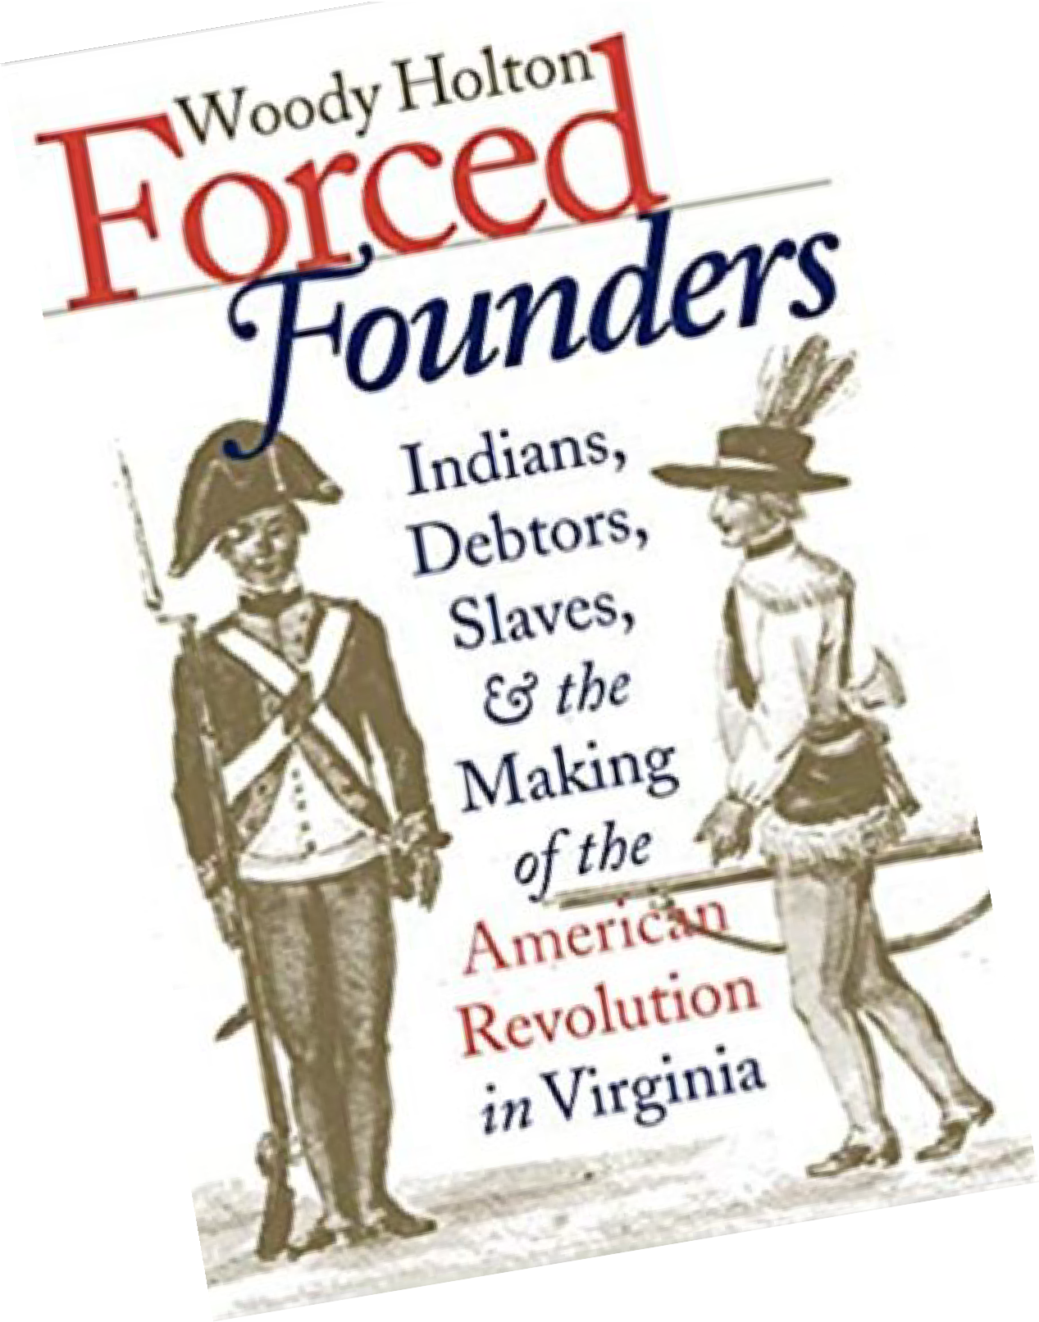

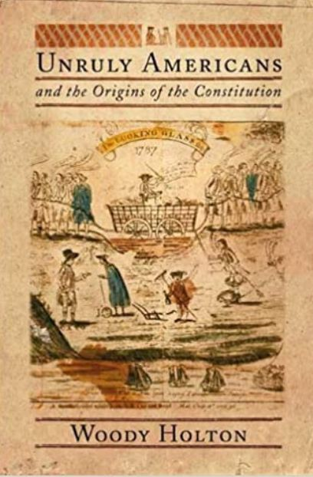
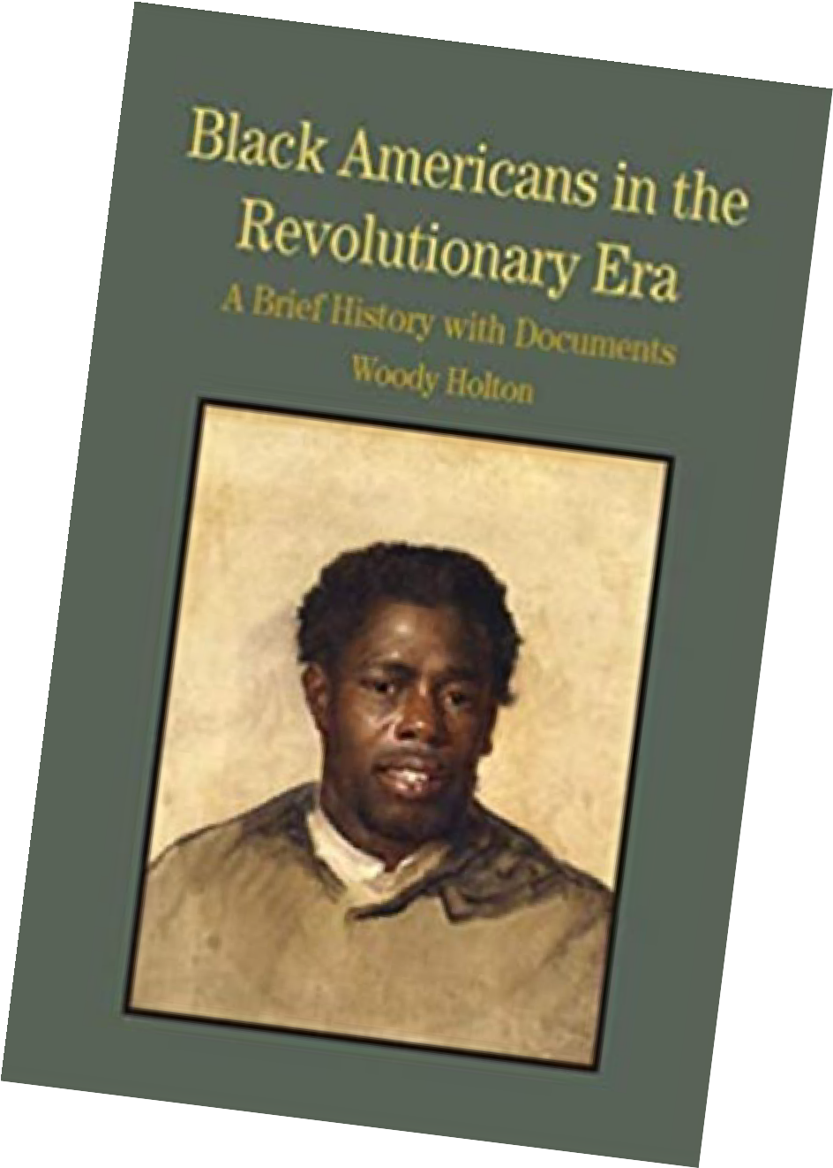


Slide 3
Articles of Confederation
Untidy Origins
Northwest Ordinance
What Went Wrong?

Slide 4
Untidy Origins

Slide 5
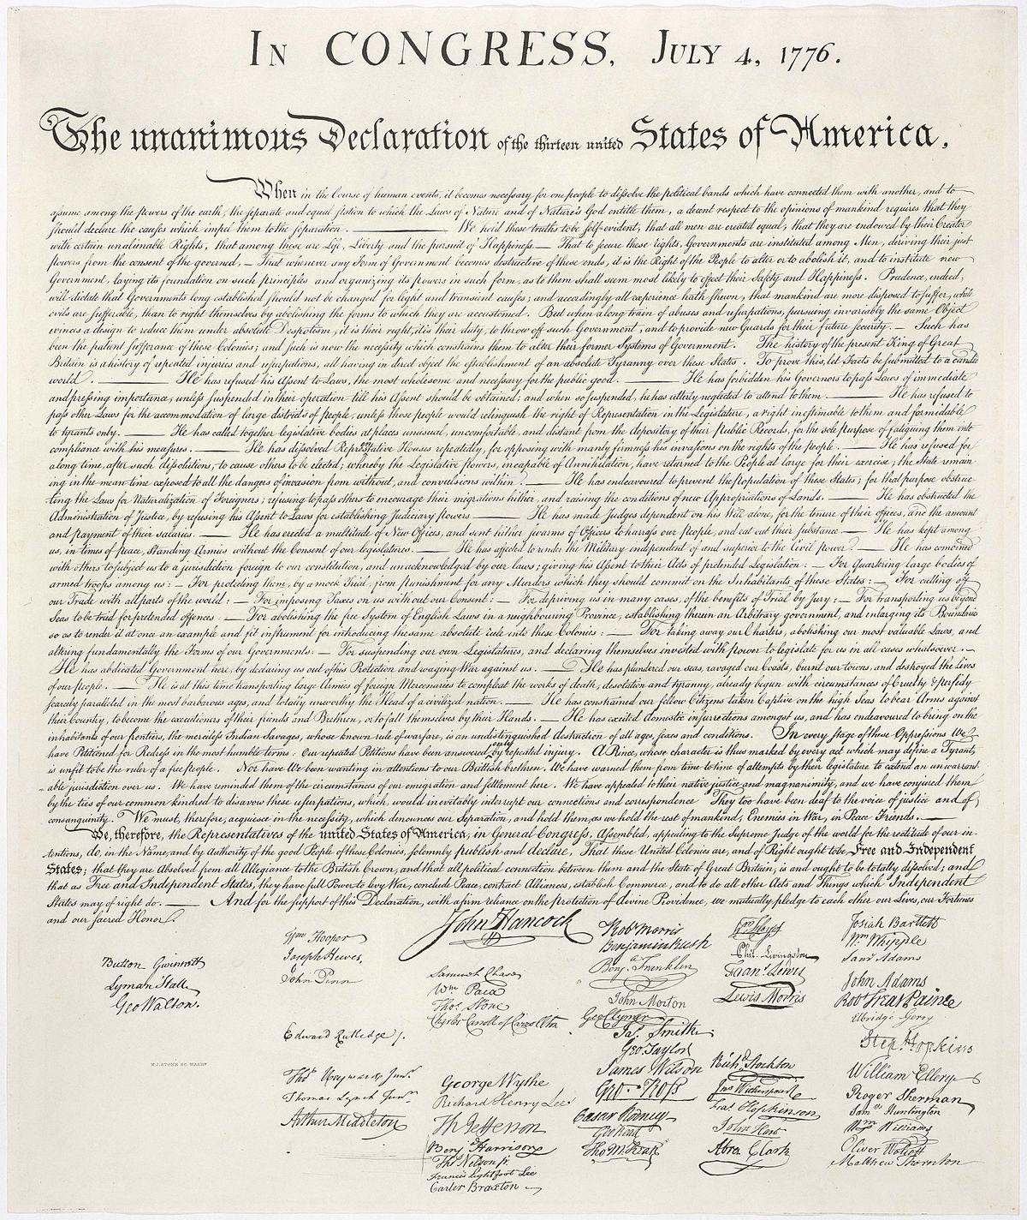

Slide 6
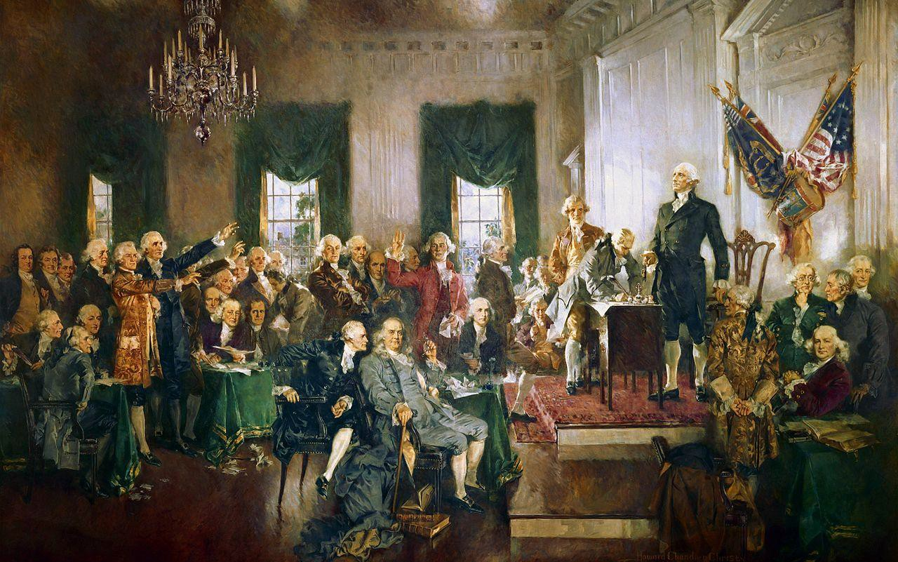
Scene at the Signing of the Constitution of the United States
Howard Chandler Christy (1940)

Slide 7
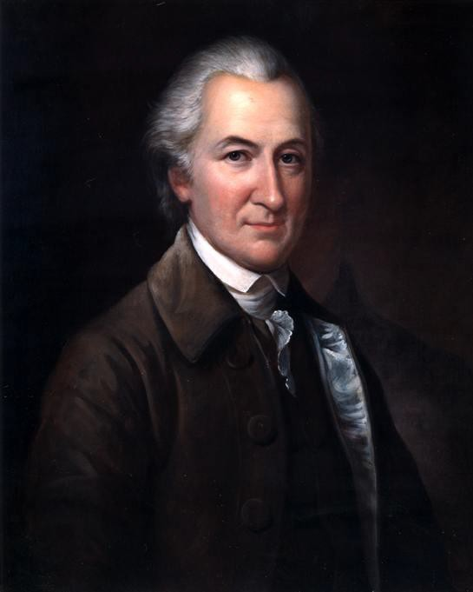
John Dickinson
(1732-1808)

Slide 8
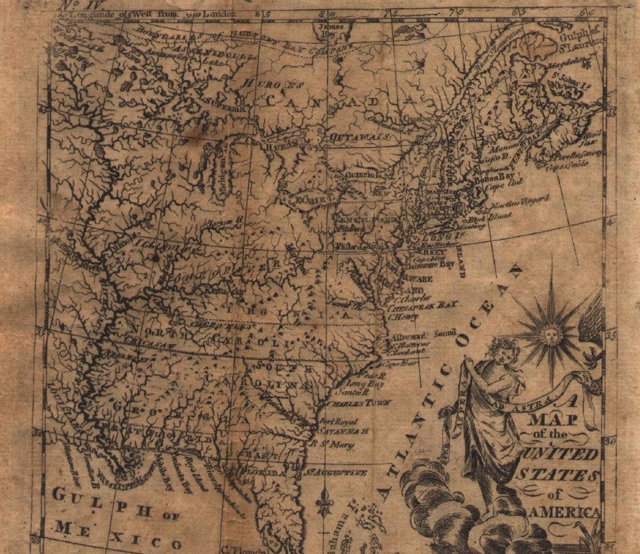
Jedidiah Morse map
1784

Slide 9
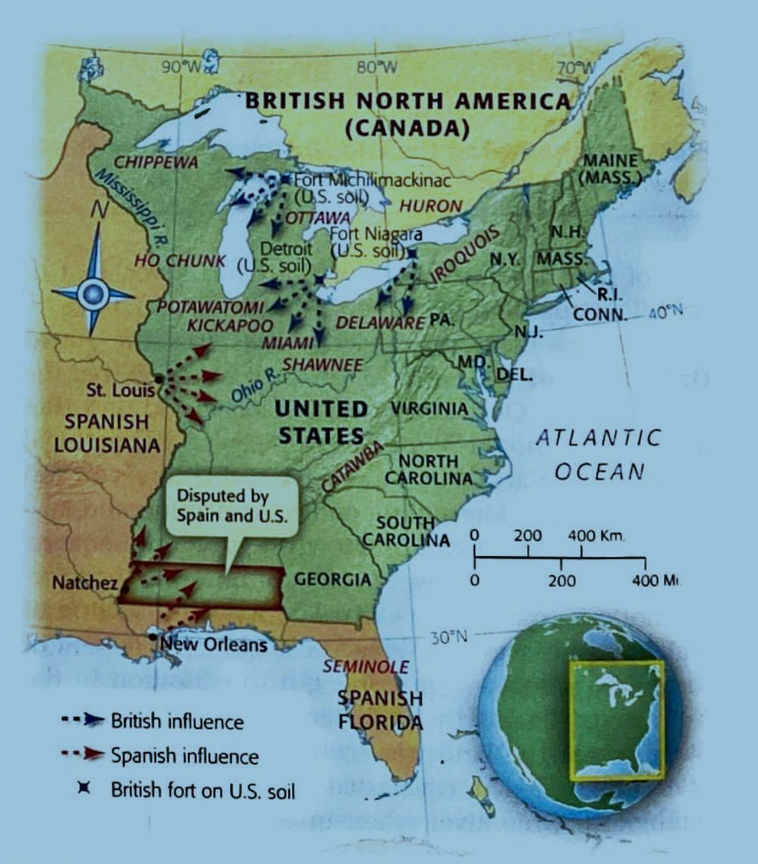

Slide 10

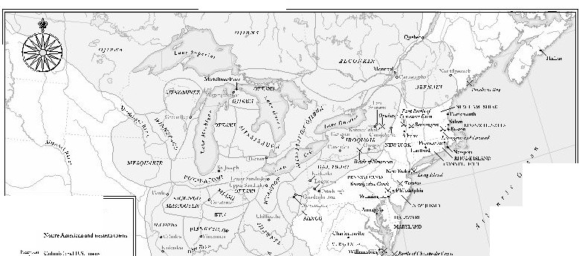

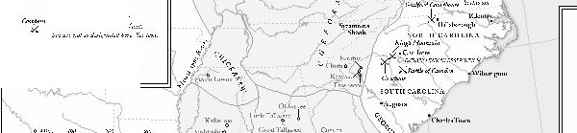

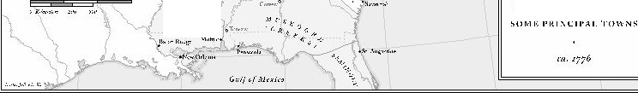
'
0
..,,.,, ,
.......
,,;,
..., ,,.,
.....
•
..,,,
.....
,-......,..
(1,,,,,.
•
ltt-nl:'l>t"IIW,••....,r.lti
i ...,.....,:..•.,.....' ....• .,.,......-.,....
NORTIIA:VIERICA
l·.'a.ttr.fthe
\,
>,1,.,1,,,, L.l- """"-.I
c,-.,,1;,- r,..,, ,,,1:,...,.1,,.
Showing
.,...., ...w
"''^{(.,:<k•<'l"l'"}►.^{,rt}.
\1,,..,.,.
;'\ATl\'E NATIO S, :\ND

Slide 11
state sovereignty

Slide 12
Northwest Ordinance

Slide 13
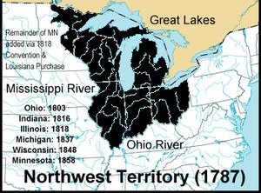

Slide 14
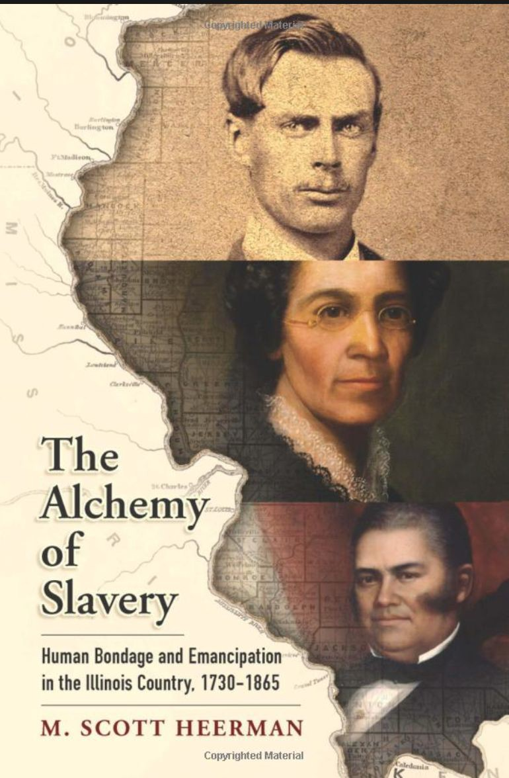

Slide 15
What Went Wrong?

Slide 16
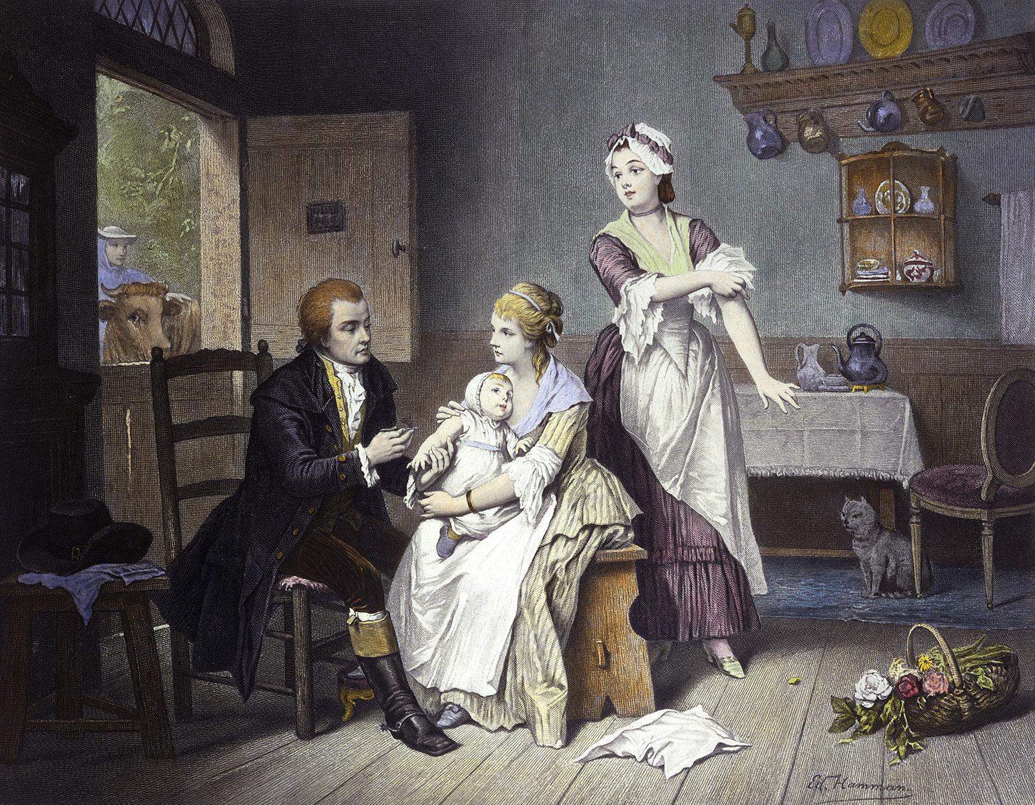
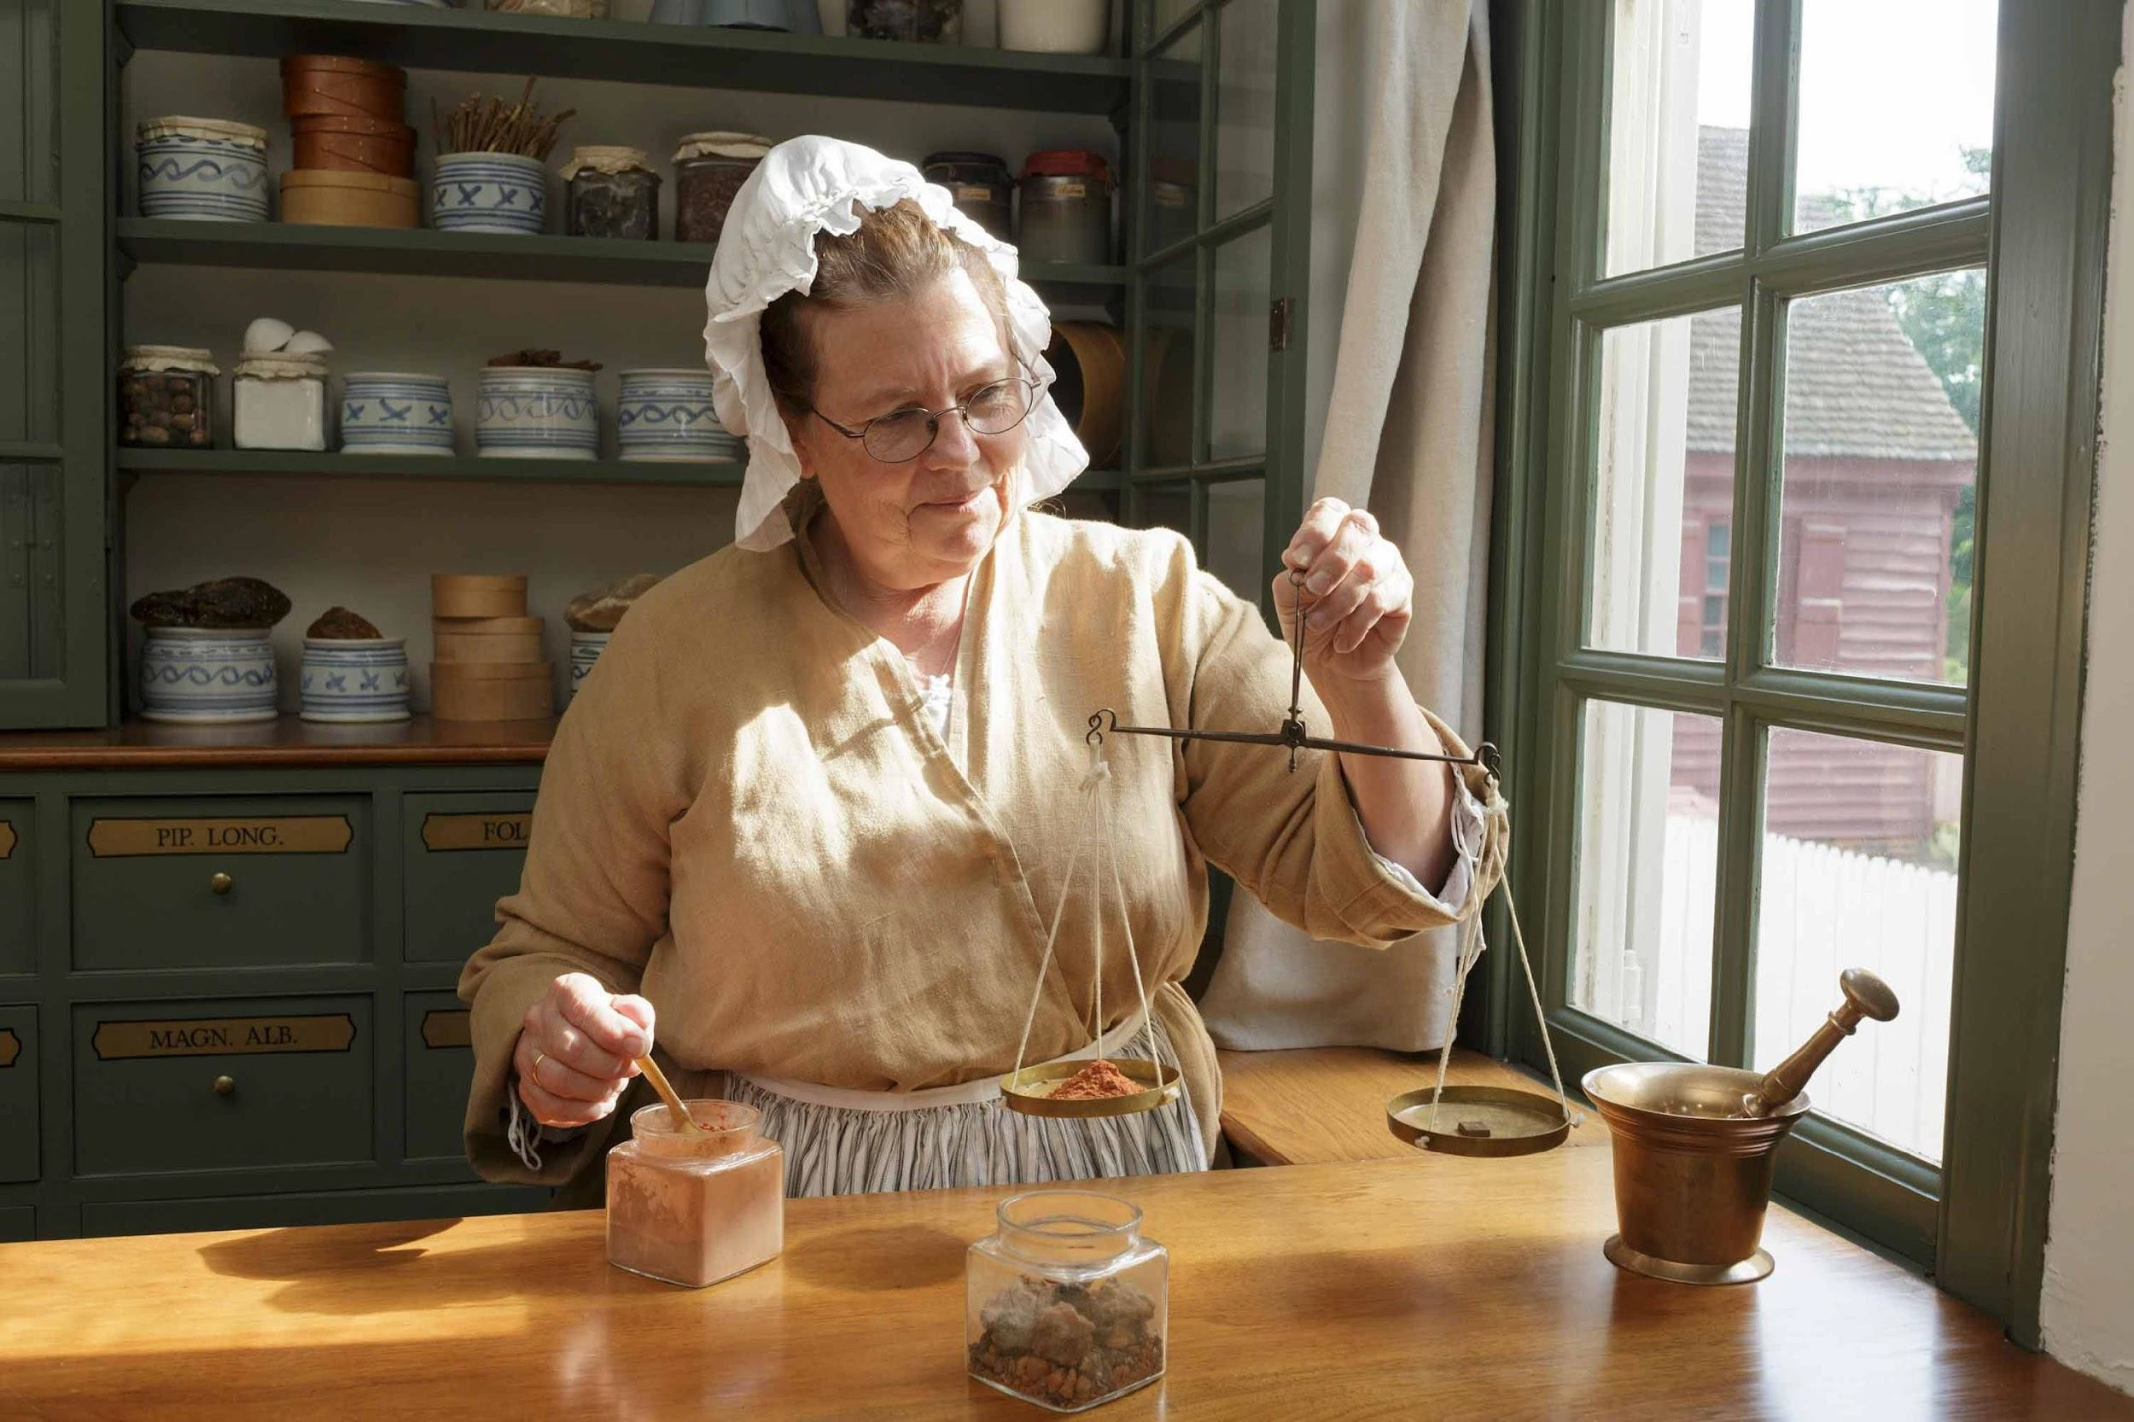

Slide 17
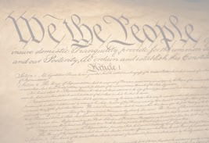
(preamble)
of the United States, in Order to form a more perfect Union, establish Justice, insure domestic Tranquility, provide for the common defense, promote the general Welfare, and secure the Blessings of Liberty to ourselves and our Posterity, do ordain and establish this Constitution for the United States of America.

Slide 18
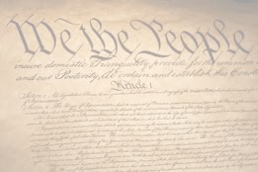
What Went Wrong
“Ensure Domestic Tranquility”

Slide 19
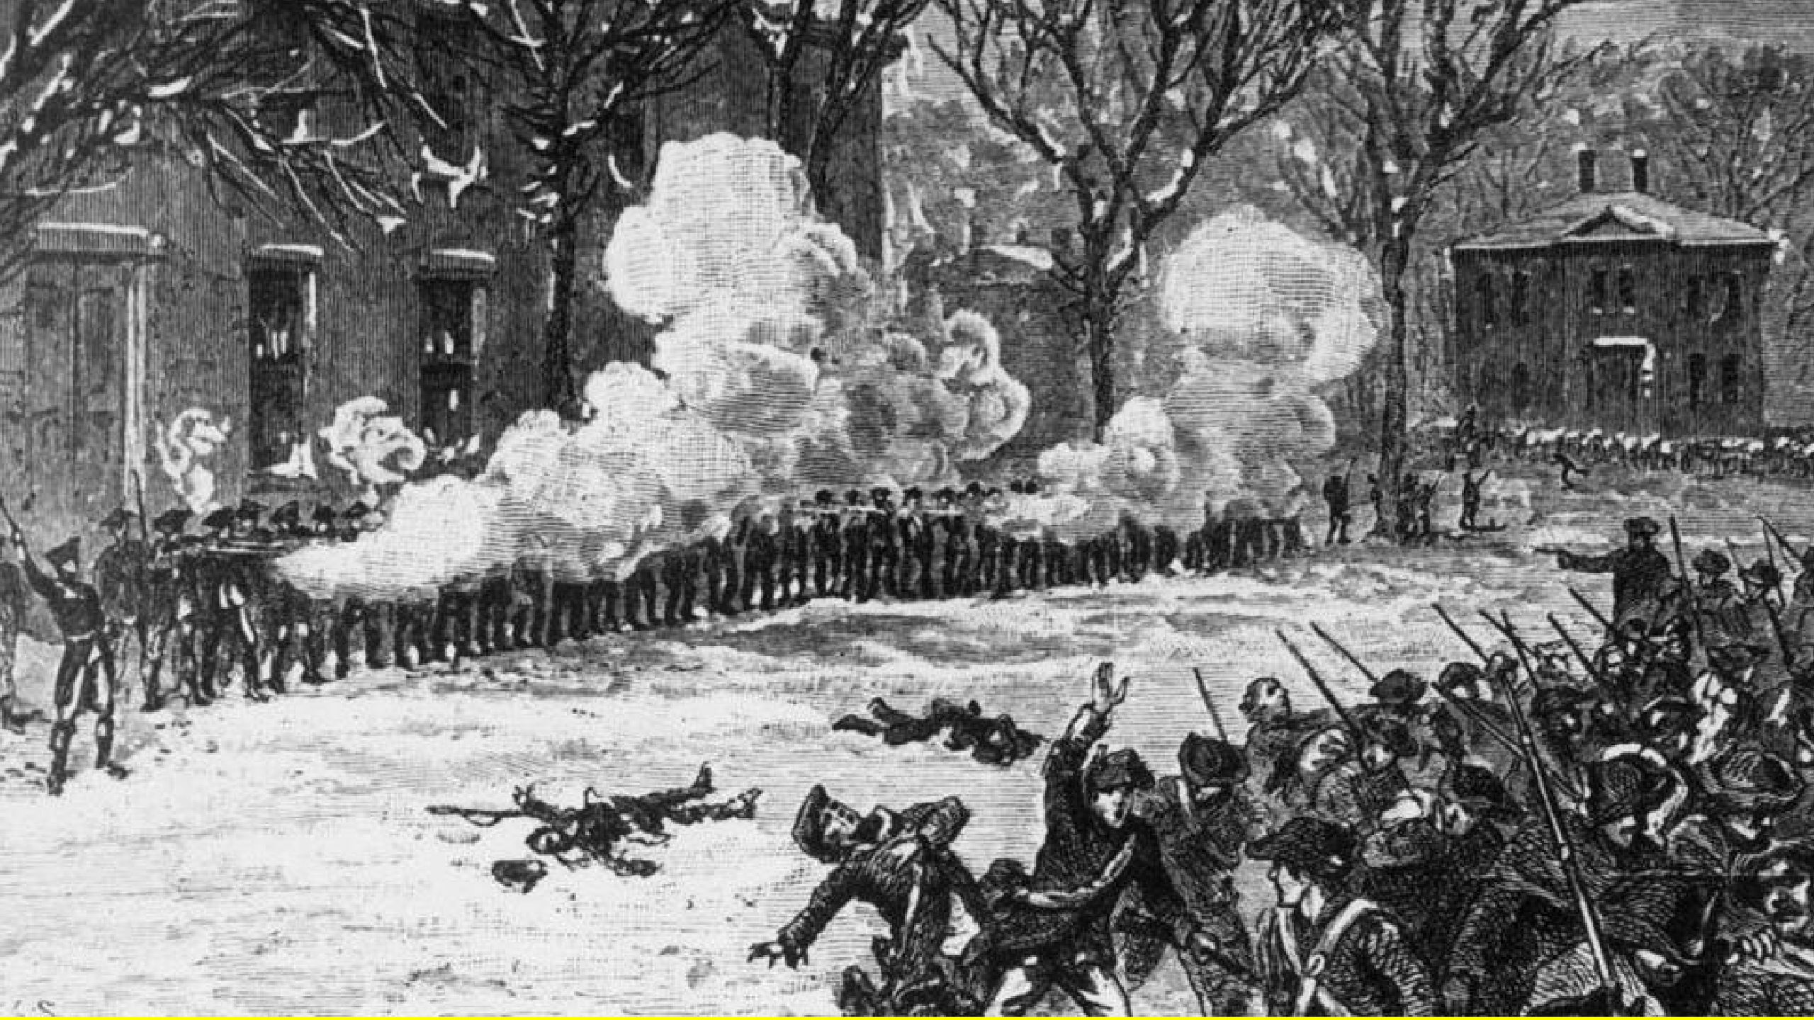

Slide 20
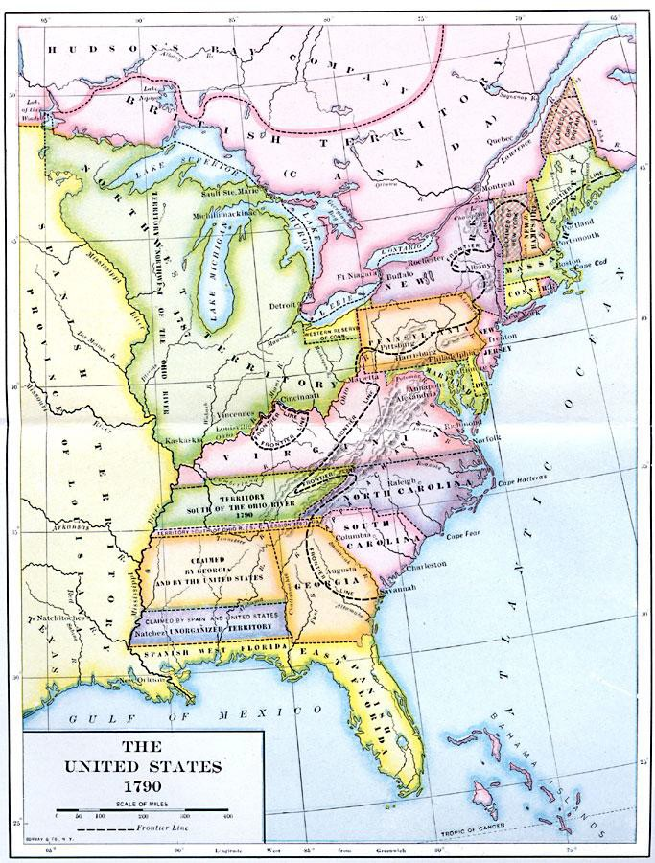
Shays’ Rebellion 1786
Whiskey Rebellion 1794

Slide 21
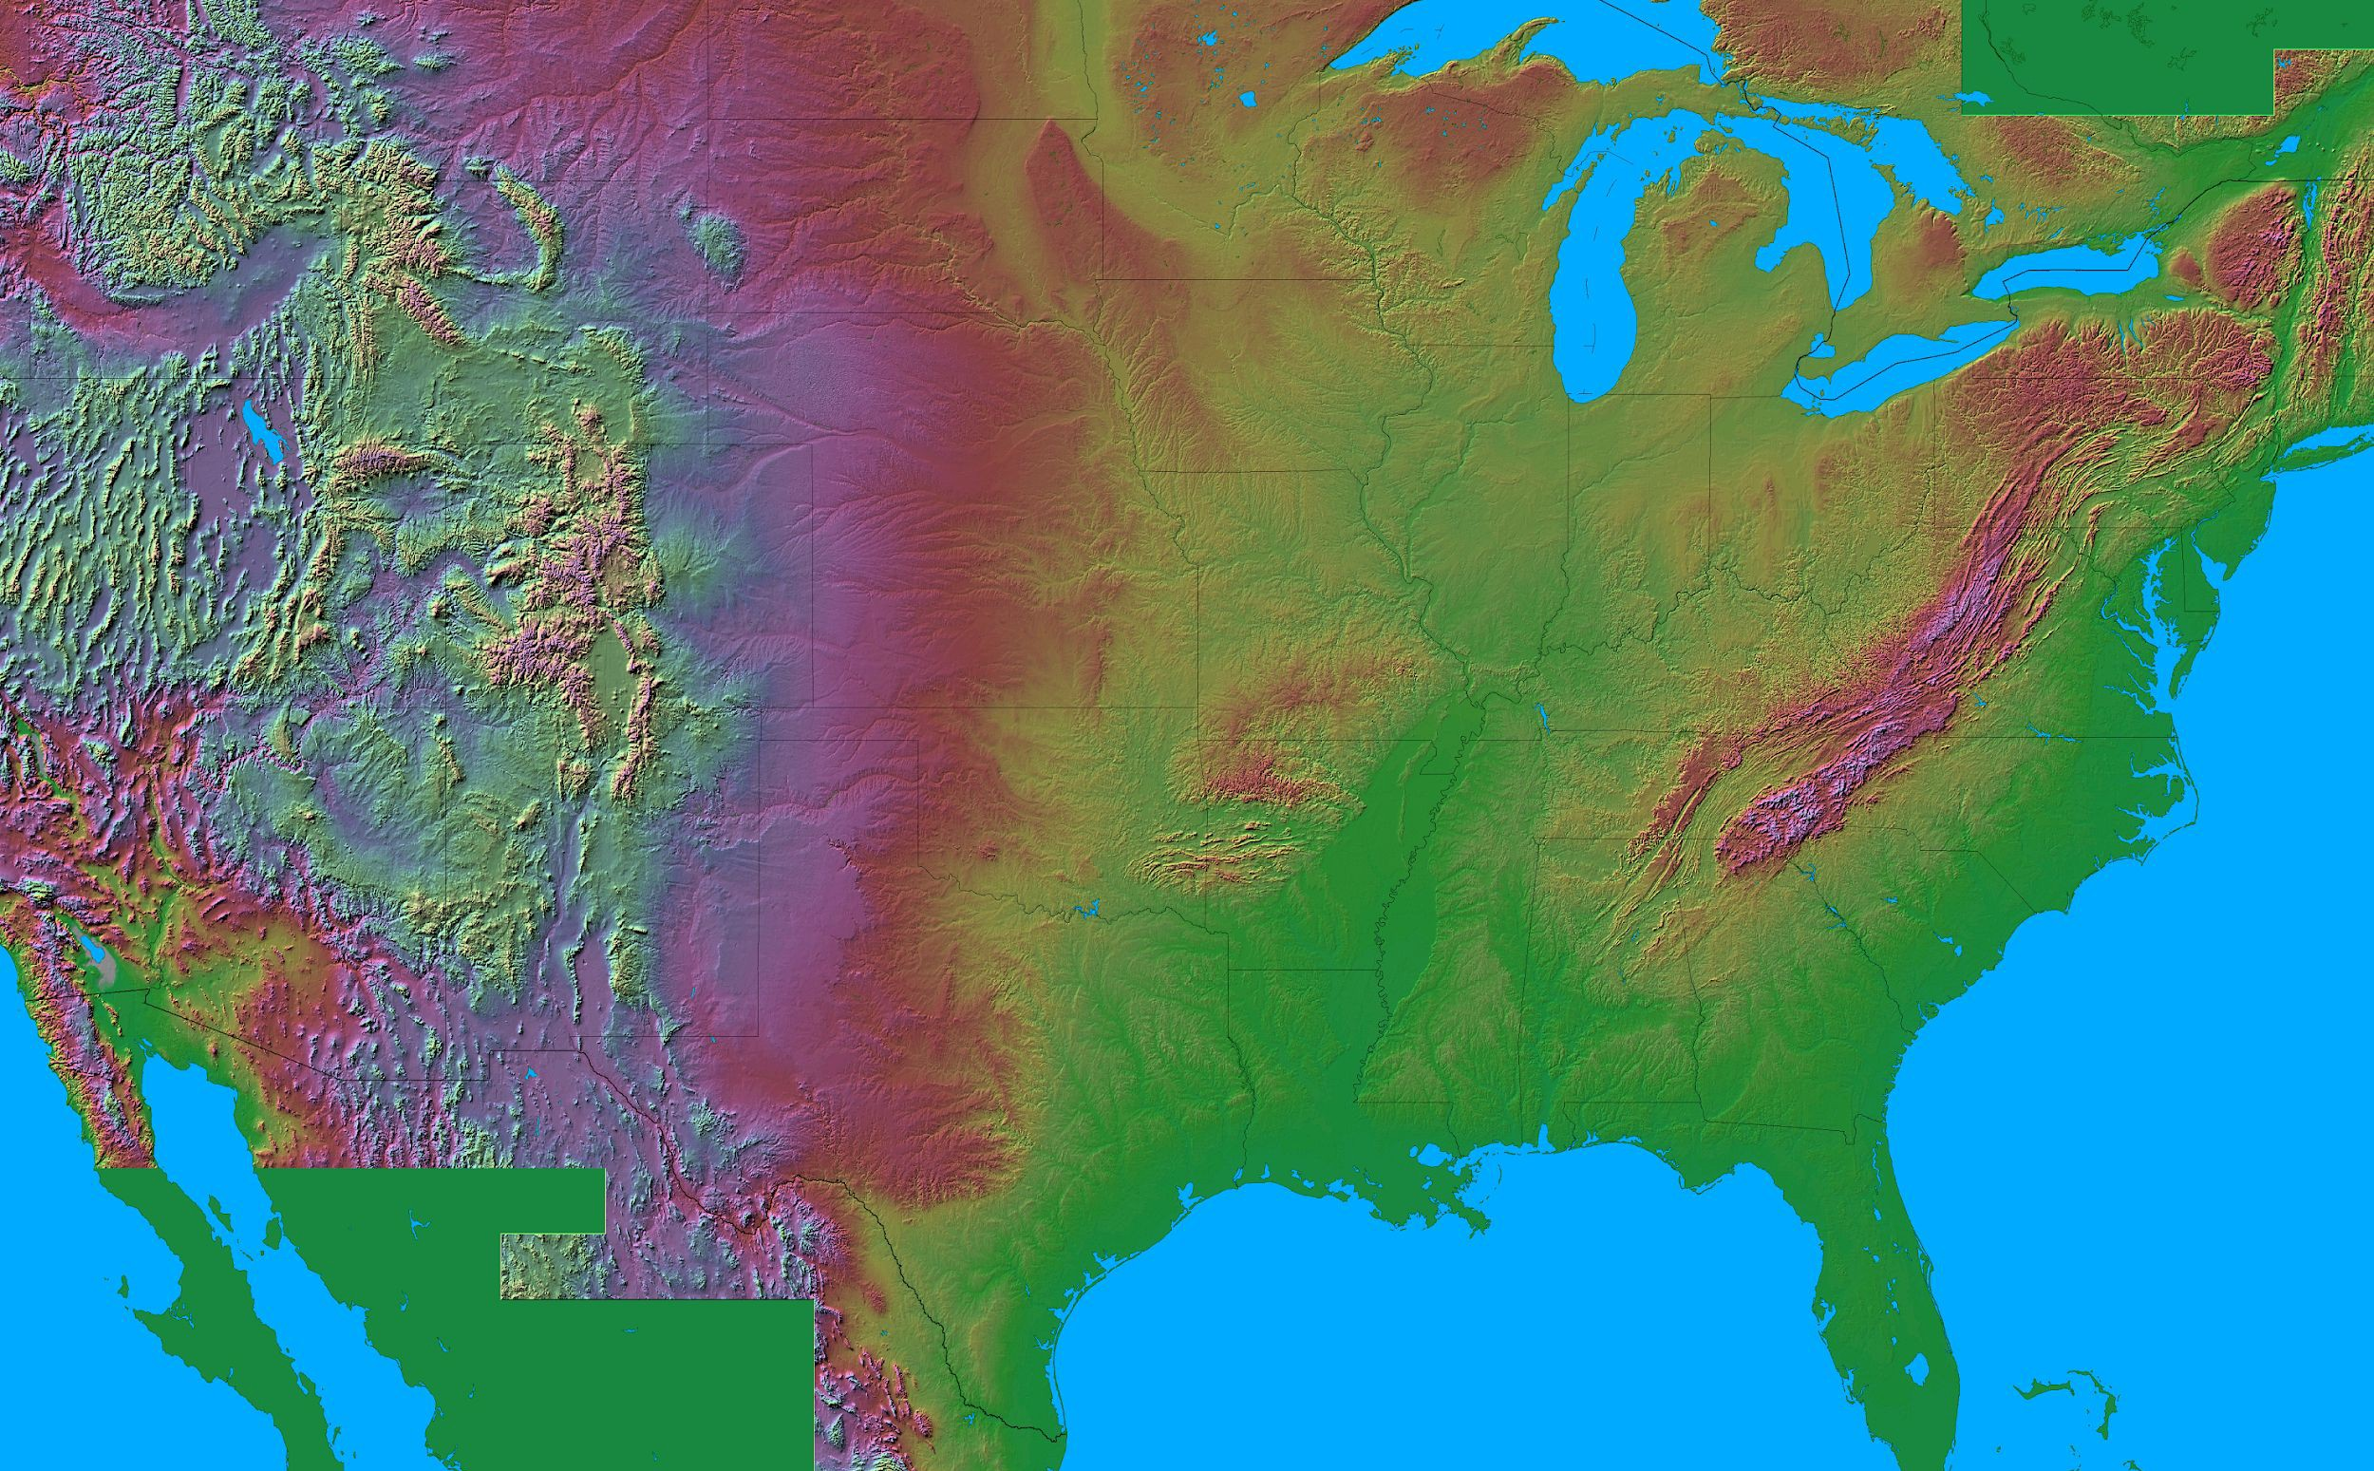
1800
1831
1822
1811
Major U.S. Slave Revolts 1800-1859

Slide 22
1859
1800
1831
1822
1811
Major U.S. Slave Revolts 1800-1859

Slide 23
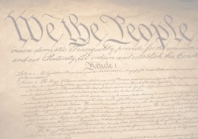
What Went Wrong?
“Ensure Domestic Tranquility”
“Provide for the Common Defence”

Slide 24
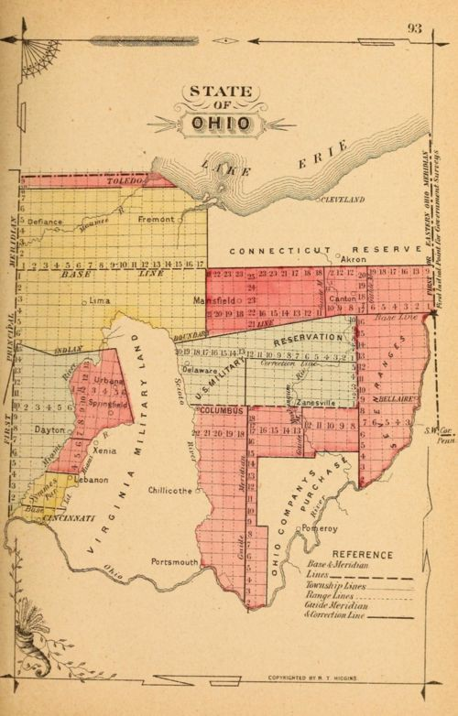

Slide 25
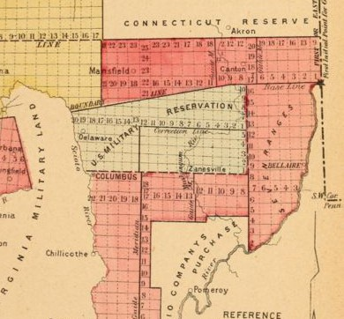

Slide 26
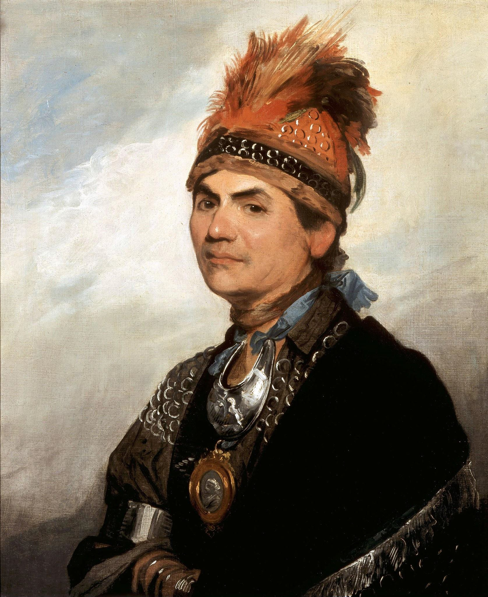
Joseph Brant

Slide 27
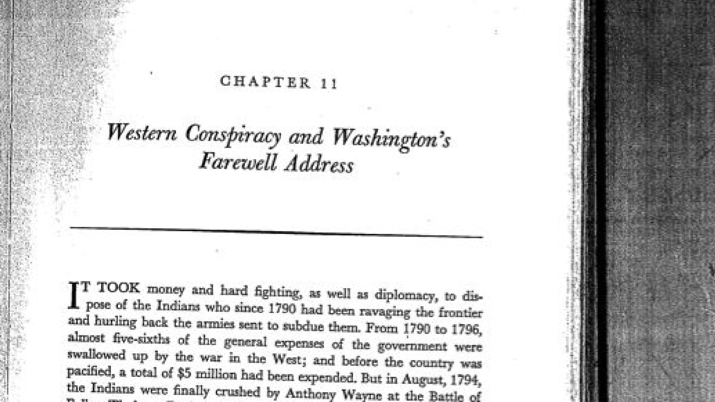
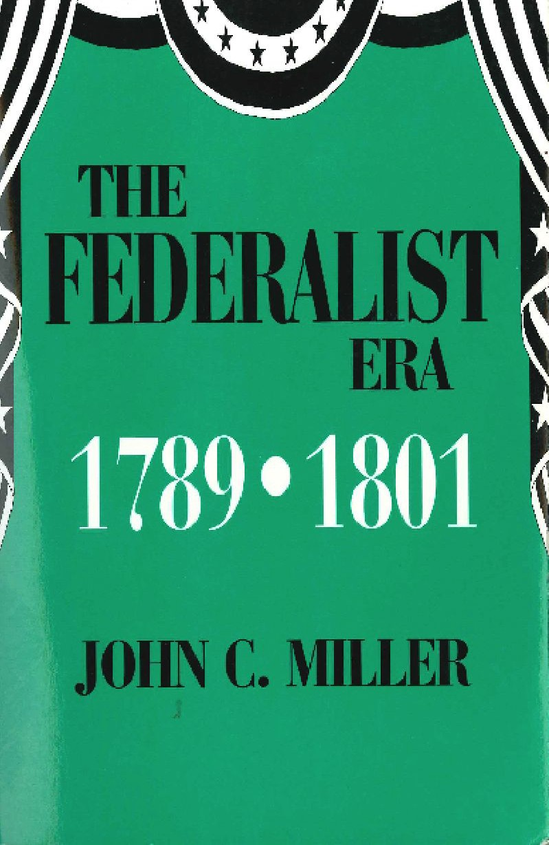

Slide 28
What Went Wrong?
“Ensure Domestic Tranquility”
“Provide for the Common DOeffence”

Slide 29
What Went Wrong?
“Ensure Domestic Tranquility”
“Provide for the Common Defence”
“Establish Justice”

Slide 30
What Went Wrong?
“Ensure Domestic Tranquility”
“Provide for the Common Defence”
“Establish Justice”

Slide 31
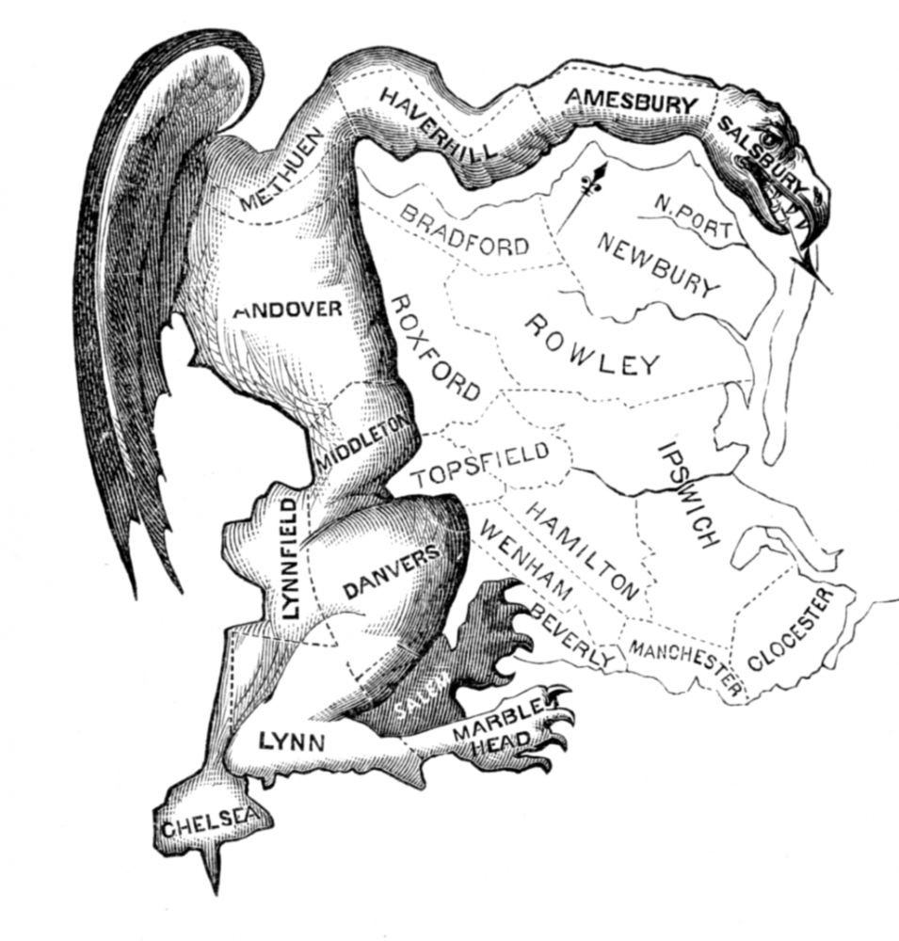
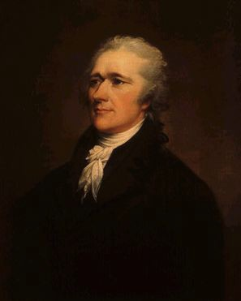
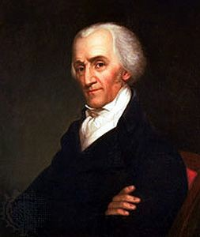
“excess of democracy”

Slide 32
''a headstrong democracy''
a ''prevailing rage of excessive democracy''
''republican frenzy'' ''democratical tyranny''
Founding Fathers
Diagnose What's
Wrong
With America,
783-1787
1
''democratic licentiousness''

Slide 33

“the reins of Government, are held with so feeble a hand, that the multitude feel no restraint” [Silas Deane, July 16, 1785]
“The reins of Government must e’er long be drawn closer.” [Elizabeth Smith Shaw, May 20, 1787]
“the reins should be resumed and held with a firmer hand” [“Camillus,” Independent Chronicle, March 1, 1787]
“Let the reins of government then be braced in time and held with a steady hand; [George Washington, Oct. 31, 1786]

Slide 34
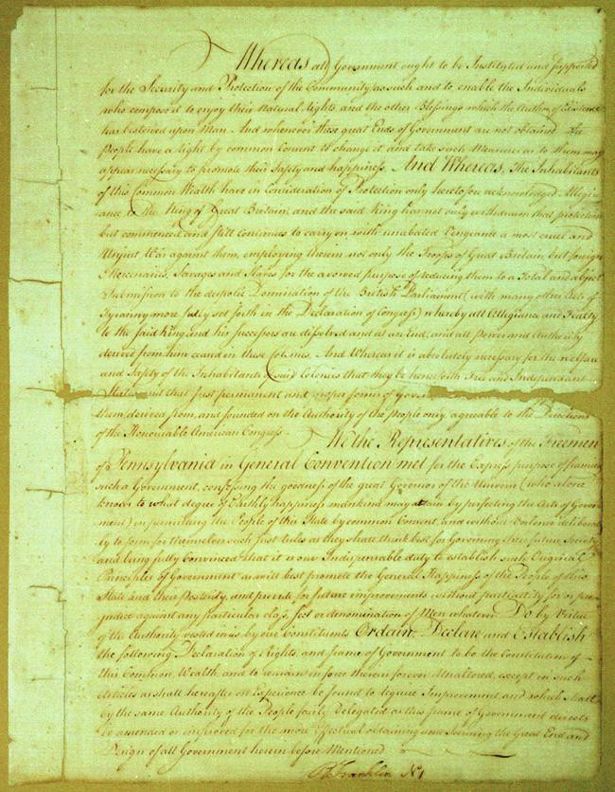
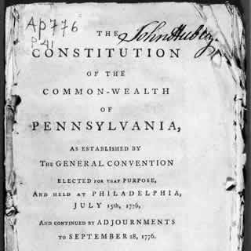
Pennsylvania State Constitution of 1776

Slide 35
What Went Wrong?
Ensure Domestic Tranquility
Provide for the Common Offense
Establish Justice

Slide 36
