Slide 1
Playing with Poetry in
Eleven Classroom Activities
Betty Sue Flowers

Slide 2
CA #1: Why don’t you like poetry? What
don’t you like about it?

Slide 3
Difficult
and
Useless

Slide 4
Difficult
Don’t understand
= feel stupid
= feel shame

Slide 5
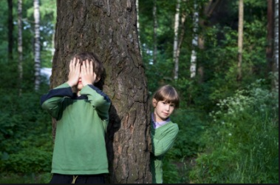
Hidden meanings

Slide 6
Poetry is not prose

Slide 7
Hidden in plain sight
CA #2 Paraphrase
The Red Wheelbarrow
so much depends
upon
a red wheel
barrow
glazed with rain
water
beside the white
chickens
Notes:
“The Red Wheelbarrow” – what? If my first task using the CRIT tool is to paraphrase, then I’d say, “The speaker is saying you depend on a wheelbarrow that’s been out in the rain and happens to be next to some chickens.” Huh? So as teachers, what do we do with this difficulty?

Slide 8
Introduction to Poetry
I ask them to take a poem
and hold it up to the light
like a color slide
or press an ear against its hive.
I say drop a mouse into a poem
and watch him probe his way out,
or walk inside the poem’s room
and feel the walls for a light switch.
I want them to waterski
across the surface of a poem
waving at the author’s name on the shore.
but all they want to do
is tie the poem to a chair with rope
and torture a confession out of it.
they begin beating it with a hose
to find out what it really means.
Billy Collins
Notes:
Here’s Billy Collins response, “Introduction to Poetry” – he could be talking about our students. But he also could be talking about us. Read poem. Why are we so obsessed with meaning? Poetry makes very bad philosophy. Poets aren’t interested in meaning. They are interested in “the experience of the rapture of being alive.” That’s a quote from Joseph Campbell about what we want out of life. He said that we don’t primarily want meaning. We want “the experience of the rapture of being alive.” That’s what poetry is after, too.

Slide 9
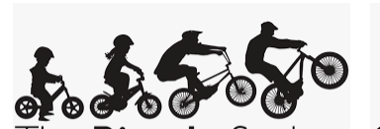
Difficult
like riding a bike, not like math
Creating confidence:

Slide 10
A poem should not mean
But be.
(Archibald MacLeish, from Ars Poetica)
Notes:
We all know this cliché. But how would we teach if we took this seriously? We wouldn’t beat the poem with a hose to find out what it really means. How do you get to know a person? You hang out with him or her. You don’t go home after the first coffee you have with someone and say, “She’s hiding her meaning from me.” You’d hang out with her more. You’d take time. It’s a slow process.
What’s the difference between prose and poetry? Prose you read fast. Prose you read through to the idea.
Poetry you meet, like a person. You have to hang out with the poem and get to know it. Your experience with poetry is physical and emotional.

Slide 11
CA #3, part 1: Know about (mean) vs knowing (be)
Some discussion examples
Truth
Angela
A bright green blanket
China

Slide 12
CA #3, part 2: How do you get to know a meaning
vs a “being”?
Prose – know about
Truth [a concept] – dictionary
Angela [a person] – read her resume
A bright green blanket [a thing] - Amazon?
China [a place] – Wikipedia?
Poetry - know
Truth – a lifetime of wisdom
Angela – hang out with her
A bright green blanket - use or look
China – live there
Studying poems more like hanging out with Angela or gym class or living in
China than studying philosophy.

Slide 13
W.C. Williams (author of “The Red Wheelbarrow”)
“No ideas but in things.”

Slide 14
CA #4: Bring a thing to class you know.
Talk about it.
Talk knowingly about it.
What’s the difference? [Class will notice: stories, emotions, “like”]

Slide 15
Time: Slowing down to be
CA #5:
Prose and Form

Slide 16
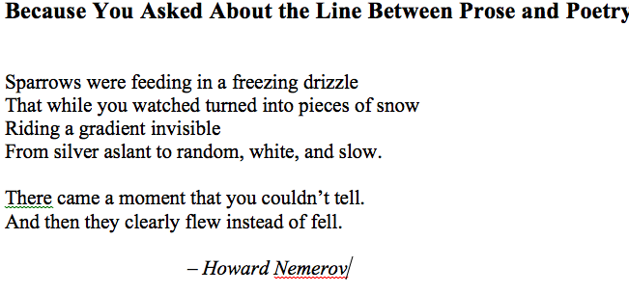
Notes:
Here’s an exercise to do with students. Tell them to find any piece of prose and turn it into poetry. Show us the before and after. How have you turned something that just falls on the page to something that flies.
Everyone will have done something different. But one thing every piece of student work will have in common? The poetry will slow you down.

Slide 17
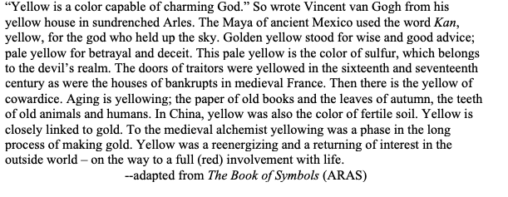
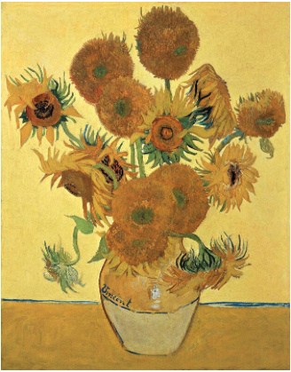

Slide 18
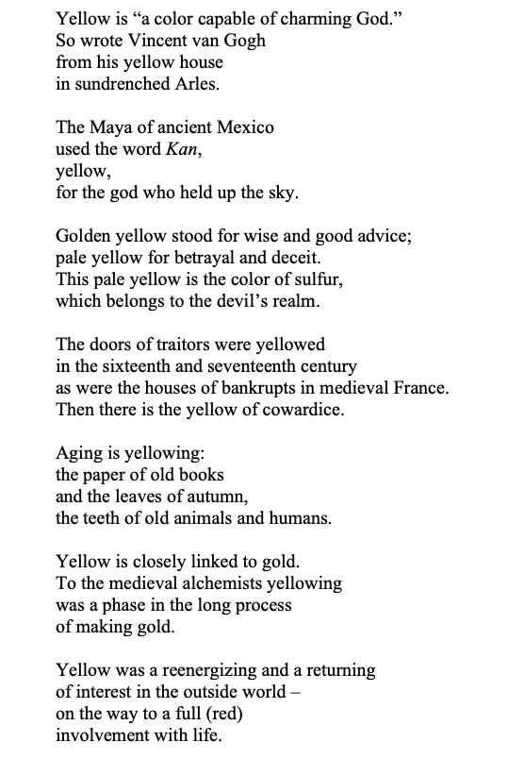

Slide 19
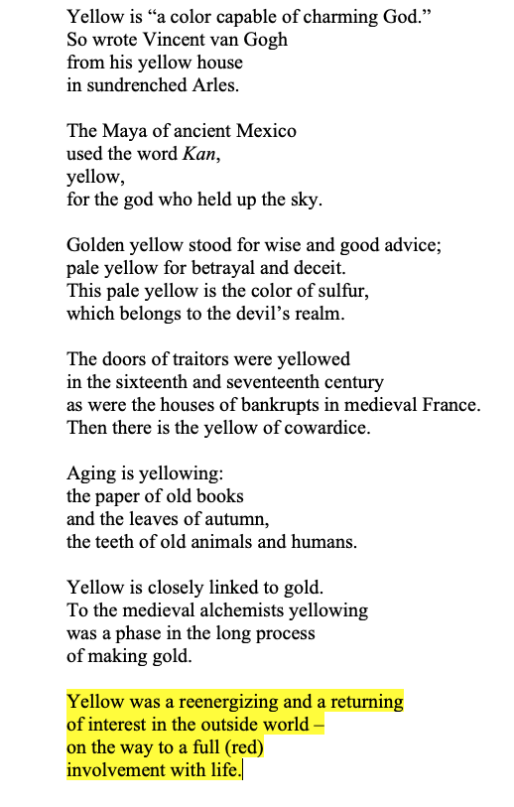

Slide 20
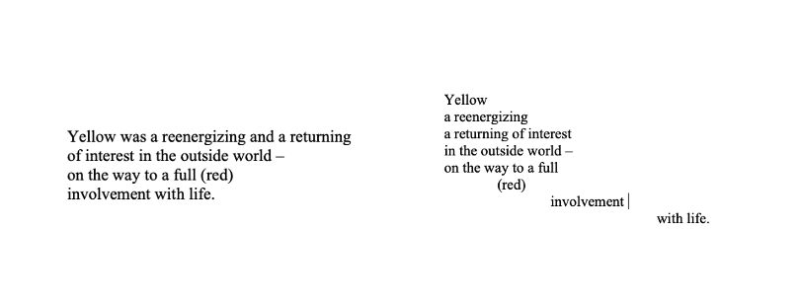

Slide 21
CA #6: Being with A Poem – learning together
Some things that fly there be—
Birds—Hours—the Bumblebee—
Of these no elegy.
Some things that stay there be—
Grief—Hills—Eternity
Nor this behooveth me.
There are that resting, rise.
Can I expound the skies?
How still the Riddle lies!

Slide 22
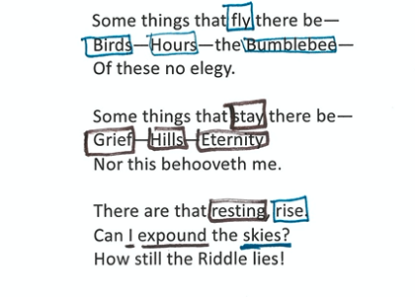

Slide 26
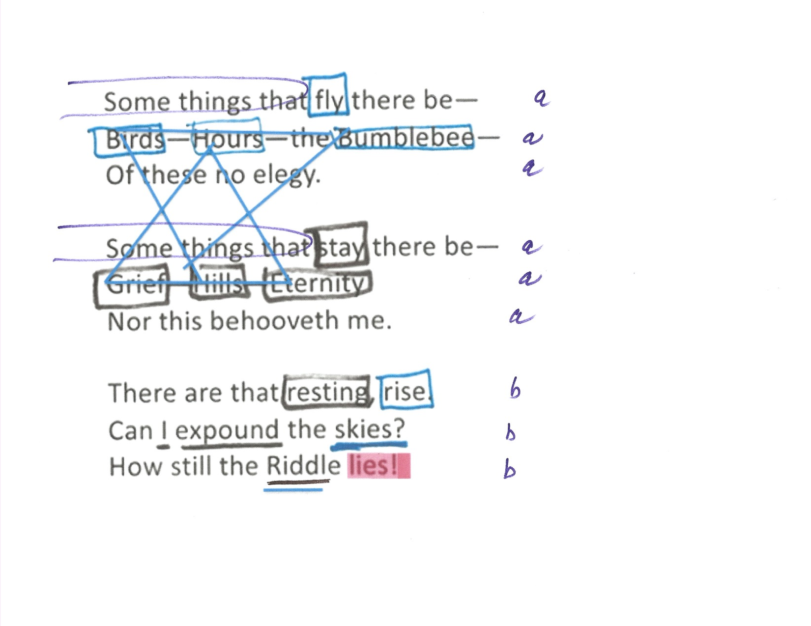

Slide 27
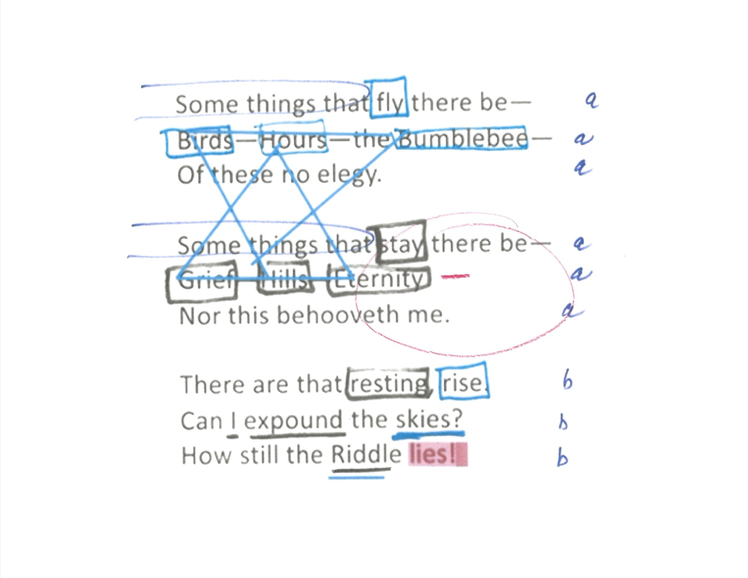

Slide 28
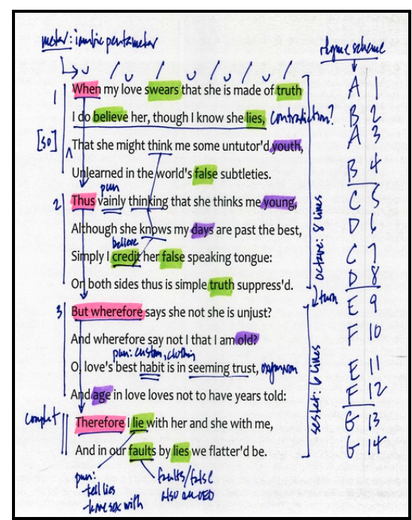

Slide 29
Other ways to be with a poem
Waterski across the surface of a poem
press an ear against its hive.
walk inside the poem’s room
and feel the walls for a light switch.
take a poem
and hold it up to the light
like a color slide
drop a mouse into a poem
and watch him probe his way out
Notes:
After reading slide: We waterskied across the surface of the Collins poem this morning.

Slide 30
CA #7
press an ear against its hive.

Slide 31
Homework: David Attenborough with Lyre Bird on YouTube: https://www.youtube.com/watch?v=VjE0Kdfos4Y
LYRE BIRD
Liar made of leaf-litter, quivering ribby in shim,
hen-sized under froufrou, chinks in a quiff display him
or her, dancing in mating time, or out. And in any order.
Tailed mimic aeon-sent to intrigue the next recorder,
I mew catbird, I saw crosscut, I howl she-dingo, I kink
forest hush distinct with bellbirds, warble magpie garble, link
cattlebell with kettle-boil; I rank ducks’ cranky presidium
or simulate a triller like a rill mirrored lyrical to a rim.
I ring dim, I alter nothing, Real to real only I sing,
Gahn the crane to Gun the chainsaw, urban thing to being,
Screaming Woman owl and human talk: eedieAi and uddyunnunoan.
The miming is all of I. Silent, they are a function
of wet forest, cometary lyrebirds. Their flight lifts them barely a semitone.
--Les Murray
Notes:
Come with a crunchy word or words.

Slide 32
press an ear against its hive.
walk inside the poem’s room
and feel the walls for a light switch.

Slide 33
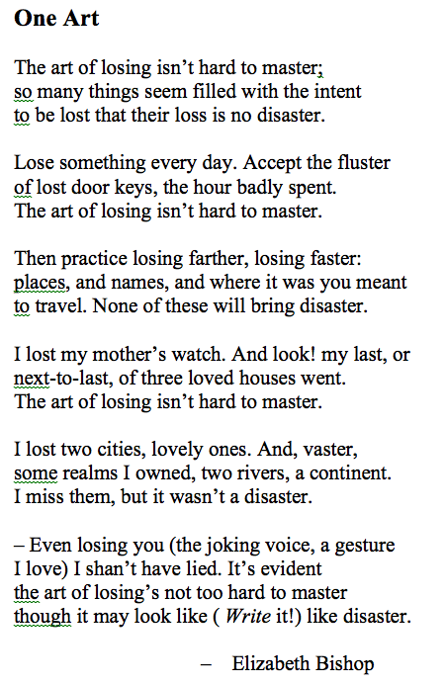

Slide 34
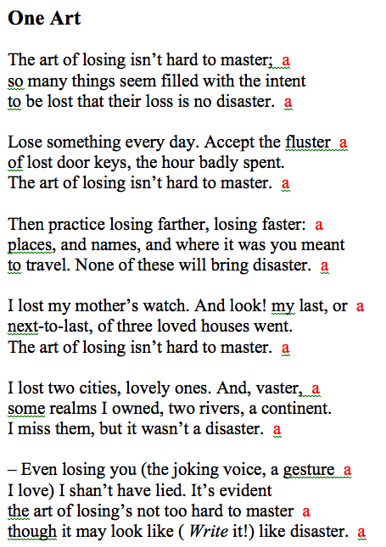
CA #8:
Rules of the
game

Slide 35
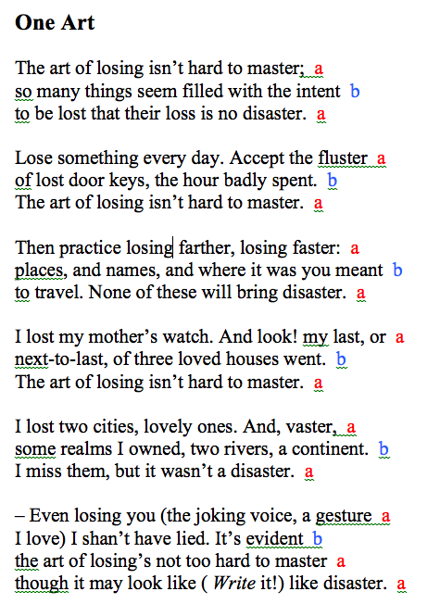

Slide 36
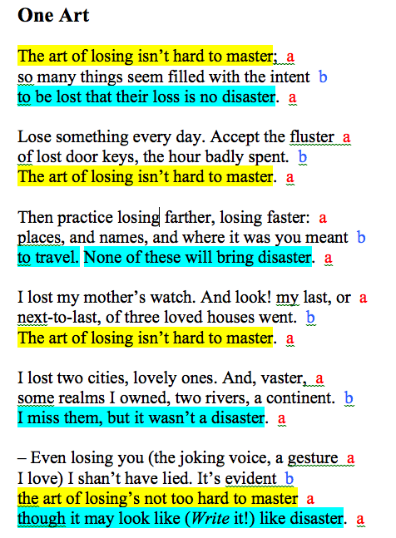

Slide 37
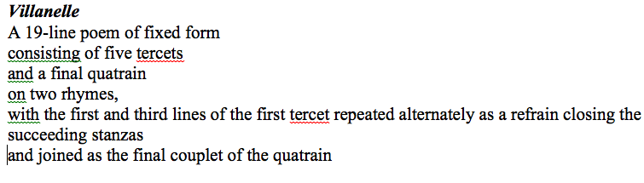

Slide 38
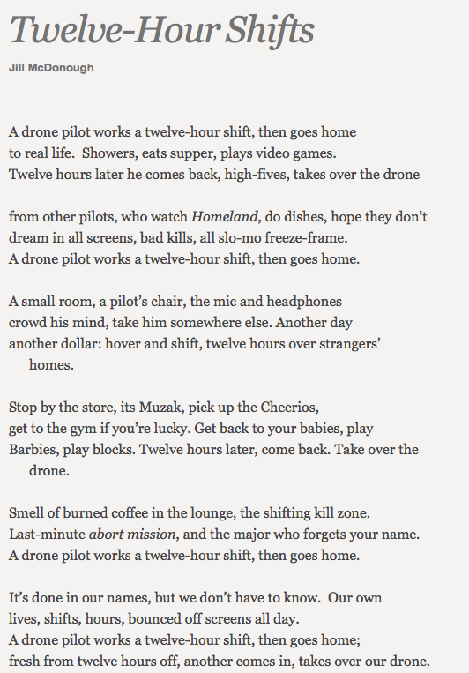

Slide 39
Useless

Slide 40
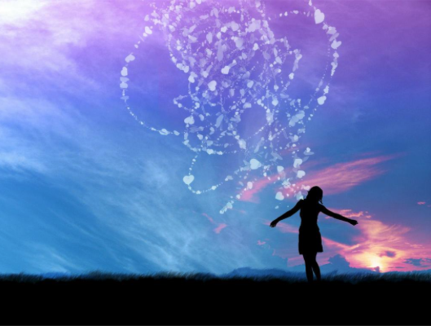
4 Gifts of poetry
(There are many more.)
1. A doorway into dreams

Slide 41
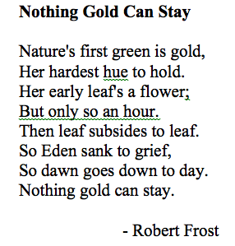
Gifts of poetry
2. New emotional experiences – concentrated

Slide 42
Gifts of poetry
Emotional intelligence
Self-awareness
Self-regulation
Internal motivation
Empathy
Social skills
Notes:
Self-awareness. The ability to recognize and understand personal moods and emotions and drives, as well as their effect on others. Hallmarks* of self-awareness include self-confidence, realistic self-assessment, and a self-deprecating sense of humor. Self-awareness depend on one's ability to monitor one's own emotion state and to correctly identify and name one's emotions.
[*A hallmark is a sure sign: since self-awareness is necessary for, say, realistic self-assessment, that is, without self-awareness no realistic self-assessment, the presence of of realistic self-assessment is a sure sign (sufficient to conclude that there is) self-awareness.]
Self-regulation.The ability to control or redirect disruptive impulses and moods, and the propensity to suspend judgment and to think before acting. Hallmarks include trustworthiness and integrity; comfort with ambiguity; and openness to change.
Internal motivation. A passion to work for internal reasons that go beyond money and status -which are external rewards, - such as an inner vision of what is important in life, a joy in doing something, curiosity in learning, a flow that comes with being immersed in an activity. A propensity to pursue goals with energy and persistence. Hallmarks include a strong drive to achieve, optimism even in the face of failure, and organizational commitment.
Empathy. The ability to understand the emotional makeup of other people. A skill in treating people according to their emotional reactions. Hallmarks include expertise in building and retaining talent, cross-cultural sensitivity, and service to clients and customers. (In an educational context, empathy is often thought to include, or lead to, sympathy, which implies concern, or care or a wish to soften negative emotions or experiences in others.) See also Mirror Neurons.
It is important to note that empathy does not necessarily imply compassion. Empathy can be 'used' for compassionate or cruel behavior. Serial killers who marry and kill many partners in a row tend to have great emphatic skills!
Social skills. Proficiency in managing relationships and building networks, and an ability to find common ground and build rapport. Hallmarks of social skills include effectiveness in leading change, persuasiveness, and expertise building and leading teams.

Slide 43
press an ear against its hive.
walk inside the poem’s room
and feel the walls for a light switch.
take a poem
and hold it up to the light
like a color slide

Slide 44
Gifts of poetry
4. Glaze
The Red Wheelbarrow
so much depends
upon
a red wheel
barrow
glazed with rain
water
beside the white
chickens
Notes:
There are experiences in life that are filled with meaning and deep significance – even if we can’t say what they mean or what they signify. When we’re in love, the whole world shines and means. Students – all of us – know the difference between a world that shines and one that seems bland and boring or depressing.
“The Red Wheelbarrow” takes these ordinary, pedestrian things and puts a glaze on them. That’s what art does. So if we take this poem and “hold it up to the light like a color slide” we have a gift, something that opens us to a way of looking at the world and seeing it with fresh eyes.
Sometimes, for me, the best way to know whether a student has really gotten the poem – has held it up to the light – is to say, now go out into the world and find your own red wheelbarrow – and bring it back into us, glazed, so that we feel its significance even though, objectively, it seems insignificant. One sentence.
Now imagine if you lived your whole life so that everything you looked on was shining like that. Wouldn’t that be worthwhile? Wouldn’t that be relevant?

